Slide 1
IRIS Services, Products, Quality Assurance Efforts, and Potential Links to High Performance Computing in the Era of BIG DATA
By T. Ahern, M. Bahavar, R.Casey, C. Trabant, A. Clark, A. Hutko, R. Karstens, Y. Suleiman, B. Weertman

Slide 2
Primary TOPICS
Data Access Services – a new paradigm
Improved internal and external ease of use
Products – stepping stones to further research
Improved Quality Assurance
Developing connections to HPC environments

Slide 3
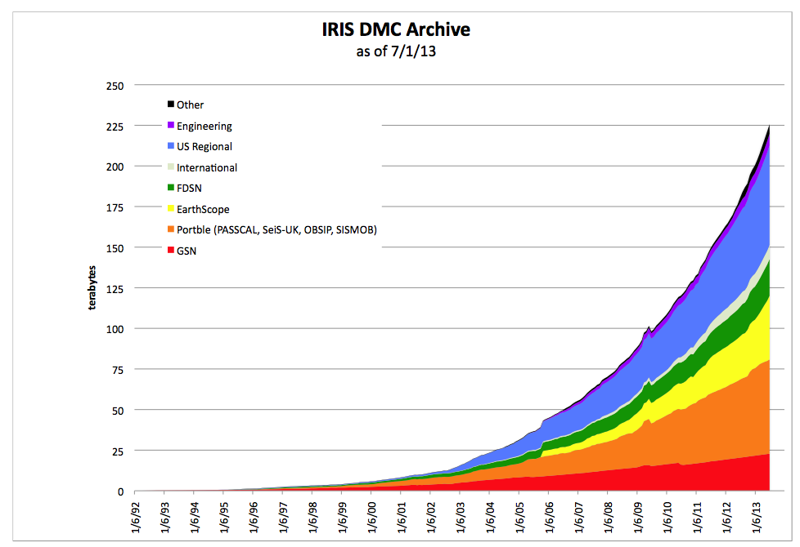
IRIS’ Crown Jewel

Slide 4
IRIS Data Services Challenge
The data holdings are large!
How do we develop simple methods to discover, access, and utilize the data?
How can we assist researchers in early stages of their research?
How can we support tools that are commonly used in the community?
How can IRIS improve the quality of global seismological data?

Slide 5
IRIS Services – service.iris.edu
FDSN Web services
dataselect
station
event
Documentation
IRIS web services
timeseries
rotation
sacpz
resp
evalresp
virtualnetwork
traveltime
Flinnengdahl
distaz
products

Slide 6
Programmatic support is widespread
Modern computer languages that include support for basic web services include:
Java
Perl
Python
PHP
MatLab
JavaScript
R (e.g. Rcurl)
C#
C/C++ (multiple libraries)

Slide 7
Perl Fetch scripts: command line access
http://service.iris.edu/clients/
FetchData
FetchEvent
FetchMetadata

Slide 8
FetchData options
FetchData retrieves miniSEED, simple metadata, SEED RESP
and/or SAC Poles and Zeros using the following selection criteria:
Network, Station, Location and Channel
all optional, can contain ‘*’ and ‘?’ wildcards, virtual networks supported
Start and end time range
Geographic box or circular region
Selections: command line, selection list file or BREQ_FAST file

Slide 9
FetchData example
Request 1 hour of GSN/ANMO long-period vertical (LHZ) data and simple metadata for 2010-2-27 M8.8 Chilean earthquake:
$ FetchData
-N IU –S ‘ANMO’ –L 00 –C ‘LHZ'
-s 2010-02-27,06:34:00 -e 2010-02-27,07:34:00
-o /data/Chile-GSN-LHZ.mseed
-m /data/Chile-GSN-LHZ.metadata
Convert the miniSEED to SAC with metadata
$ mseed2sac Chile-GSN-LHZ.mseed –m Chile-GSN-LHZ.metadata
-E '2010,058,06:34:11/-36.122/-72.898/22.9'

Slide 10
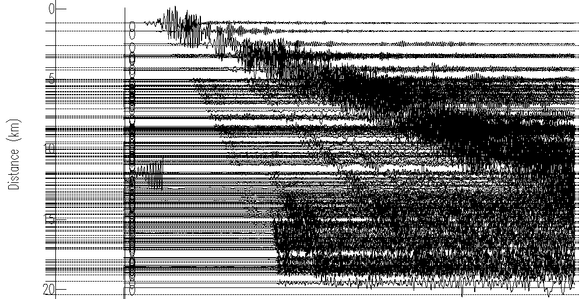
FetchData example results
2 minutes later…
121 SAC files and a quick-n-dirty record section:

Slide 11
Performance
WS-dataselect has been shown to be able to deliver 1 terabyte of data per day to a single remote user

Slide 12
FetchEvent options
FetchEvent retrieves event information from ws-event and prints simple ASCII output. Events can be selected using these criteria:
Start and end time range
Geographic box or circular region
Depth range
Magnitude range and type
Catalog and contributor
IRIS event ID
Other options:
Include secondary origins (default is primary only)
Order results by magnitude or time
Limit to origins updated after a specific date

Slide 13
FetchEvent example
Request events for a 20 minute period including secondary origins:
$ FetchEvent -s 2010-2-27,6:30 -e 2010-2-27,6:50 -secondary

Slide 14
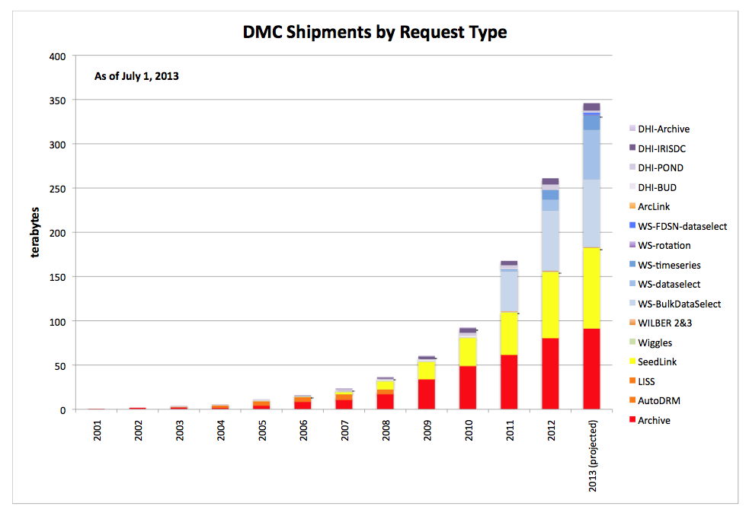
The success of web services

Slide 15
International Coordination
FDSN web services are well coordinated between Europe and the US
Intend to promote them elsewhere
Canada, Japan, China, SE Asia
Many developers producing ws aware clients
ObsPy
SOD
jWeed
WILBER 3

Slide 16
EFFORTS in Higher Level Products Adapted from National Research Council Committee on Data Management and Computation (CODMAC)
LEVEL 4
Integrated Research Products
LEVEL 3
Seismological Research Products
LEVEL 2
Derived Information
Standard Processing
LEVEL 1
Quality Controlled Data
LEVEL 0
Raw Data

Slide 17
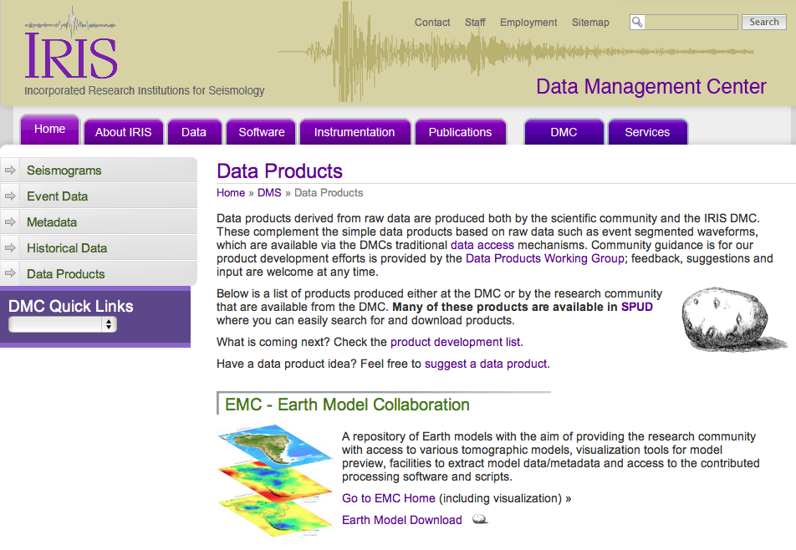
Products from IRIS http://www.iris.edu/dms/products/
PRODUCT

Slide 18
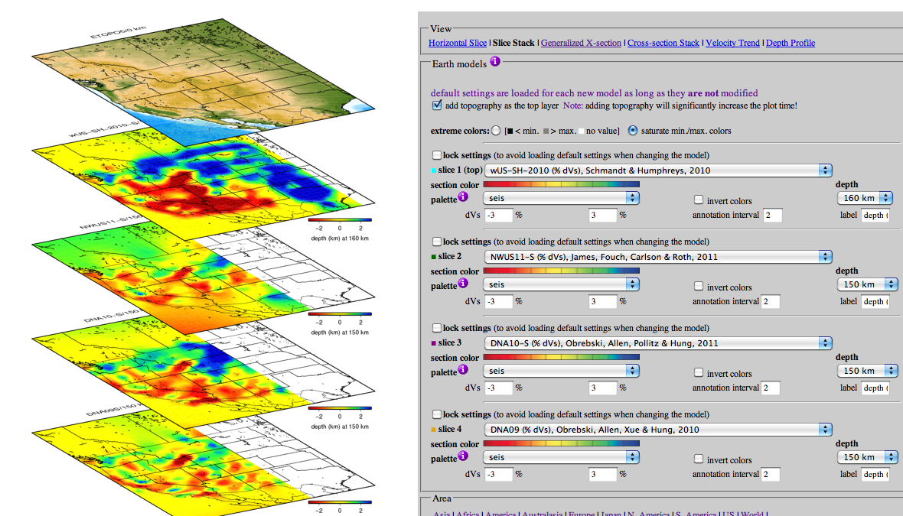

Slide 19
Searchable ProdUct Depository (event products all products)

Slide 20
Special Event Products

Slide 21
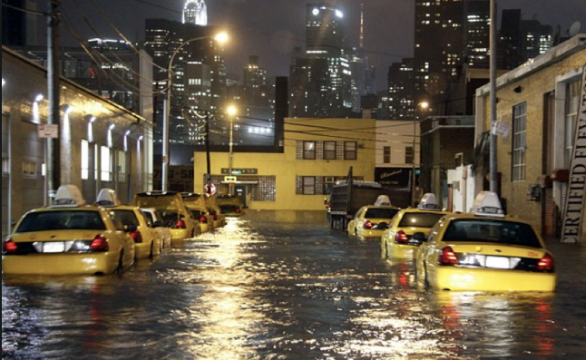
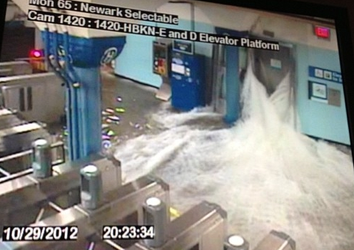
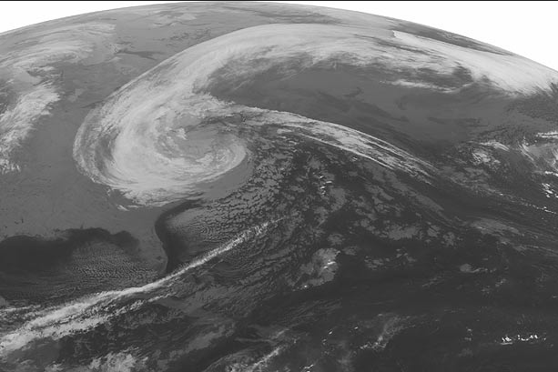
Hurricane Sandy: very bad for New York City, $75B in damage overall

Slide 22
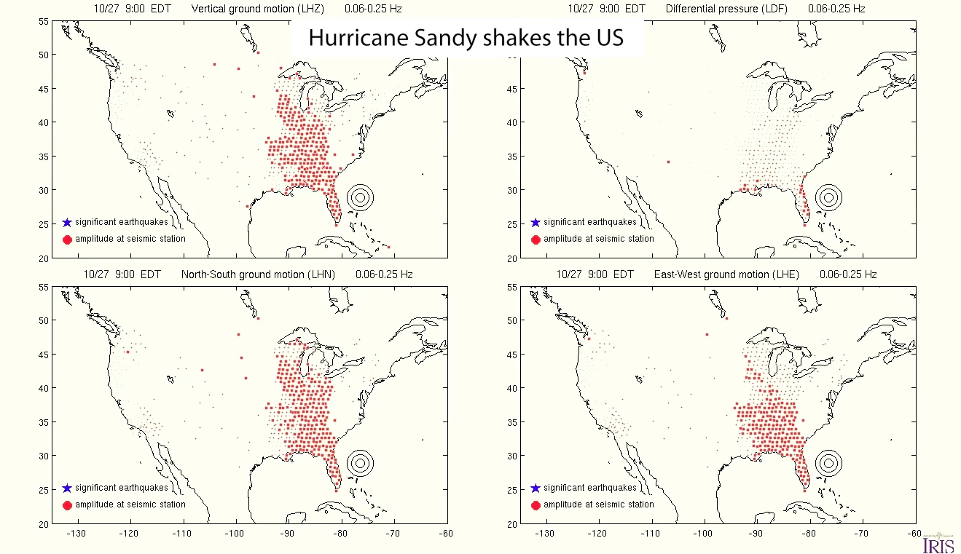
Hurricane Sandy: very interesting seismic noise source
Vertical
Pressure
North-South
East-West

Slide 23
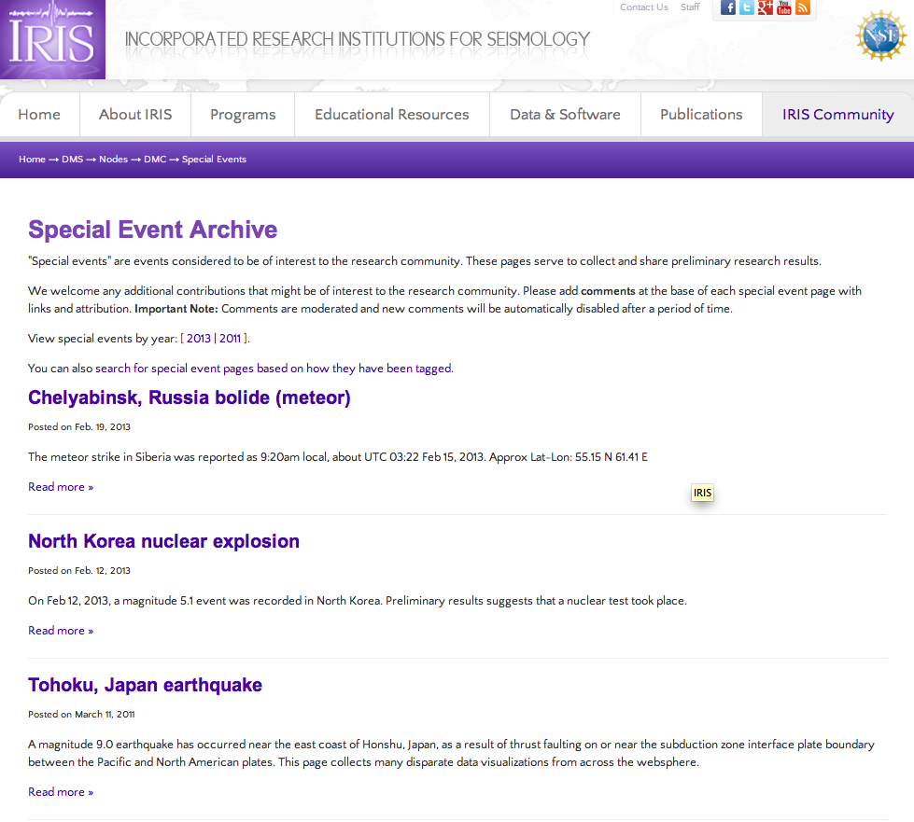

Slide 24
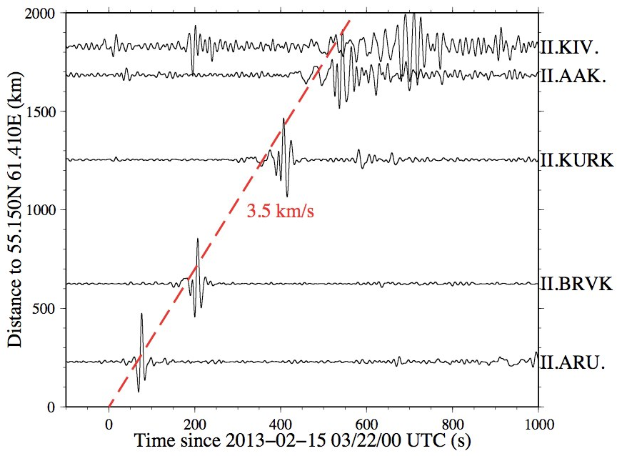
Russian bolide seen by Global Seismic Network stations
(atmospheric to ground coupling generated long period surface waves)
but…..

Slide 25
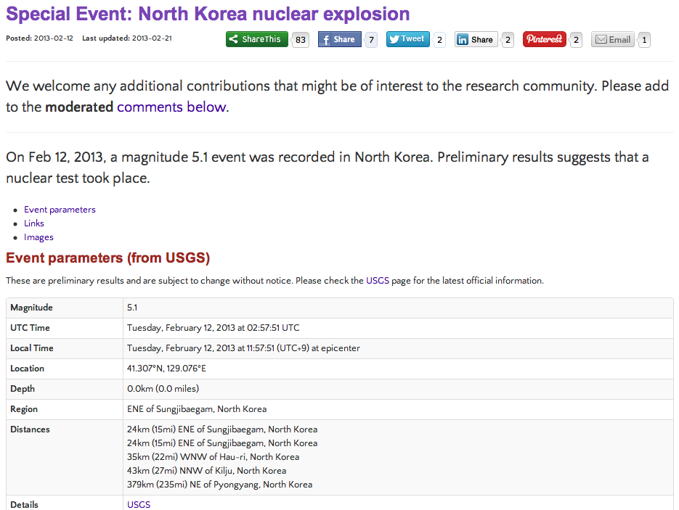

Slide 26
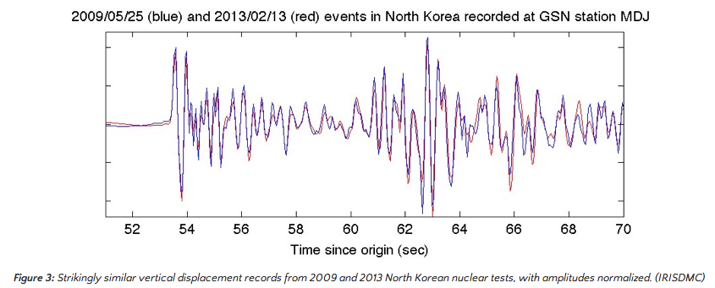
2009 & 2013 test had very similar locations!

Slide 27
On-demand synthetic seismograms
We are computing a complete GF database for:
* High resolution 2D axisymmetric SEM (maybe 0.5 Hz?)
* All source depths/distances
* Seven 1D reference models (PREM, AK135, PREMoceanic…
* Available on demand/command line to anyone through IRIS
* Returns synthetic seismograms: filtered, GCMT or any moment tensor convolved
ETH: Tarje Nissen-Meyers, Martin viel Driel, Niloufar Abolfathian
IRIS: Alex Hutko & Chad Trabant

Slide 28
Quality Assurance Using MUSTANG Modular Utility for Statistical Knowledge Gathering
What is MUSTANG
A system initially providing ~two-dozen QA metrics
Web service architecture and accessible
Crawls through all data in the archive
Changes in data and metadata trigger recalculation
Integration with IRIS Web Services suite
Can be part of a larger network of QA systems

Slide 29
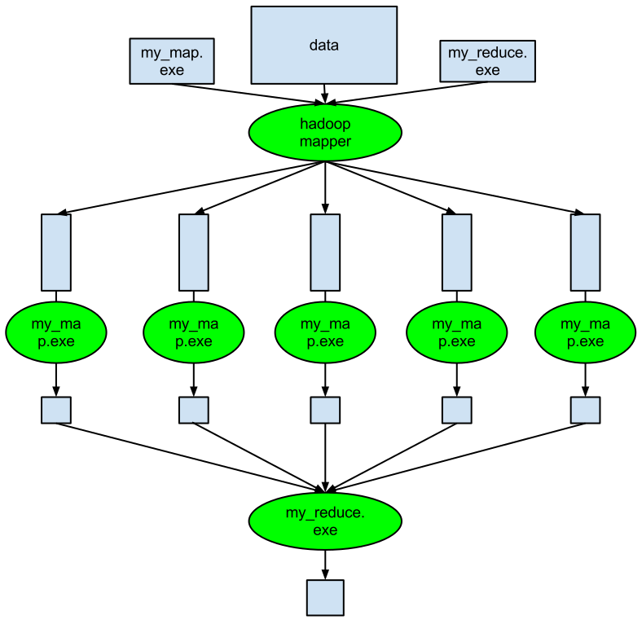
How is MUSTANG designed?
Consists of 3 major components
A Master Scheduler (MCR)
A central storage system (BSS)
A metrics compute cluster
sched
mcrmom
resched
jobmgr
Node A
Node B
Node C
Node D
Node E
store

Slide 30
Metrics Project Status
Simple metrics development
Includes development of data acquisition, messaging, metadata processing, and other foundational details
Gaps, STA/LTA, Overlaps, Availability, Max/Min/Mean/Median values, RMS
SNR – event based using tau-p
Data Latency adapted from existing QUACK code
Polarity reversal will follow SNR
Linearity is challenging
State of health metrics

Slide 31
Metrics Project Status (2)
Multiple time series metrics
Station percent completeness
Multiple station min/max/mean/median
Other metrics being worked on
Complex processing – in pipeline
PSD algorithm just completed
Processing just beginning
Calculations do not have instrument corrections applied
PDF plots will be generated dynamically to support aggregation and spectral differencing

Slide 32
More Metrics in Development
Coherence of two separate time series
Cross-correlation of two separate channels
Differencing in PDFs, Aggregate PDFs
Percent difference above HNM
Check channel orientation – finding max coherence
Compare cross-spectrum of two co-located channels
Compare data to synthetic tide

Slide 33
Later Phase
Additional metrics to be produced
Look for spectral trends through mode differencing
Timing integrity check by comparing to TauP
Correlation of data to atmospheric data
Ping or glitch detection
Histogram of DC offsets
Dead channel detector

Slide 34
Visualization Client -LASSO
Flagship visualization client
Provide ability to easily browse metrics data
Provide ability to generate plots of indicated metrics
Provide ability to organize results in web page
Intended audiences
Network operators
Scientific users

Slide 35
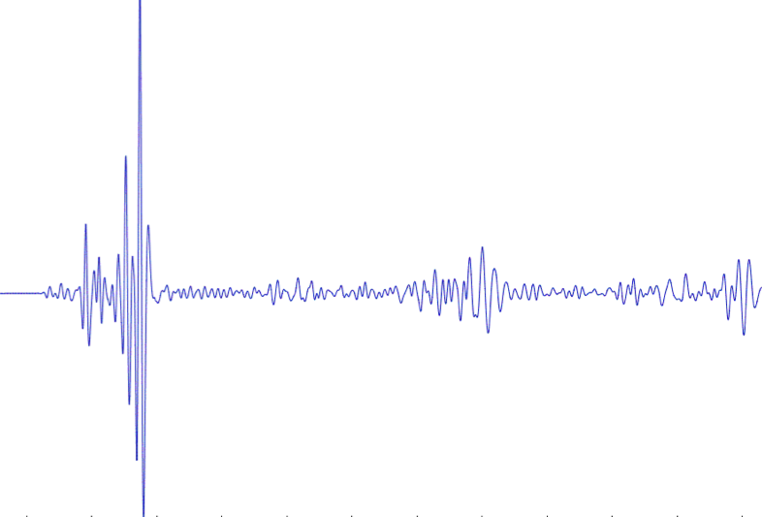
IRIS DMC: Enhanced Quality Assurance
MUSTANG Metric Estimators
Gaps, overlaps, completeness, signal to noise, power density, pdf mode changes,
Glitches, (~24 metrics in phase 2)
PostgreSQL Database
Data Quality Technician
Domestic & Non-US
Network Operators
Archived and Real Time Data

Slide 36
IRIS DMC: Research Ready Data Sets
MUSTANG Metric Estimators
Gaps, overlaps, completeness, signal to noise, power density, pdf mode changes,
Glitches, (~24 metrics in phase 2)
PostgreSQL Database
Data Quality Technician
Domestic & Non-US
Network Operators
DMC Filters Data Request Using Defined Constraints
Research Ready Data Sets
Archived and Real Time Data
Filtered Data Request Returned to Researcher
Researcher Specifies Required Data Metric Constraints

Slide 37
Auxiliary Data Center
IRIS currently operates an Active Backup System in Boulder, CO at UNAVCO
Replication of time series and DBMS
And other key items such as software source, etc.
We wish to move toward a fully functional auxiliary data center model
LLNL
SDSC
Argonne
This can provide “cycles close to data”

Slide 38
Multiple Fully Functioning DMCs
Load
Balancer
LLNL
Seattle
SDSC
Ingestion
BUD Real Time System
File Ingestion System
Web Services - Entire suite
Breqfast
WILBER3
MUSTANG
SeismiQuery
Breqfast Requests
WebRequest
DBMS
DBMS
DBMS
Wave
forms
Wave
forms
Wave
forms

Slide 39
Links with High Performance Computing
Research Ready
Formatted for HPC
netCDF
HDF5
ADIOS
other
Scriptable
Event Extraction
Web Services
With Research Readiness
LLNL
Seattle
Event Products
DBMS
DBMS
Wave
forms
Wave
forms

Slide 40
Coordination with University Researchers
Builds on IRIS DMC Strengths
Provide access to hi-graded event products
Plumbing between the archive and HPC environment streamlined
Builds on LLNL strengths
Data Mining
Algorithmic processing on an HPC environment
Fosters Collaboration

Slide 41
Some short live demonstrations
Fetch data
Conversion to SAC
The entire GSN in 2 minutes per event

Slide 42
THANK YOU FOR YOUR ATTENTION

Slide 43
Requirements
Identical (or very similar) hardware and software
Hardware
300 terabyte RAID
~ 5 Dell Enterprise Servers
Firewalls, routers, local area network
High speed connections to Internet 2 or greater
Software
VMWare
Oracle Linux
Oracle RDBMS
Trying to move to Enterprise Postgres
etc.

Slide 44
USArray GMVs Ground Motion Visualizations

Slide 45
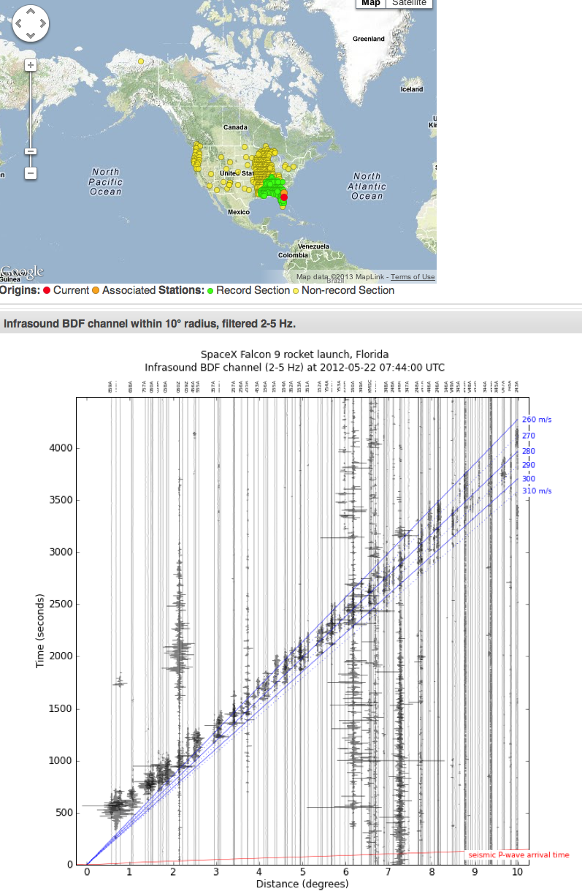
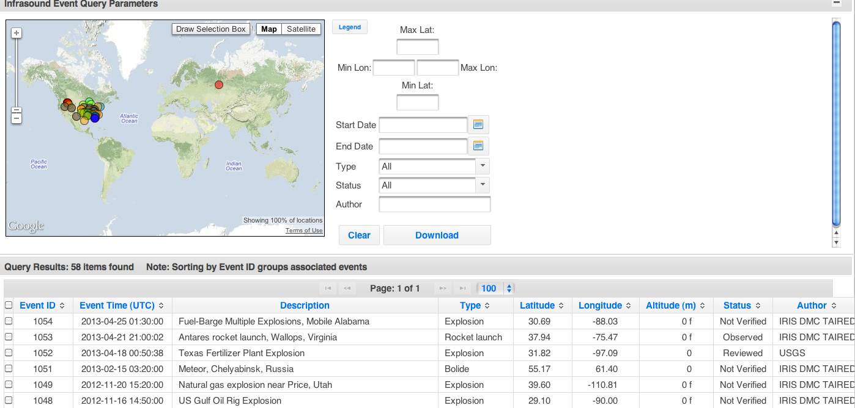

Slide 46
-Continually running infrasound auto-detections

Slide 47
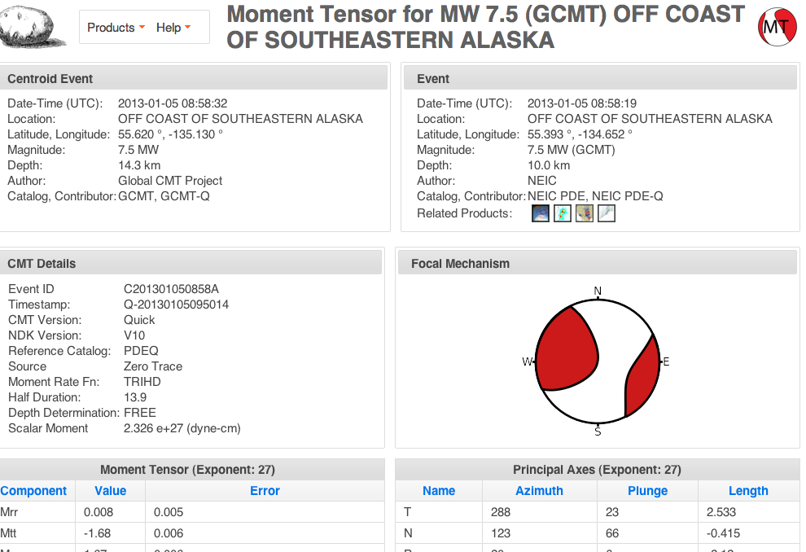
All SPUD products are accessible through a webservice/XML.
Translation: command line download GCMTs
(email product@iris.washington.edu for help)

Slide 48
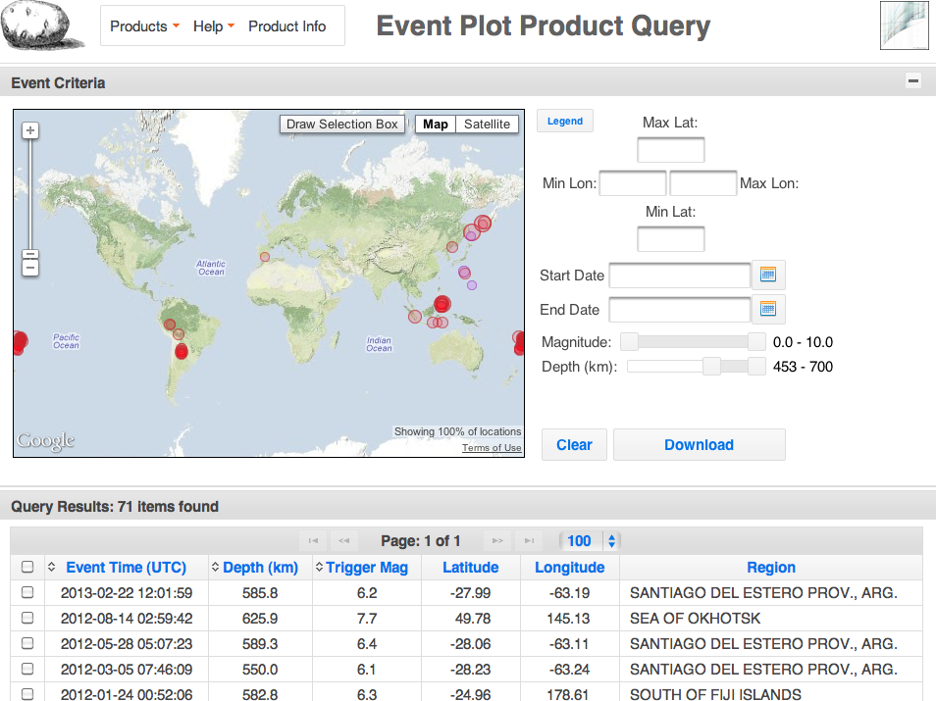

Slide 49
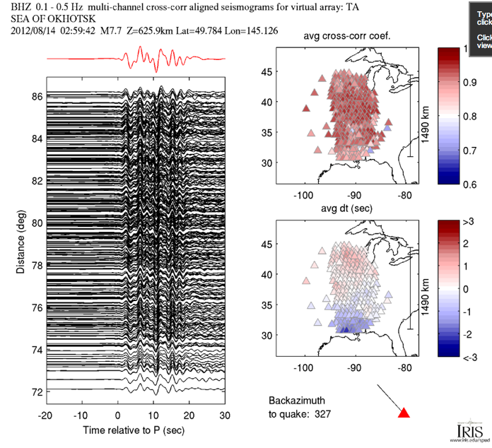
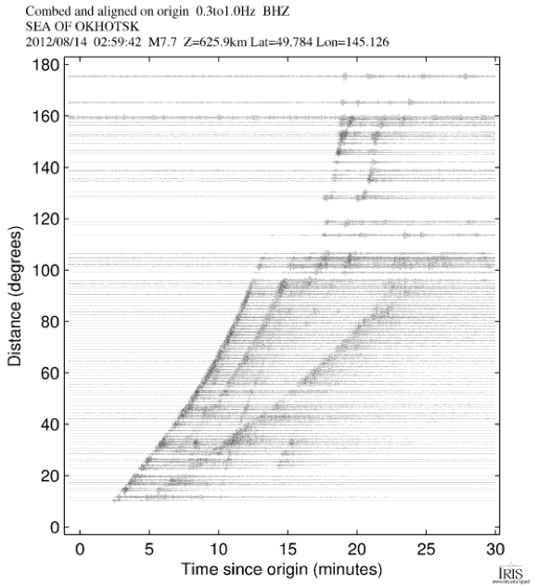
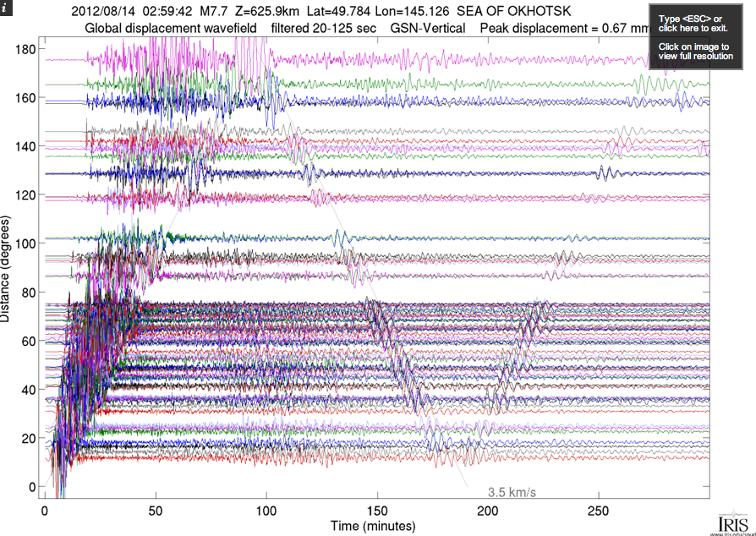
Dozens of record sections

Slide 50
