Slide 1
Improvements in Data Quality, Integration and Reliability: New Developments at the IRIS DMC
By Tim Ahern, Rick Benson, Rob Casey, Chad Trabant and Bruce Weertman
and many more talented people at the IRIS DMC

Slide 2
Key points in this talk
Reliability of IRIS Data Services
Improvements in Data Quality monitoring
MUSTANG
Vertical Integration in seismology
Federated Services (COOPEUS)
IRIS Federator
Horizontal Integration in Earth Sciences
Deploying web services across geosciences

Slide 3
Auxilliary Data Centers to improve System Reliability
Historically IRIS has operated a primary data center in Seattle, Washington
Backup system for redundant copies of data files, database files, software, etc.
Primarily for protecting assets in case of a major catastrophe
IRIS currently operates a second facility in the San Francisco Bay Area near a High Performance Computing installation (LLNL)
(Cycles Close to Data effort)

Slide 4
Multiple & Fully Functioning Data Centers
Load
Balancer
Ingestion
BUD Real Time System
File Ingestion System
Web Services - Entire suite
Breqfast
WILBER3
MUSTANG
SeismiQuery
Breqfast Requests
WebRequest
ADC1
Seattle
DBMS
DBMS
Wave
forms
Wave
forms

Slide 5
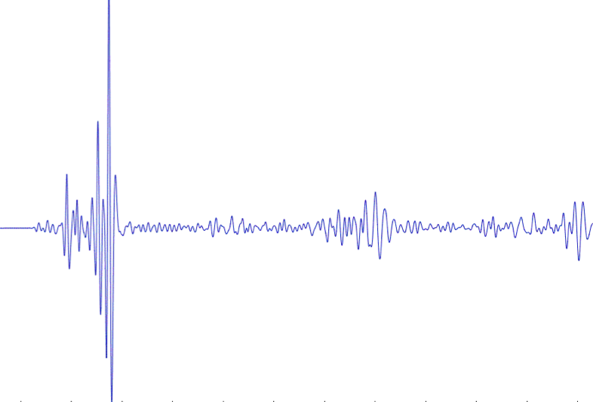
IRIS DMC: Enhanced Quality Assurance
MUSTANG Metric Estimators
Gaps, overlaps, completeness, signal to noise, power density, pdf mode changes,
Glitches, (~24 metrics in phase 2)
PostgreSQL Database
Data Quality Technician
Domestic & Non-US
Network Operators
Archived and Real Time Data

Slide 6
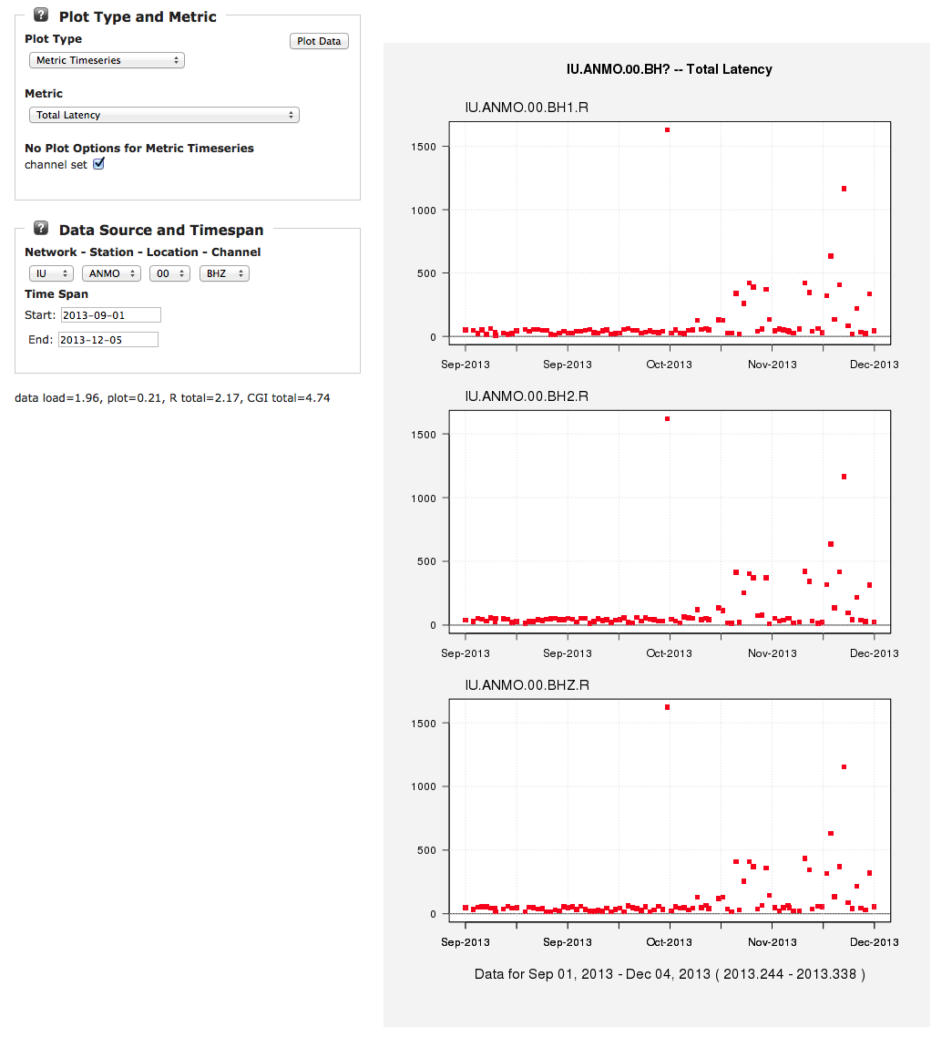
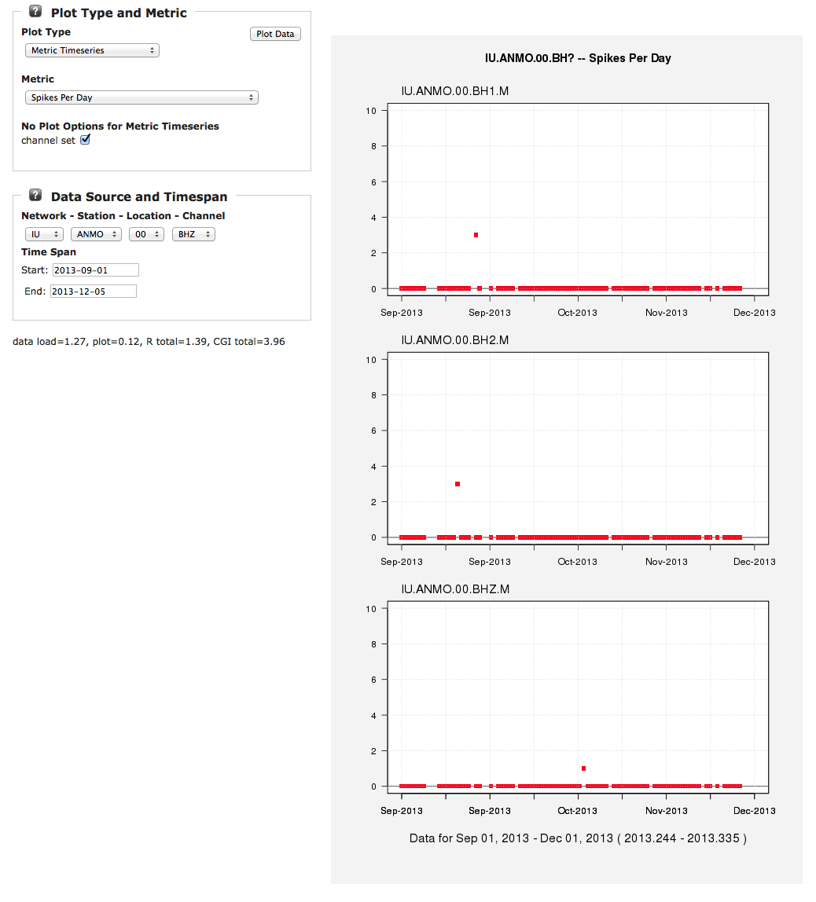
MUSTANG single metric displays showing 3 months of data below but time span is user determined

Slide 7
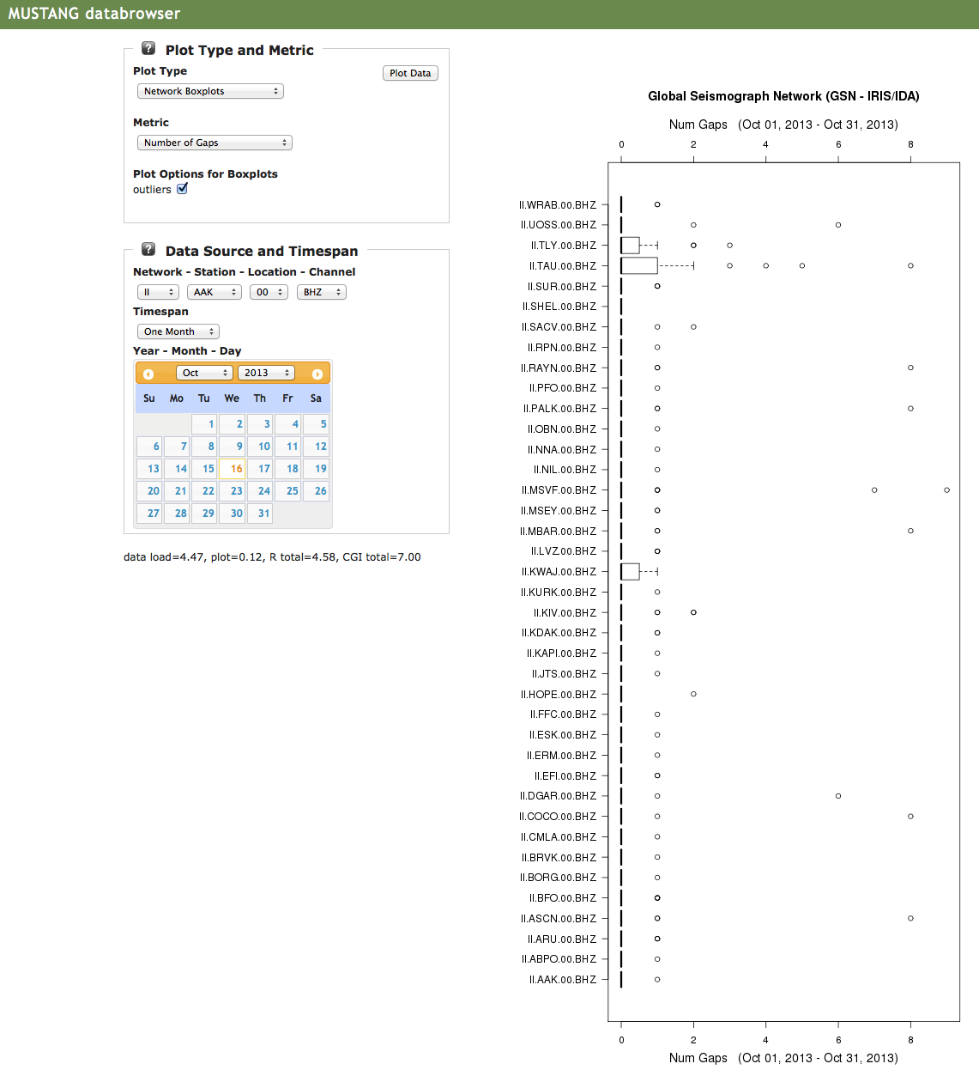
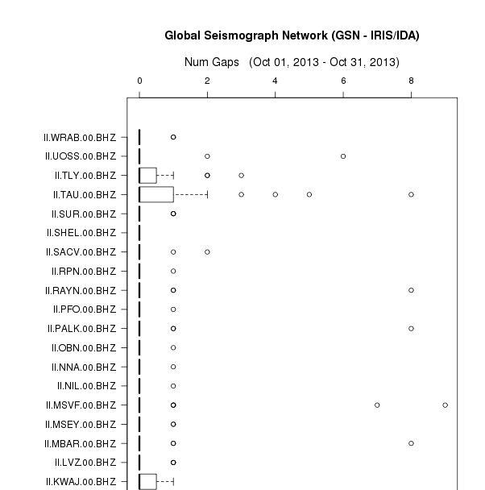
MUSTANG Quality Control System statistical distribution of a given metric

Slide 8
Vertical Integration of Seismological Data Centers
FDSN federated web services
dataselect – for time series observations
station – for metadata describing the recording station
event – info related to earthquakes and events
Fully adopted by the FDSN working groups
Description of the payload (XML, text, etc)
Calling convention ( parameter specifications)

Slide 9
Participants in Federation
Europe
France – RESIF
Germany – GFZ
Italy – INGV
Netherlands – ORFEUS Data Center
Switzerland – ETH
US
IRIS DMC
NCEDC

Slide 10
Standardization of web services
Root URL: unique for each data center
IRIS http://service.iris.edu/fdsnws/station/1/
ORFEUS http://www.orfeus-eu.org/fdsnws/station/1/
NCEDC http://ncedc.org/fdsnws/station/1/
RESIF http://ws.resif.fr/fdsnws/station/1/
GEOFON http://geofon-open2.gfz-potsdam.de/fdsnws/station/1/
INGV http://webservices.rm.ingv.it/fdsnws/station/1/
query?net=IU&sta=ANMO&loc=00&cha=BHZ&starttime=2010-02-27T06:30:00&endtime=2010-02-27T10:30:00&nodata=404
Query Parameters: standardized
More information will be presented on Thursday at 8:45 AM in SM1.3 Room G3
Integrated Research Infrastructures and Services to users:
supporting excellence in a science for society

Slide 11
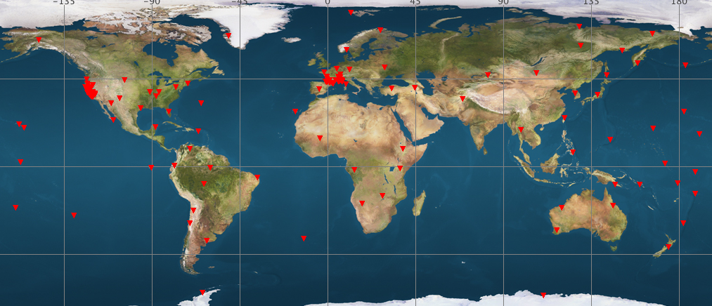
Accessing Information from NCEDC (BK), RESIF (FR), and IRIS (IU)

Slide 12
IRIS Federator
IRIS is developing a federating web service that will allow a user to make a request to a web service at IRIS. This service will return a set of URLs that will allow the software running on a user’s computer to directly access the appropriate data center to service their request
IRIS
Federator
USER

Slide 13
EarthCube: Geo-WS Overall Goals
To simplify
Data discovery
Standard and simplified web services supporting space-time (and more) queries
Data access
Simplified services also mean simple clients
PERL, MatLab, R, wget, etc
Data Usability
When possible standard widely used formats will be supported and when reasonable text output formats will be available to aid in interdisciplinary access

Slide 14
EarthCube GeoWS Partners
RAMADDA
Long Tail Data
GGP
NEON
IRIS
UNAVCO
UTEP
Gravity
NGDC
GeoWS
CUAHSI
SDSC
Caltech
GPlates
Inter
Magnet
OOI
Columbia
IEDA
Unidata
Structural
Geology
WOVODAT
B-Cube
CINERGY

Slide 15
Key milestones
Standardized space-time queries for 14 geosciences data types/centers
Data discovery client
Standardized documentation
URL builders
GUI to URL builders to provide proper URL construction
Development of Simple clients
Standard and Simple cross-domain formats developed

Slide 16
Thank You!

Slide 17
Links with High Performance Computing
Research Ready
Formatted for HPC
ADIOS
HDF5
other
Scriptable
Event Extraction
Web Services
With Research Readiness
LLNL
Seattle
Event Products
DBMS
DBMS
Wave
forms
Wave
forms

Slide 18
IRIS DMC: Research Ready Data Sets
MUSTANG Metric Estimators
Gaps, overlaps, completeness, signal to noise, power density, pdf mode changes,
Glitches, (~24 metrics in phase 2)
PostgreSQL Database
Data Quality Technician
Domestic & Non-US
Network Operators
DMC Filters Data Request Using Defined Constraints
Research Ready Data Sets
Archived and Real Time Data
Filtered Data Request Returned to Researcher
Researcher Specifies Required Data Metric Constraints

Slide 19
