Slide 1
Building a Network Dataless SEED Volume with PDCC

Slide 2
The General Approach
Create a complete, representative station
Clone, or copy, the station
Update the new station entry as needed
Save new dataless SEED

Slide 3
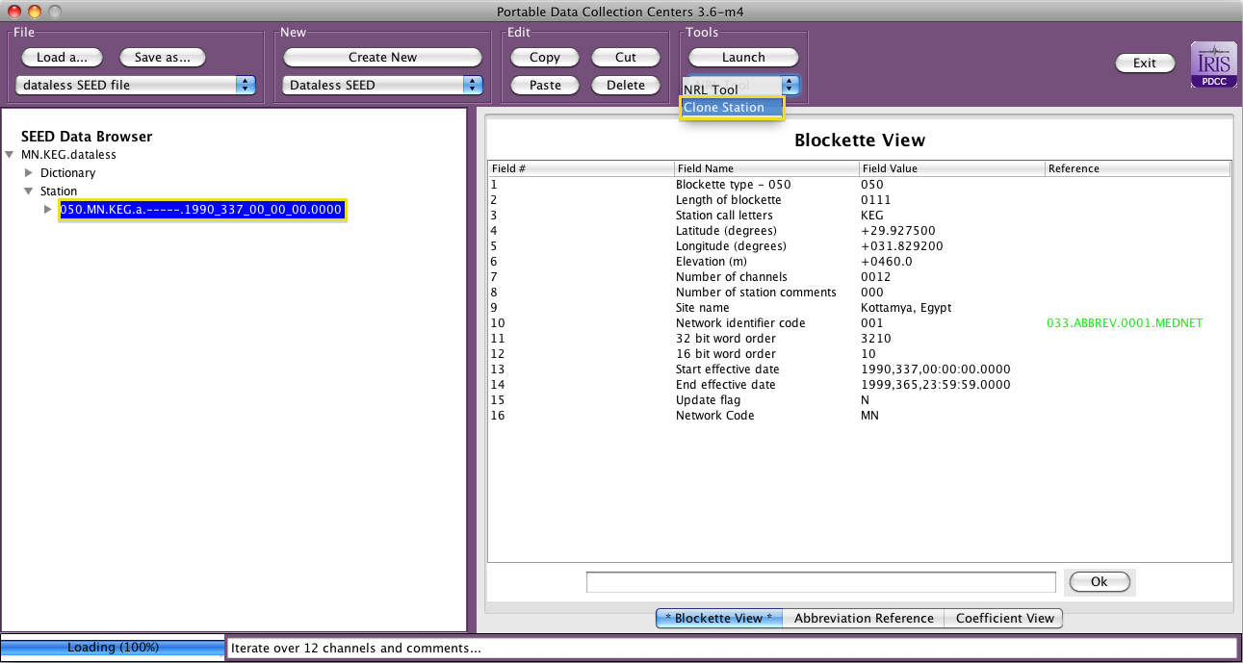
Select Station and Launch Clone Tool

Slide 4
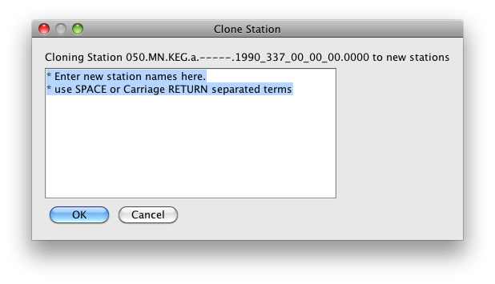
Clone Station Dialog
One more more stations can be created
Reminder of station being copied

Slide 5
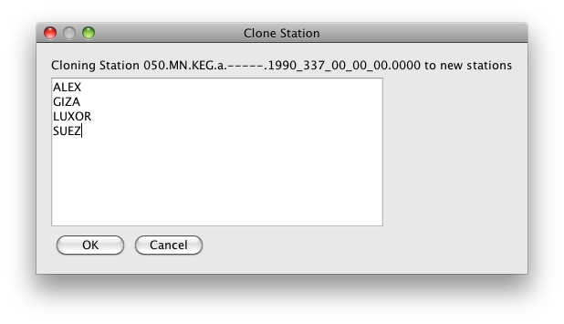
Clone Stations

Slide 6
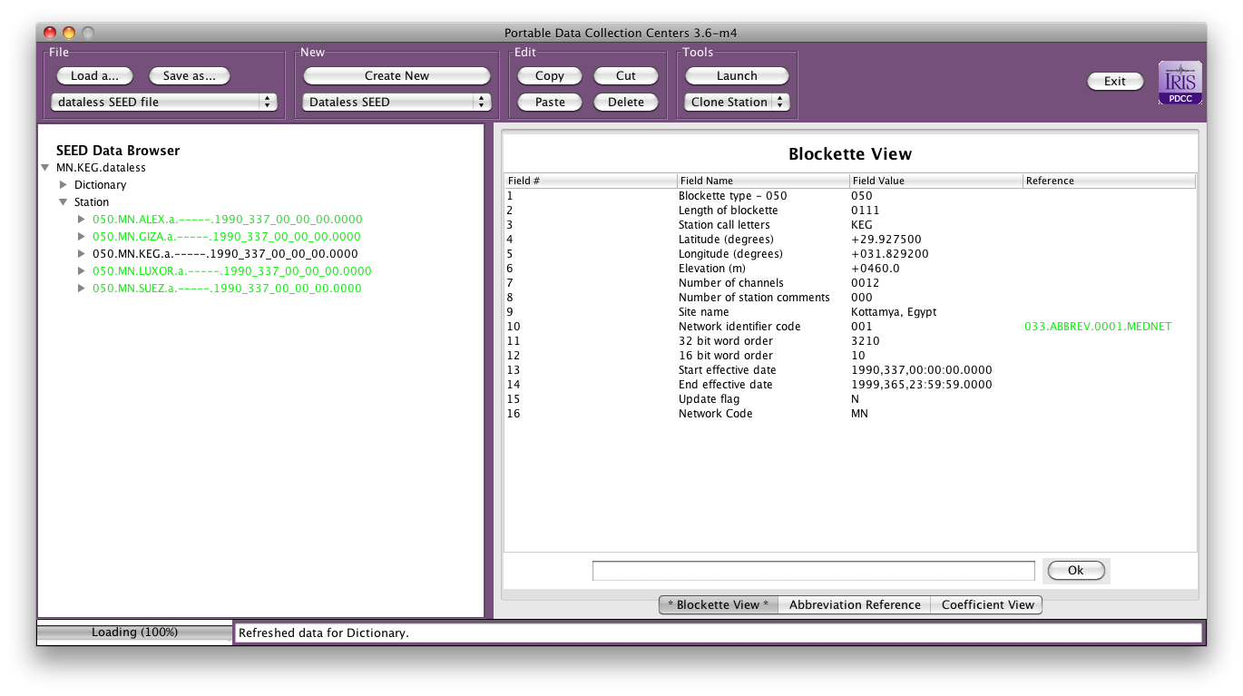
Cloned Stations (green)

Slide 7
Updating New Stations
Critical fields to be updated:
Latitude (Blockette 50, field 4)
Longitude (Blockette 50, field 5)
Elevation (Blockette 50, field 6)
Site name (Blockette 50, field 9)
Start date (Blockette 50, field 13)
End date (Blockette 50, field 14)
Local depth (Blockette 52’s, field 13)
Channel set (Blockette 52’s)
* Select channel (B052) and use “Delete” to remove entries

Slide 8
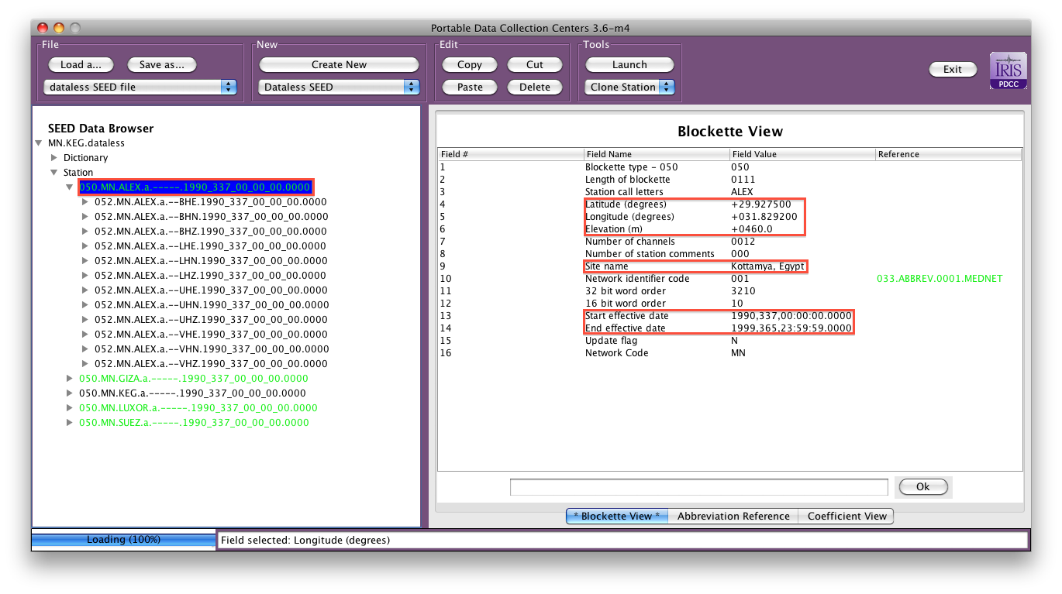
Updating New Station Entries

Slide 9
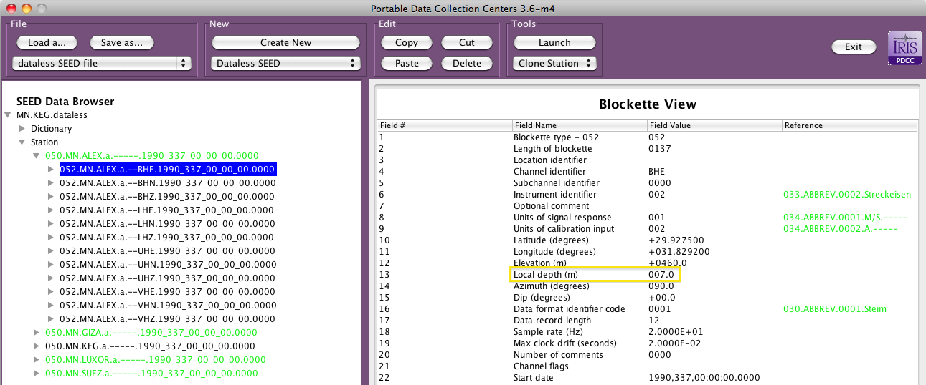
Updating Channel Set and Local Depth
Verify that the channel set is appropriate for the station
Verify that the local depth for each channel is correct, for surface
installations the local depth is 0 meters.

Slide 10
Other Potential Considerations
Further modifications might be necessary: Network Code, channel comments, etc.
Creating representative station metadata templates for equipment sets

Slide 11
Exercise: Building Your Own Network Dataless SEED Volume
Load representative metadata
* Single station dataless
Clone stations
Modify new station entries
Save new dataless
Fields to update: Latitude, Longitude, Elevation, Site Name, Start Date, End Date, Local Depth and Channel Set

