Slide 1
An introduction to PDCC the Portable Data Collection Center

Slide 2
PDCC Overview
The purpose of PDCC is to enable seismic network operators to describe and maintain their instrument metadata in the international FDSN defined SEED format.
PDCC represents a continued effort by IRIS to support the seismological community with tools to enable data management, exchange and research.

Slide 3
System Requirements
PDCC 3.7 is written in Java and requires Java 5 or 6 to run (Java 6 is recommended). You must install a Java virtual machine (JVM) designed for your computer platform in order to run PDCC, see: http://java.oracle.com
Recommended CPU: 2.0+ GHz, Memory: 1+ GB
Recent Windows, Mac OS X, Linux, and Solaris operating systems are supported. Other systems may be compatible.
Testing has been performed on Mac OS 10.5/10.6, Ubuntu Linux 10.04, and Windows XP SP3.

Slide 4
Downloading & Installing
You can download PDCC 3.7 from the following URL:
http://www.iris.edu/pub/programs/pdcc/pdcc-3.7.zip
Available on USB drives for Workshop participants
Once you have downloaded the zip file, simply move the file to a directory where you want to carry out the installation and unzip it. For Unix/Linux/Mac OSX you can use the following command:
unzip pdcc-3.7.zip
In some operating systems double-clicking will also unzip.

Slide 5
PDCC: A hands-on demo

Slide 6
NRL: Nominal Response Library & The NRL Tool

Slide 7
SEED Metadata
SEED headers are comprehensive with many required fields. Creating proper SEED metadata requires many details, particularly the channel response information.
The Nominal Response Library (NRL) provides a catalog of response information for many common sensors and data recorders.

Slide 8
The IRIS Nominal Response Library
http://www.iris.edu/NRL
Verified with the manufacturer
Integrated into PDCC using NRL Tool
Flexible design for updates and merging

Slide 9
NRL Components
Each instrument and digitizer in the NRL is represented by a SEED RESP file.
Categorized by equipment type and manufacturer
HTML web pages for detailed information not readily available elsewhere

Slide 10
NRL Tool
Features:
Integrated into PDCC
Selection of complete instrument (sensor and data logger) from NRL
Merging NRLs (e.g. IRIS and local)

Slide 11
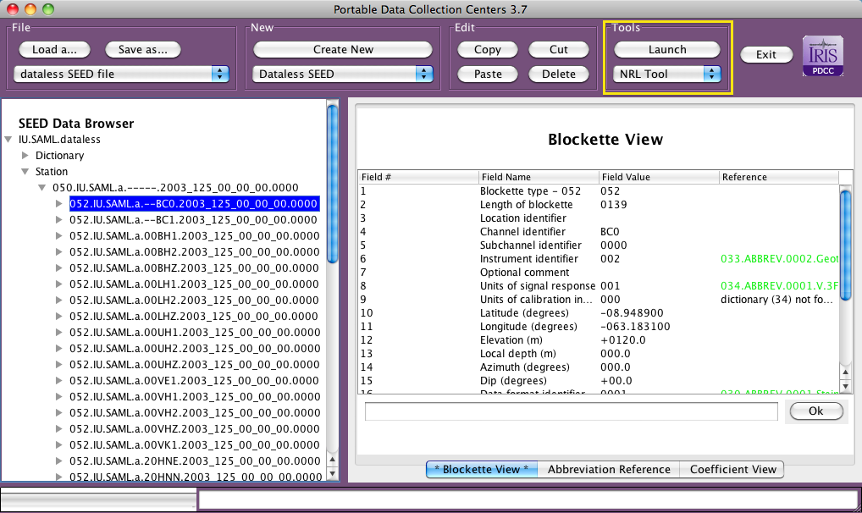
How to launch NRL Tool in PDCC

Slide 12
NRL Tool Demo
Important:
A channel (Blockette 052) must be selected before launching NRL Tool
NRL Tool will replace the response information for the selected channel

