Slide 1
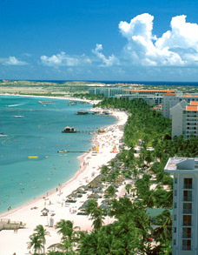
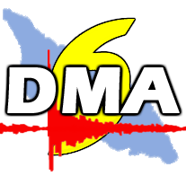
Data Management Workshop
Bogota

Slide 2
Kingdom of the Netherlands
Dismantling of the Neth.Antilles and Meteorological Service Neth.Antilles & Aruba as of 101010 (Kingdom is now Neth, Aruba, Cur, St.Maarten)
Former branch MDNA&A on Aruba becomes Departamento Meteorologico di Aruba as of 101010
The Meteorological Department Aruba is now the source for Meteorological, Seismological and Climatological data for Aruba, as well as the official governmental entity to issue severe weather bulletins for Aruba.
Web-page http://www.meteo.aw

Slide 3
Neotectonic Map (Funvisis)
Pueblo Nuevo Fault on the Peninsula of Paraguana, lying about 50 km south from Aruba, has a seismic potential to generate an earthquake of magnitude 6.6 and a return period of some 2300 years.
Cuiza Fault Nothwestern Venezuela and Northeastern Colombia, some 120 km southwest of Aruba, has a capability to generate an earthquake of 6.7, with a return period of 1500 years.
Eastern Oca Fault some 160 km south of Aruba and has a seismic potential to produce an earthquake of magnitude 7.5, with a return period of 390 years. The Eastern Oca Fault represents the highest seismic hazard for Aruba, because of its short return period and seismic potential.

Slide 4
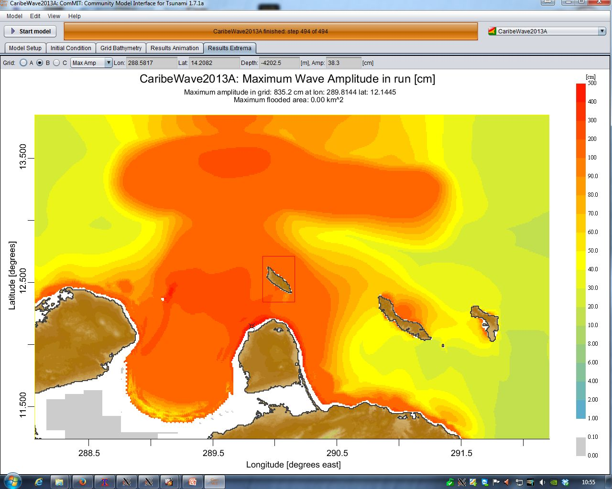
SCDB

Slide 5
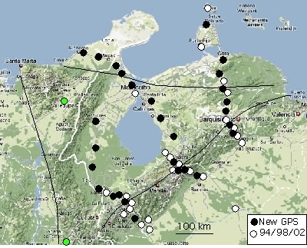
Minimum Mw = 8.7, 300 km x 200 km x 6 m slip
(no slip since 1492)
Mw 8.9 if 14 m slip
9.1<Mw<9.1
if both segments slip
Mw=8.7
Mw=8.7

Slide 6
Seismic Activity Near Aruba 1921-2008 (Funvisis)

Slide 7
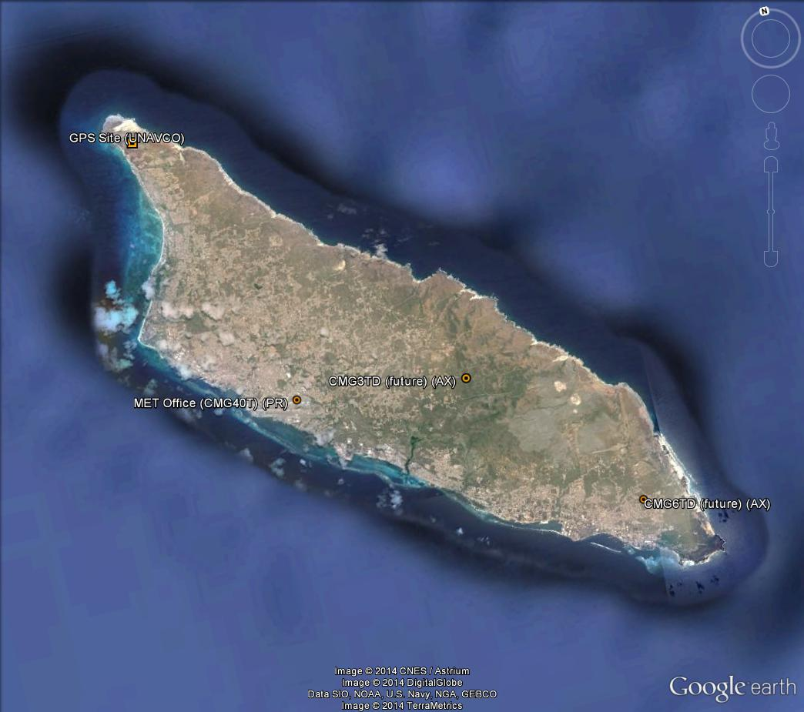
Seismic Stations Aruba
Current
Future

Slide 8
Type of Stations
CMG40T (30s-50hz), NETDAS (24bit) (prsn)
CMG3TD (120s-50hz), digitizer 24 bit (aruba)
CMG6TD (0.003hz-50hz), digitizer 24 bit (unesco)

Slide 9
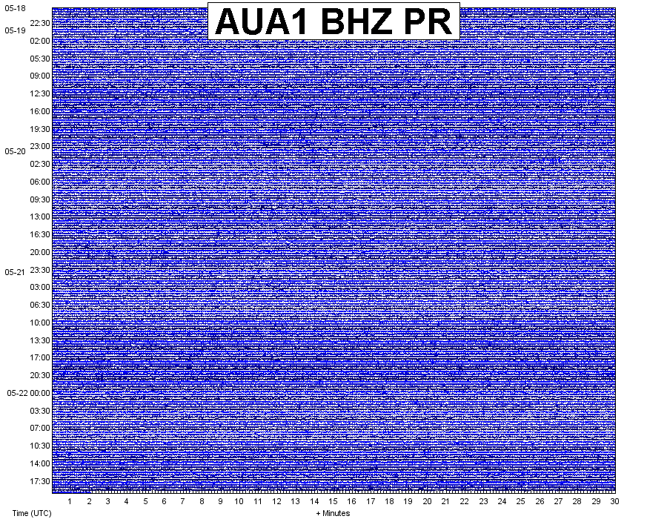
Seismic Station near Airport to noisy

Slide 10
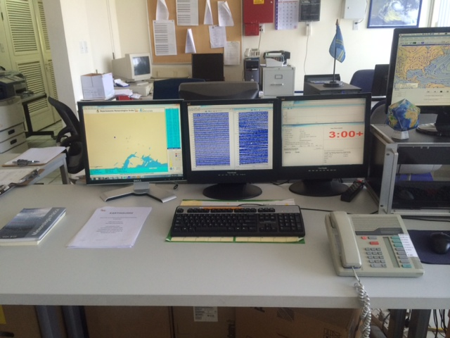
Seismic WS Aruba

Slide 11
Why Seismology on Aruba?
CaribeEWS
Recommendation FNVS 1997
Citizens reporting ‘quakes’
Citizens reporting ‘growing hill’ on eastward side
Great way to create science awareness

