Slide 1
PDCC: Portable Data Collection Centers Single Station: Starting from Scratch
Rick Benson
IRIS DMC

Slide 2
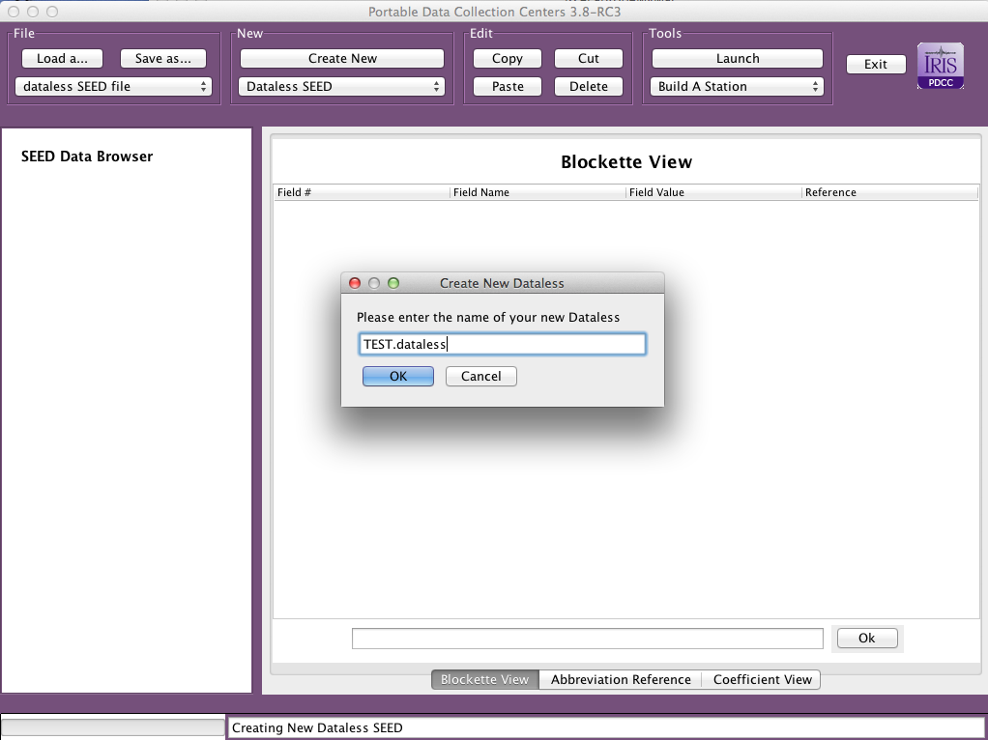
Single Station Creation
Step 1:
Create New
Dataless SEED
Step 2:
Name your New
Dataless SEED

Slide 3
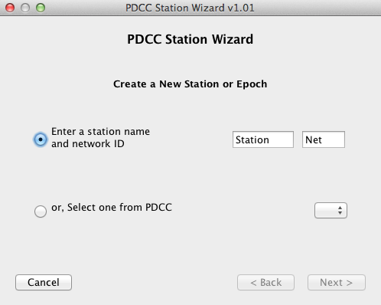
Step 3: Click on
dataless name in
left frame
Step 4: Launch the
“Build a Station”
Tool

Slide 4
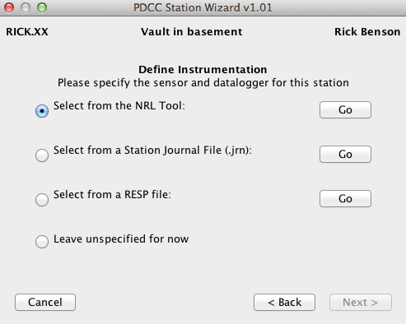
Step 5: Fill in all pop-up
Information, proceeding
to NRL Tool Option
Step 6:
Use this NRL GUI
to complete
equipment
information

Slide 5
PDCC: Portable Data Collection Centers Cloning Stations
Rick Benson
IRIS DMC

Slide 6
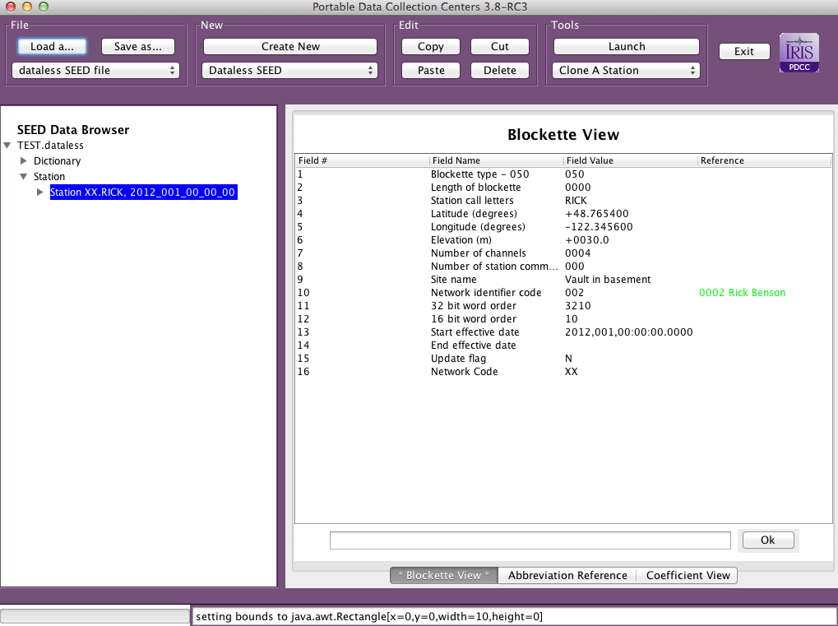
Cloning Station Operation
Step 1:
Click on station you
want to clone
Step 2:
Select “Clone a
Station” from
Tools selection

Slide 7
Start adding new stations, but remember that you are replicating the instrumentation
so restrict this new station list to SAME instrumentation.

Slide 8
When done, the
new station(s)
are added to the
dataless

