Slide 1
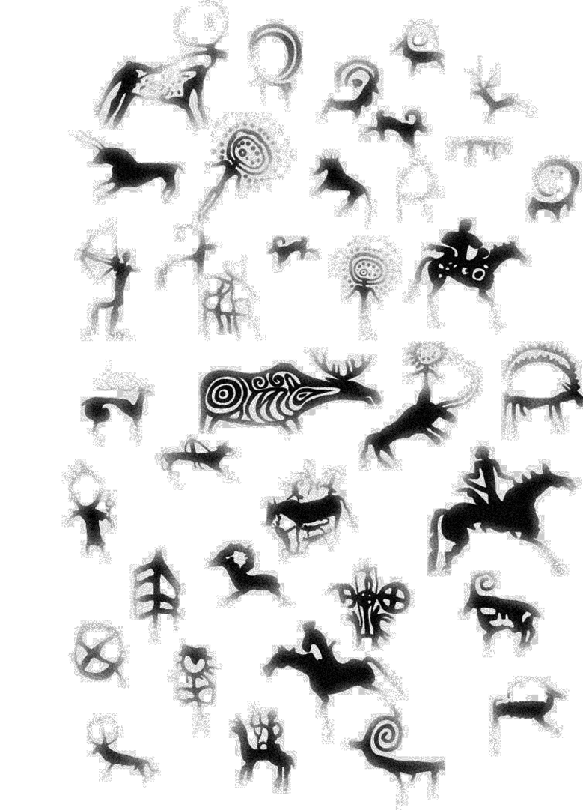

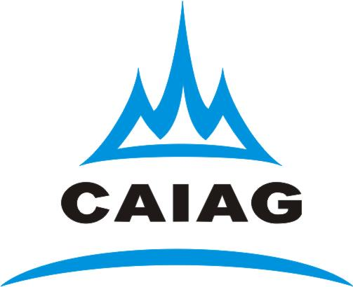
Central Asian Institute for Applied Geosciences
Seismic monitoring network of CAIAG
Azamat Sharshebaev
a.sharshebaev@caiag.kg
www.caiag.kg

Slide 2
Background
Central-Asian Institute for Applied Geosciences was established in 2004 on the basis of the Cooperative Agreement between the Government of the Kyrgyz Republic and the German Center for Geosciences, Potsdam;
Legal status – public foundation;
CAIAG is a non-commercial research institute;
CAIAG is a multidisciplinary institute comprising most of the geoscientific discip­lines like geology, glaciology, hydrology, limnology, climatology, geophysics, seismology, geodesy and remote sensing.
CAIAG operates dedicated monitoring networks for seismology and geodesy, a network of hydro-meteorological monitoring stations and high mountain glacier observatories.

Slide 3

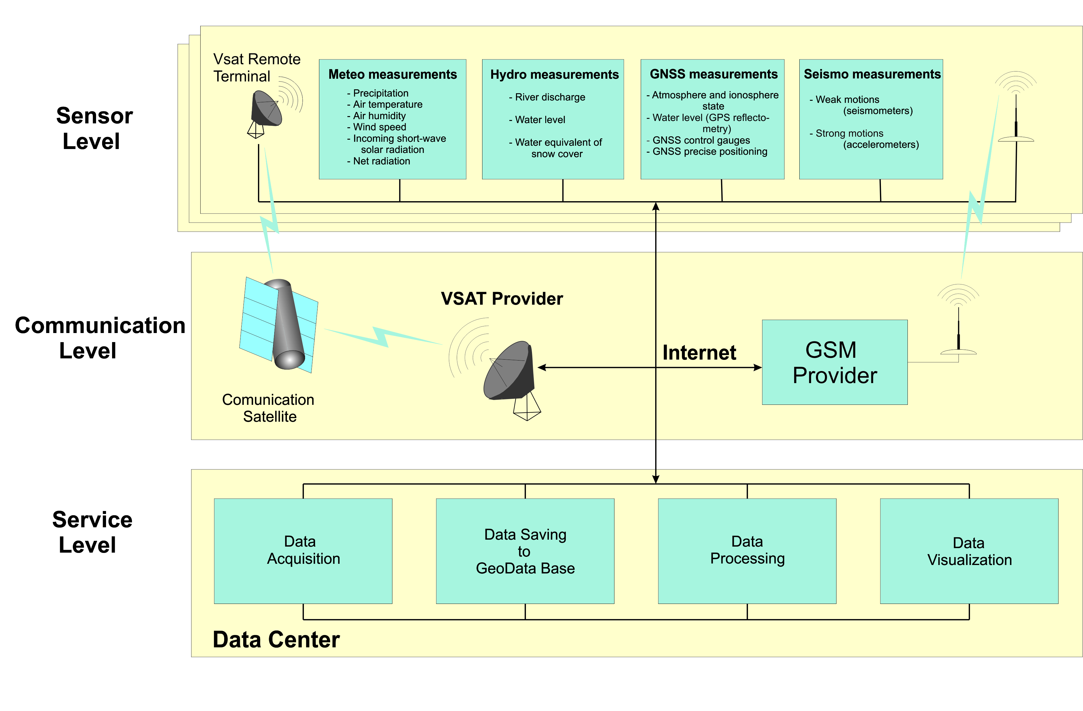
Monitoring System Concept

Slide 4

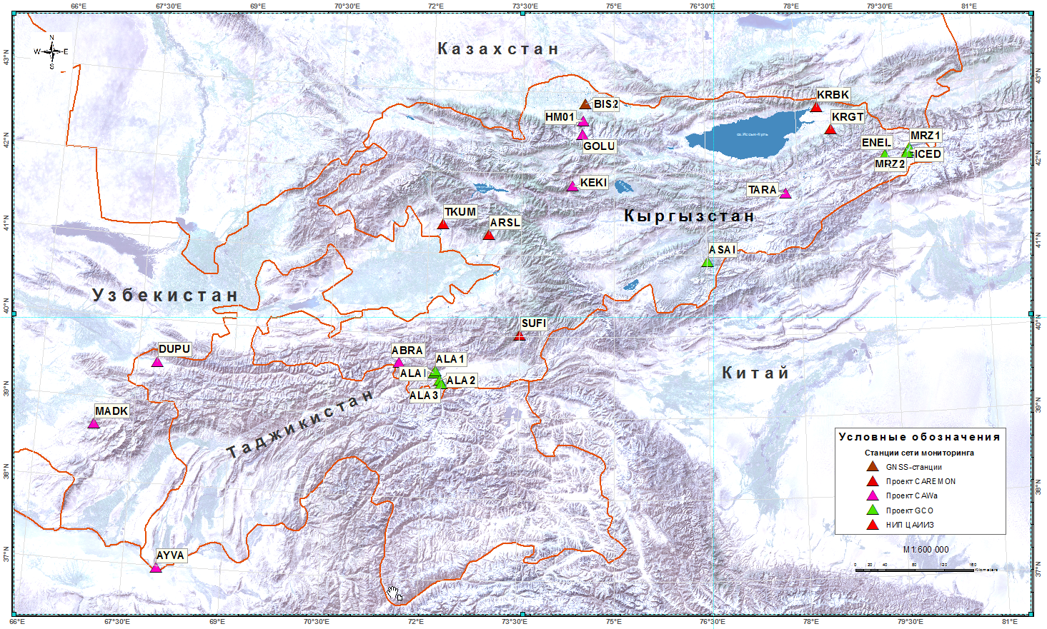
Monitoring network stations of CAIAG
SMART (VSAT+seismo + meteo + GNSS):
- TARA (Taragay)
- MRZ1(Mertzbaher)
- ASAI (Ak-Sai)
CAREMON network
(VSAT+seismo) :
- SUFI (Sufi-Kurgan)
other stations :
VSAT & GSM + meteo + GNSS
Notes:
All CAIAG stations

Slide 5
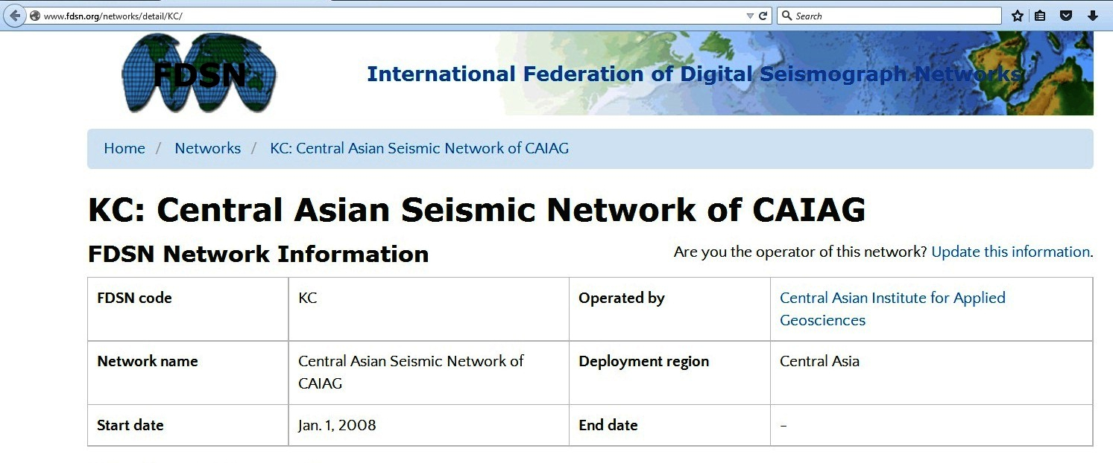
Registration in FDSN network

Slide 6

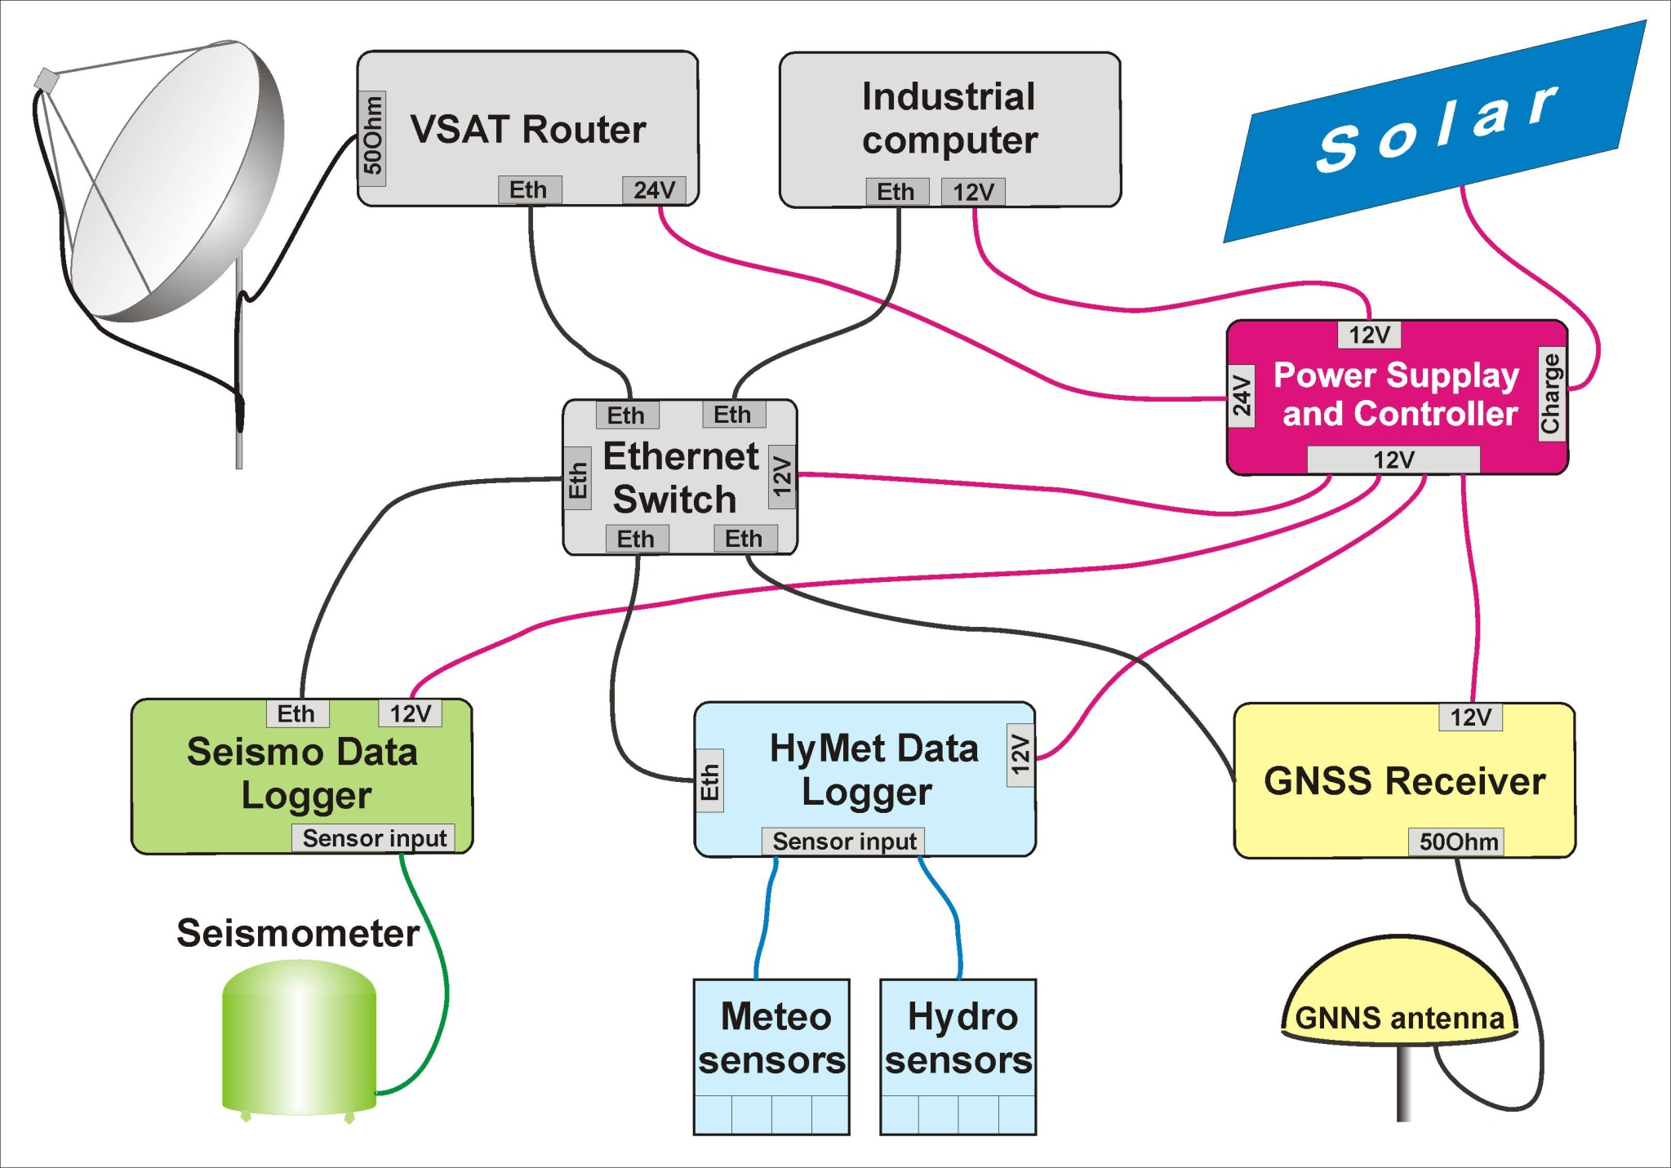
Scheme of Monitoring Station

Slide 7

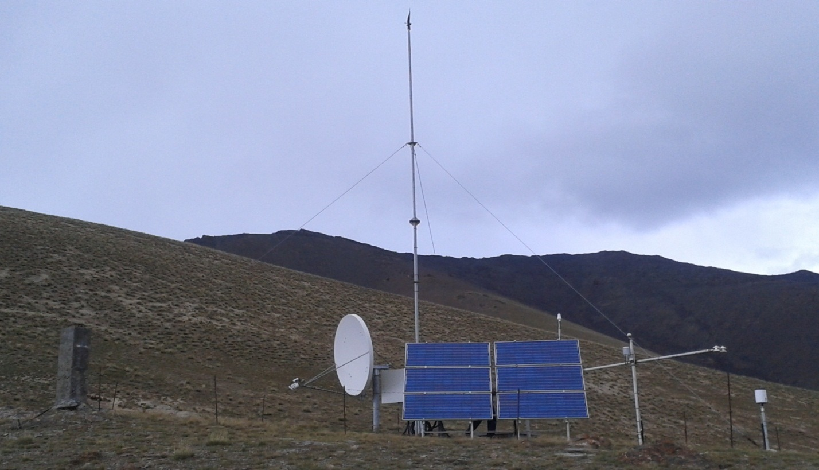
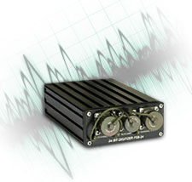
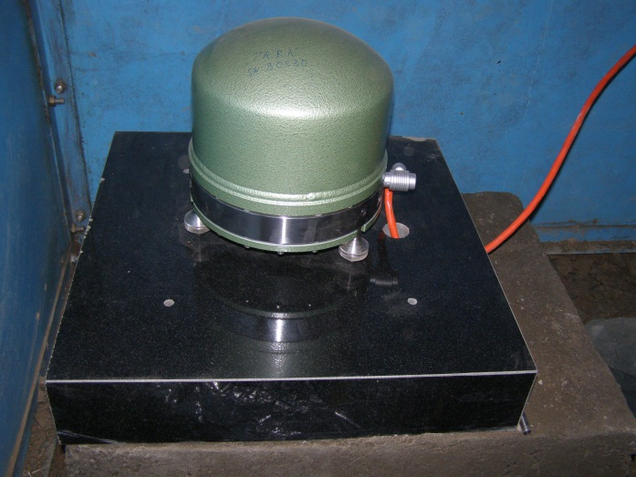
SMART station “Taragay” (TARG)
Smart Station consist from GNSS , seismic and meteorological stations.
Seismic station located in the bunker at a depth of 2 m below ground, includes broadband STS-2 seismometer and EarthData PS6-24 digitizer. To service precise time used GPS antenna Trimble.
Files written in miniseed format with a frequency of 100 SPS (sample per second) and transmitted via VSAT antenna in real time mode to data server.
Digitizer EarthData PS6-24
seismometer STS-2

Slide 8

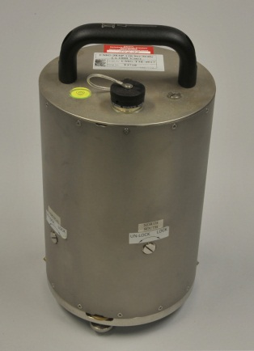
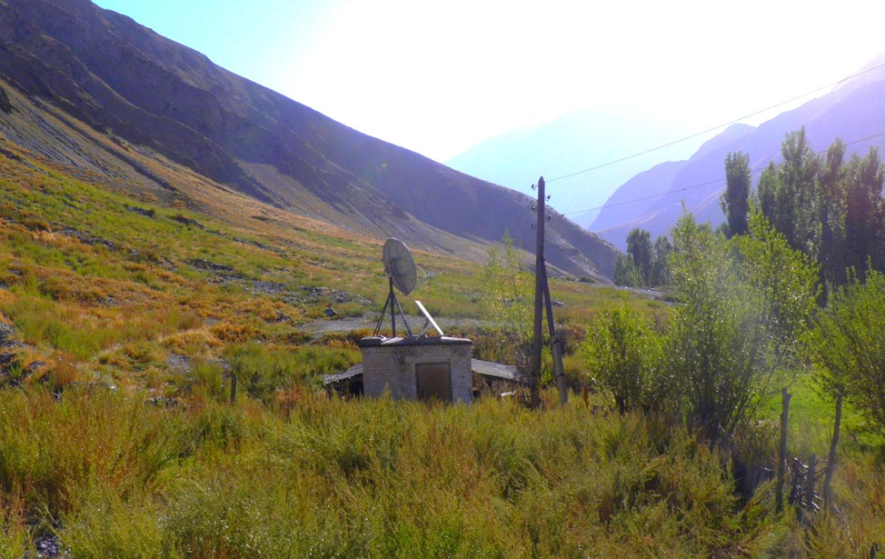
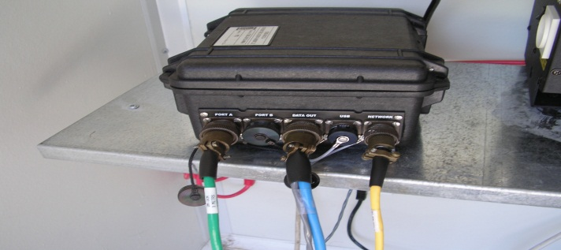
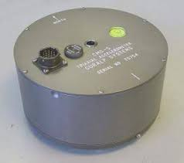
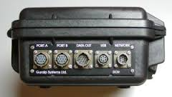
Seismic station “Sufi-Korgon” (SUFI)
One of the stations in the network CAREMON seismic station “SUFI “ was handed over to the CAIAG.
Seismic station “SUFI” was set within the project “CASCADE”(Central Asian Cross-border natural disaster prevention, network “CAREMON” in 2009)
Seismic station includes broadband seismometer CMG-3ESP, accelerometer CMG-5T, digitizer CMG-DM24S6 and Dataloger CMG-EAM.
Files written in the format GCF, with frequency 100 SPS (samples per second) and transmitted via VSAT antenna in real time mode to data server.
digitizer CMG-DM24S6
seismometr CMG-3ESP
accelerometer CMG-5T
dataloger CMG-EAM

Slide 9
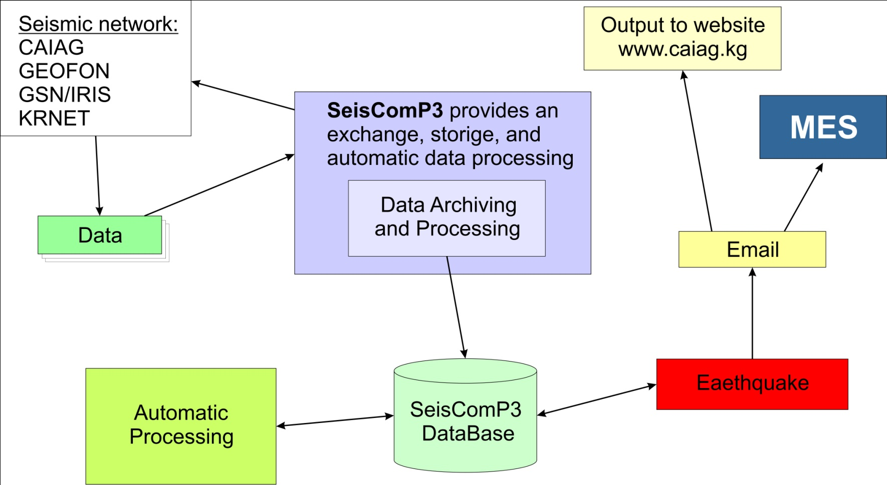
Data processing
Earthquake alert!!!
Manual Processing

Slide 10

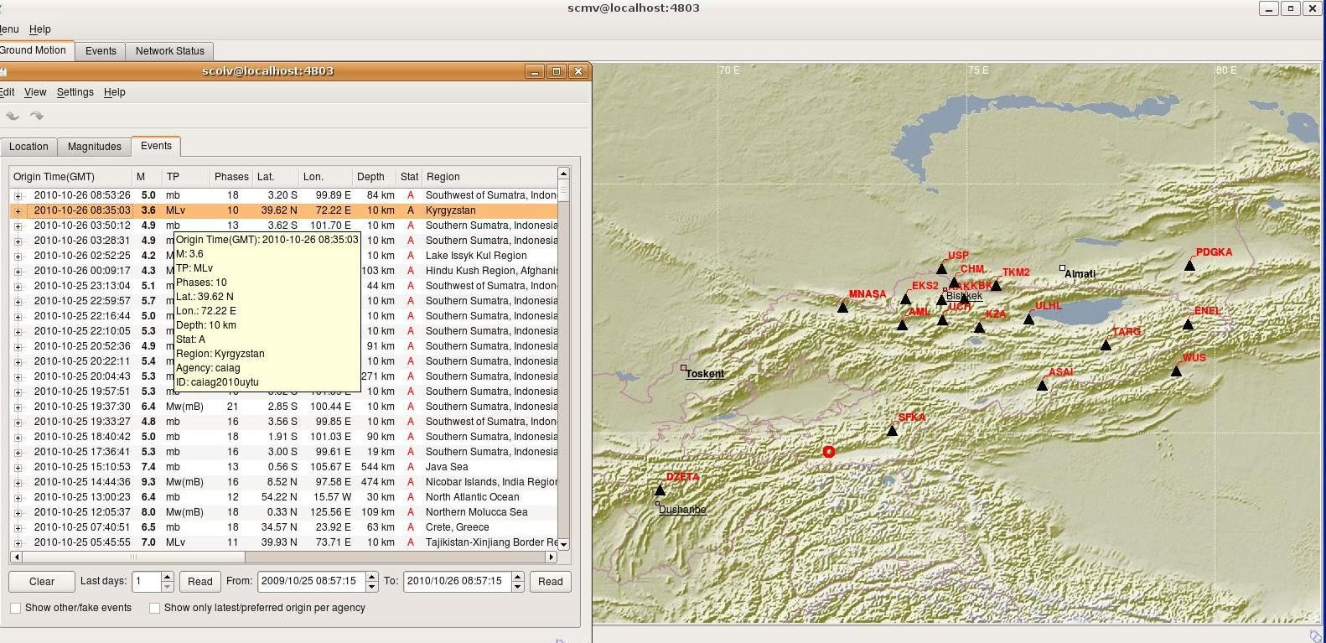
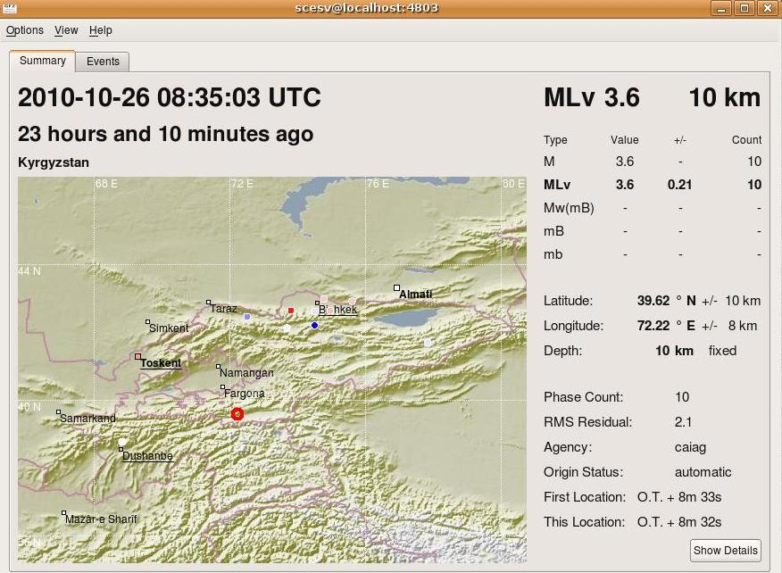
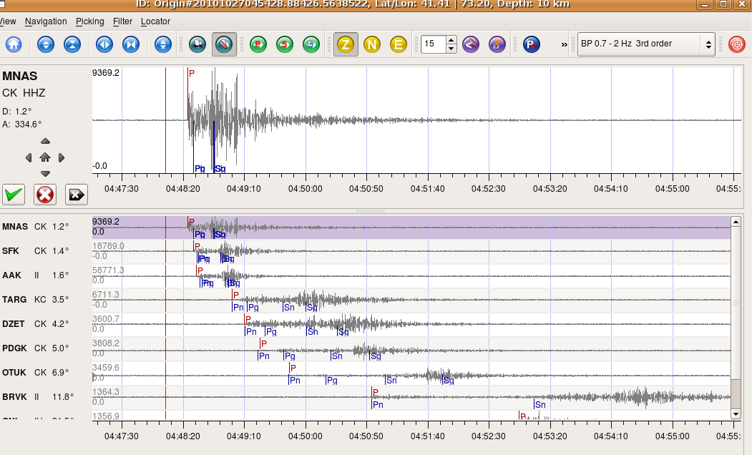
Software SeisComp3 in Data Center
Software SeisComp3 allow acquisition and automatic data processing in a real-time mode.
.

Slide 11


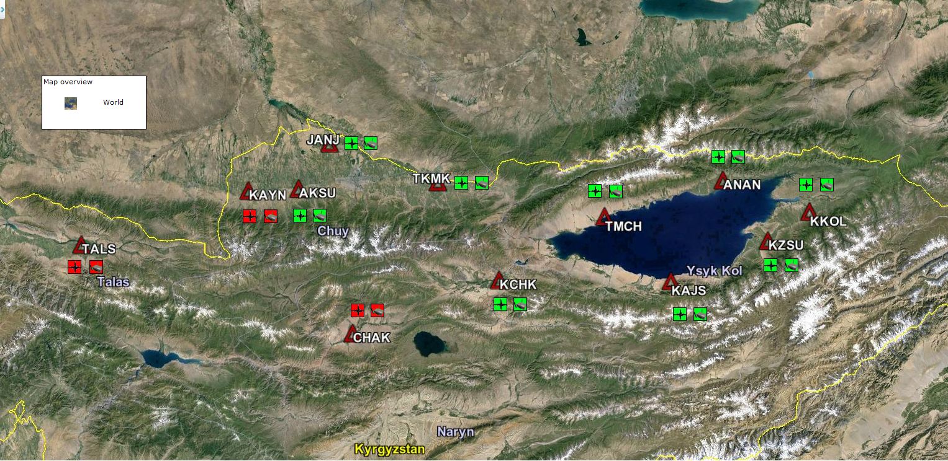
New project: Central Asian Real-Time Strong Motion Network
(ACROSS)
The aim of the ACROSS project is the installation of a permanent real-time strong motion network in Central Asia that can be used, in future, also as the back bone of a regional early warning rapid response system. ACROSS is fully funded by the Helmholtz Association. Partners (GFZ, CAIAG,INGV,MES and others)

Slide 12

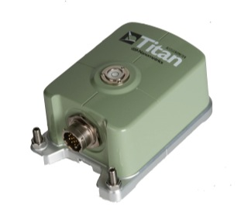

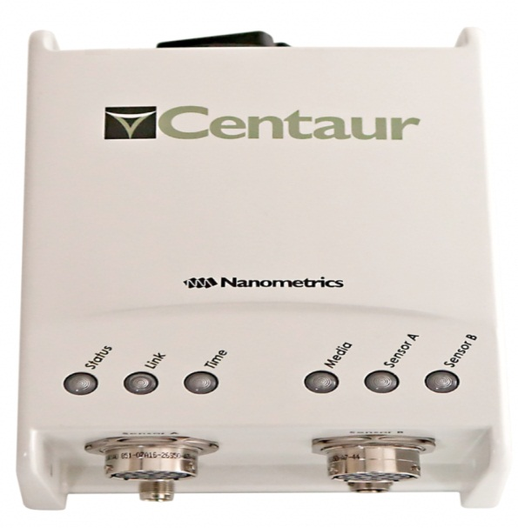
New project: Central Asian Real-Time Strong Motion Network (ACROSS)
Strong Motion Network consist :
Titan 4g accelerometer and Centaur digitizer.
Files written in miniseed format with a frequency of 100 and 200 sps (sample per second) and transmitted via GSM antenna in real time mode to data server.

Slide 13
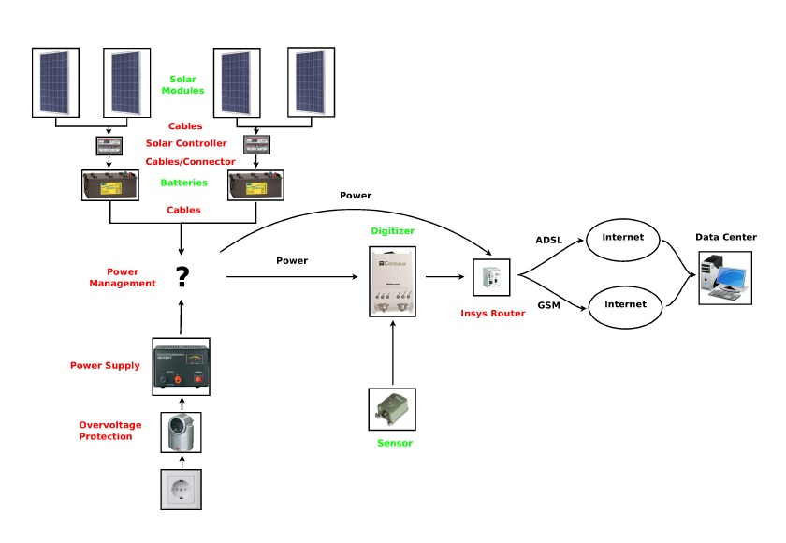
New project: Central Asian Real-Time Strong Motion Network (ACROSS)
Permanent installation

Slide 14

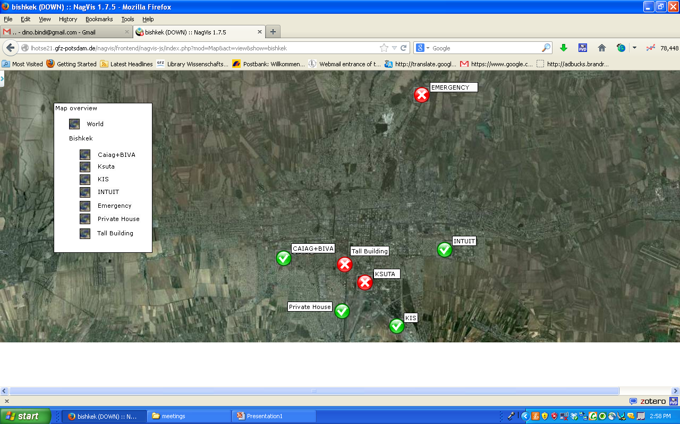
Registration of earthquakes with monitoring network Sosewin network in Bishkek

Slide 15
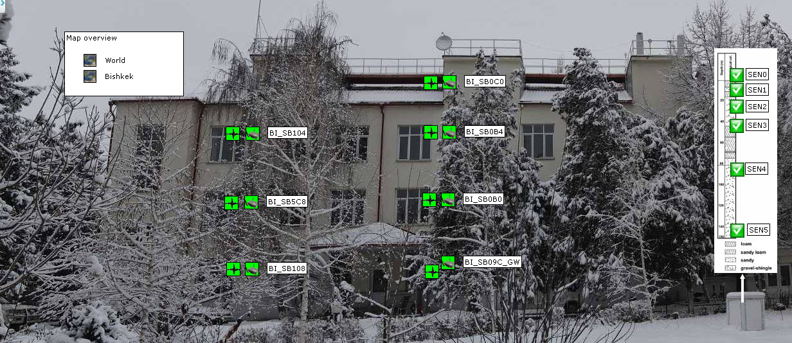
Installed stations
SOSEWIN
(mems)
Vertical Array
(Güralp strong motion)
Notes:
15

Slide 16
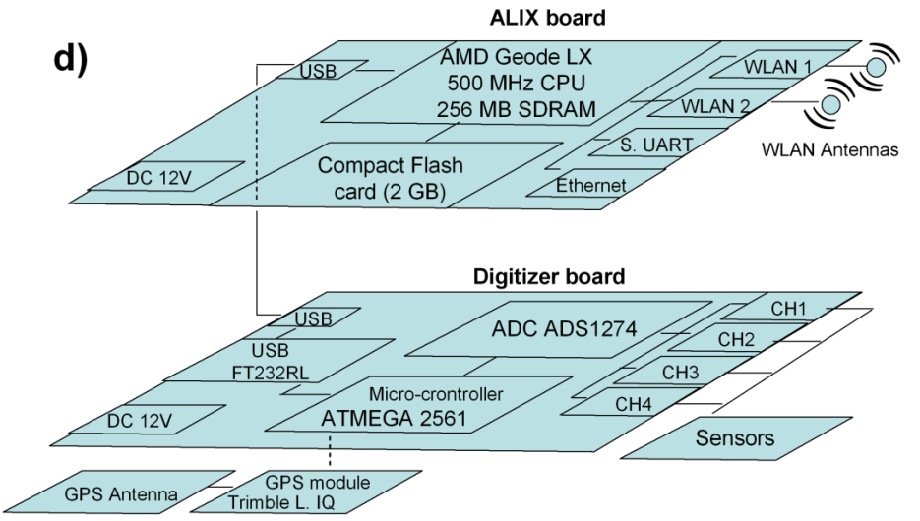
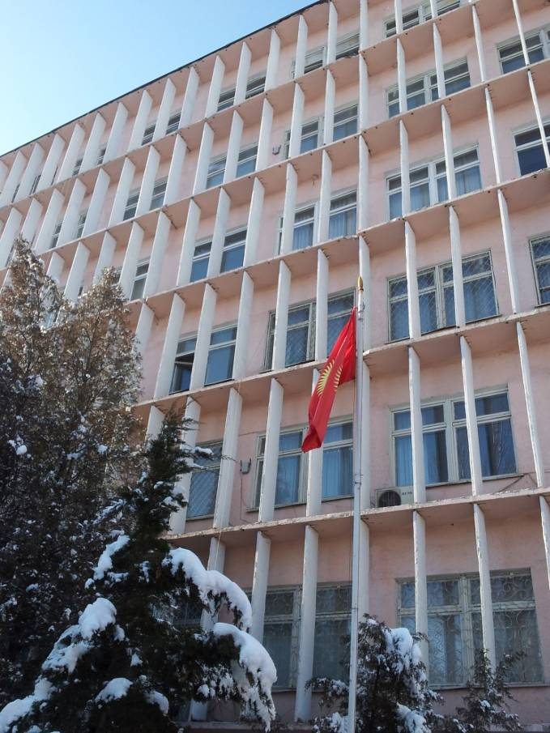
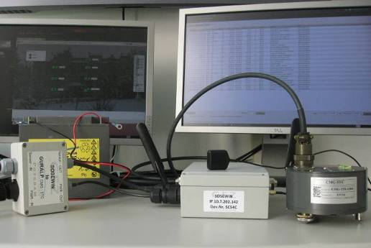
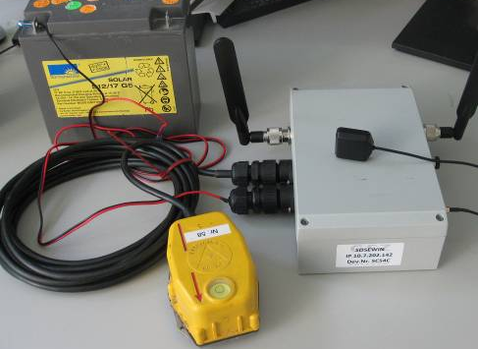
wlan antennas
SOSEWIN node
wifi communicating
FBA-Accelerometer
Power supply
GPS Antenna
LAN connection
Main board
GPS receiver
Geophone
Micro controller
MEMS
One node wired to internet
Notes:
16

Slide 17
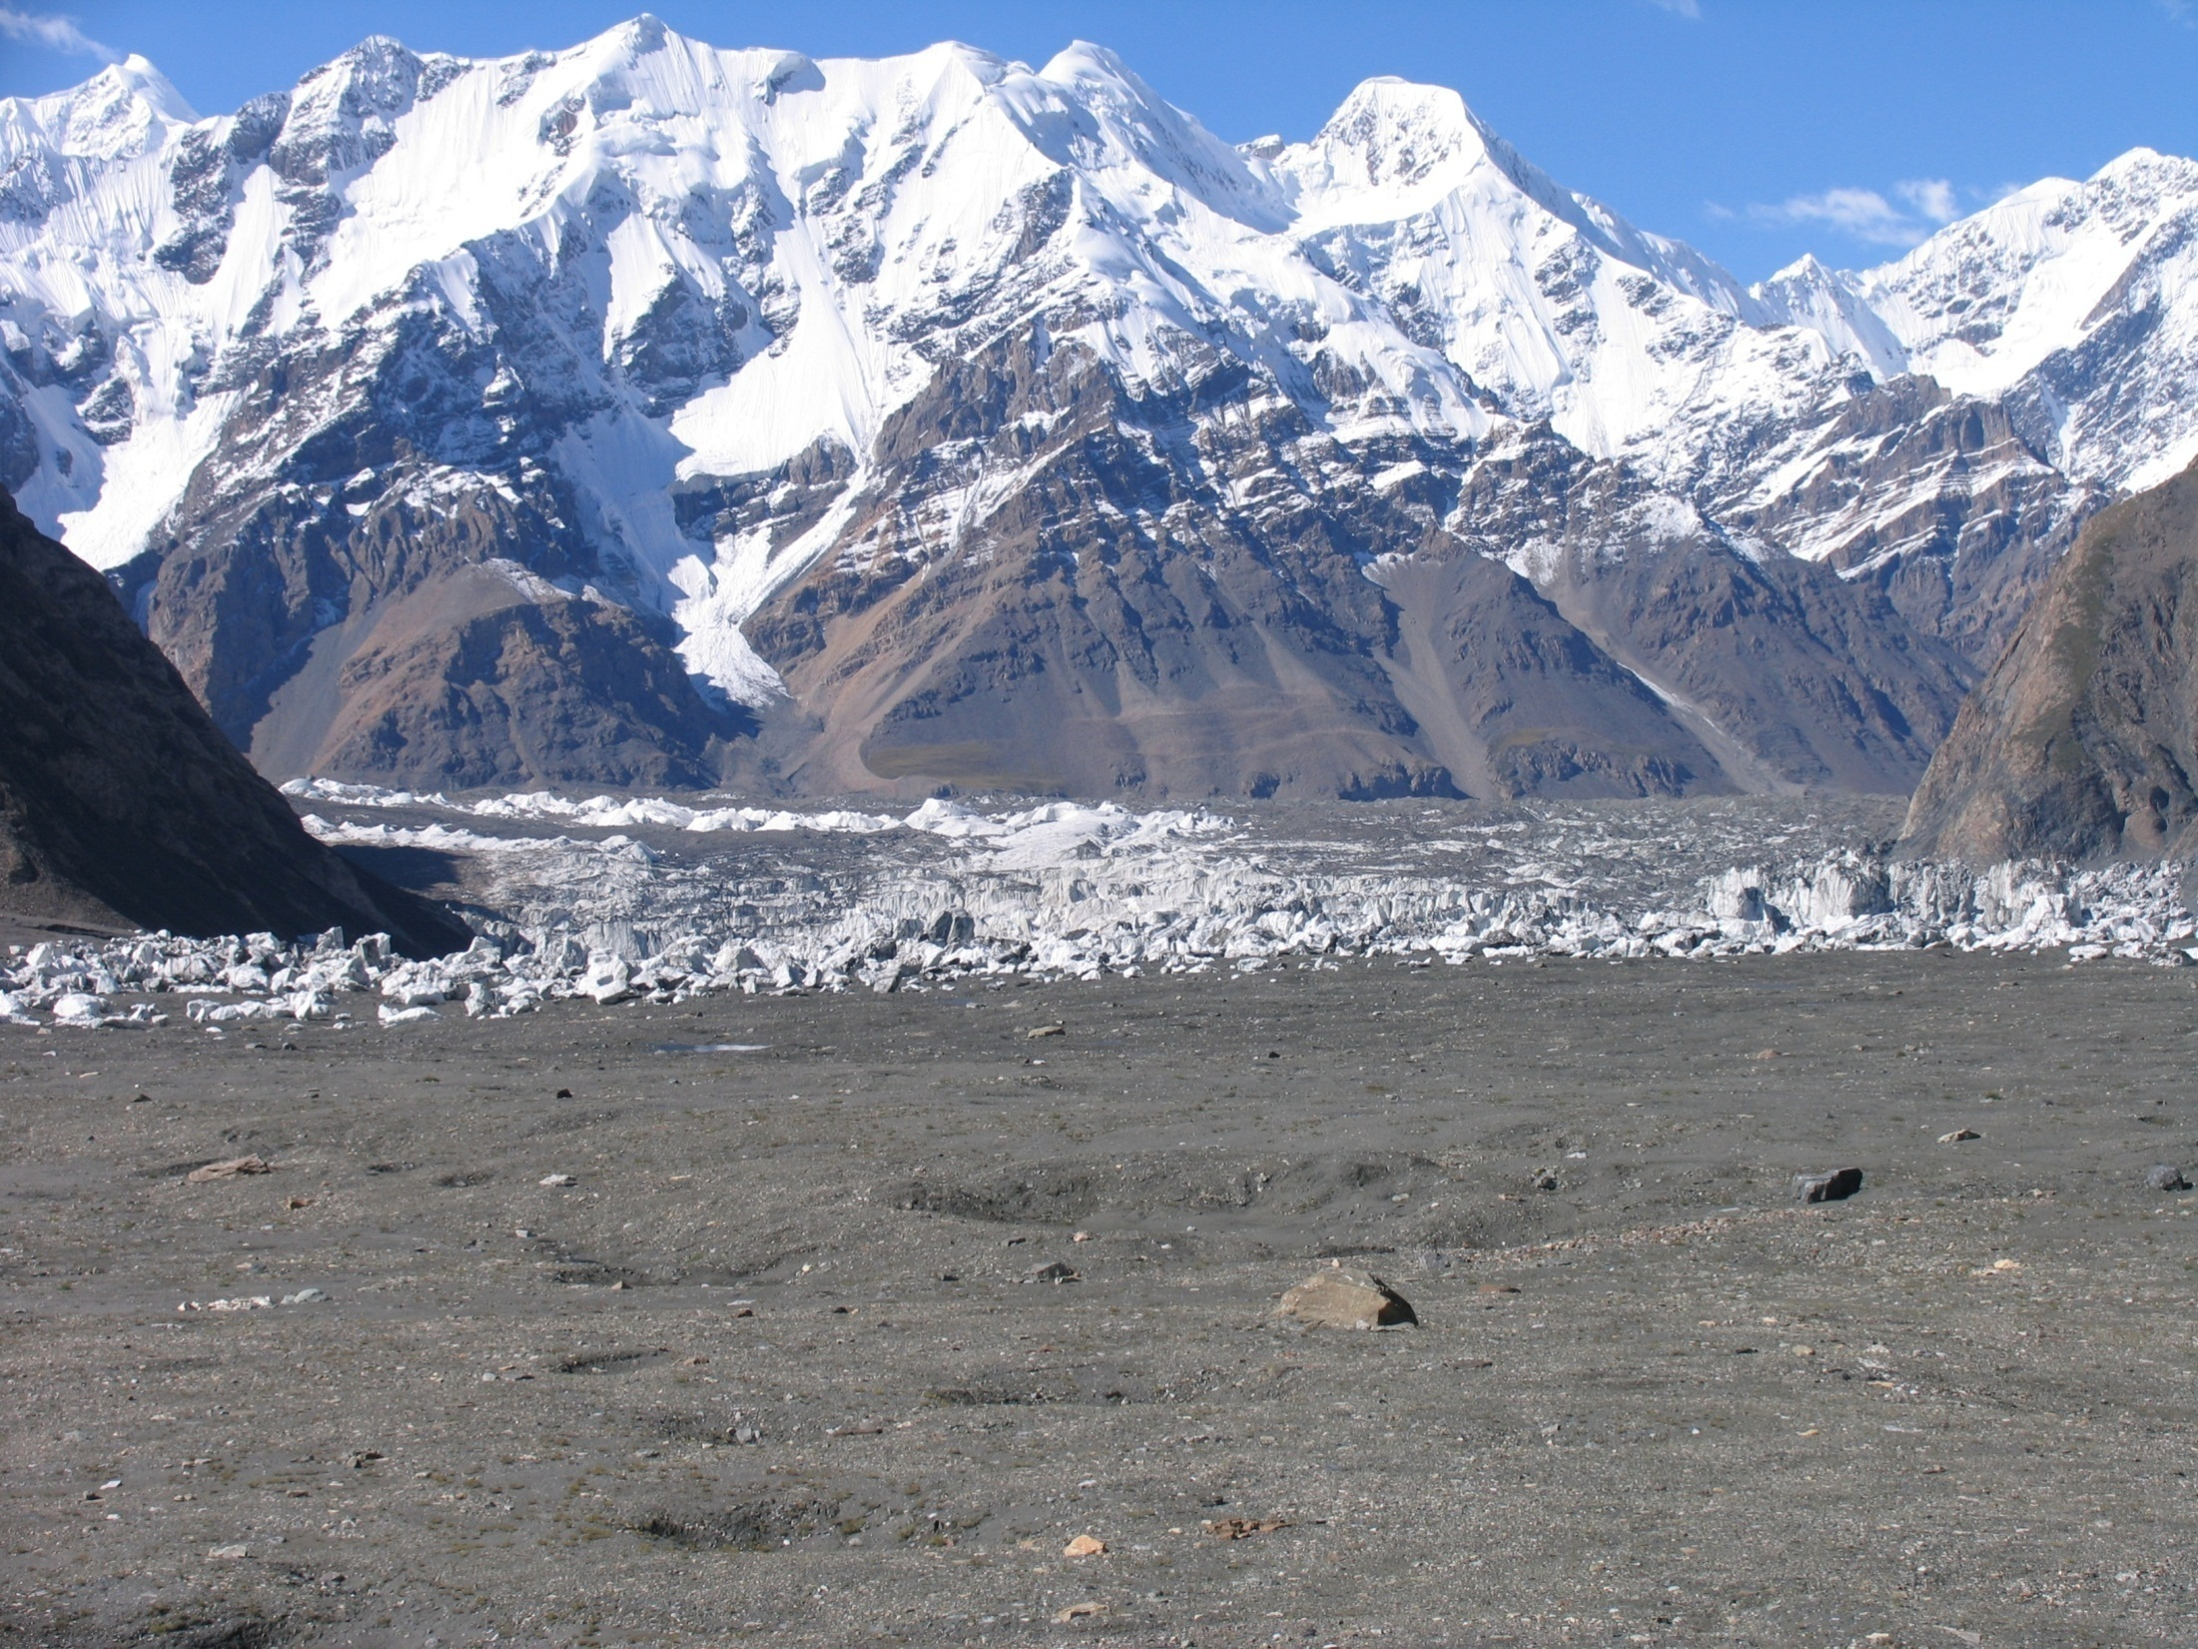
Thanks for attention!
Photo: Enylchek glacier, Kyrgyzstan

