Slide 1
Seismic Monitoring Capabilities of Pakistan
By
Nasir Mahmood, Pakistan

Slide 2
INTRODUCTION
Pakistan lies at marginal collision zone of Indian and Eurasian plates.
Deformation due to this collision has produced complex structures (Faults and Folds)
Earthquakes had colossal devastating impact for the region.

Slide 3
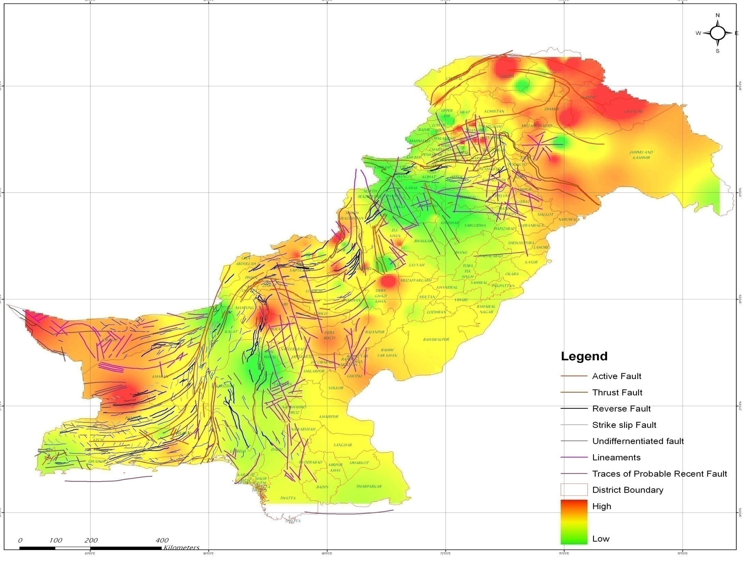
Active Faults in Pakistan

Slide 4
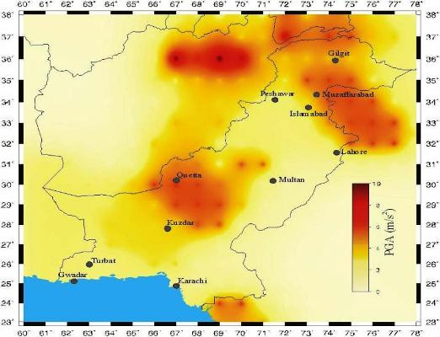
Seismic Hazard Map of Pakistan

Slide 5
Broadband Seismic Network of Pakistan

Slide 6
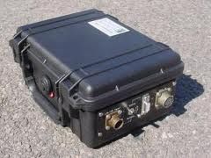
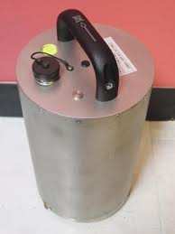
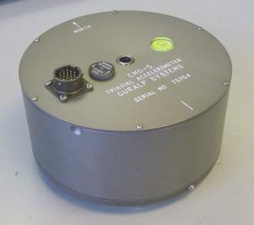
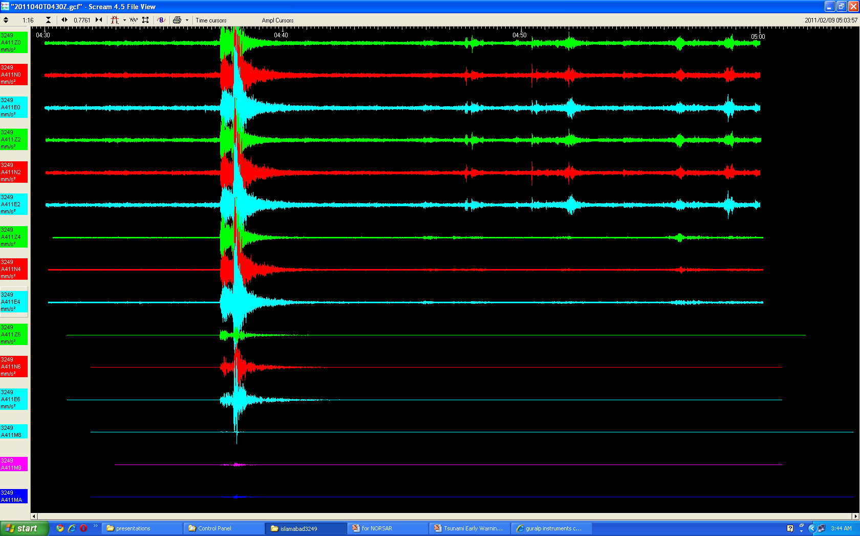
Seismic Network Instrumentation
Guralp Sensors (CMG-3T, 120s) and Digitizer (24bit)
Wave form out put from Guralp instrument

Slide 7
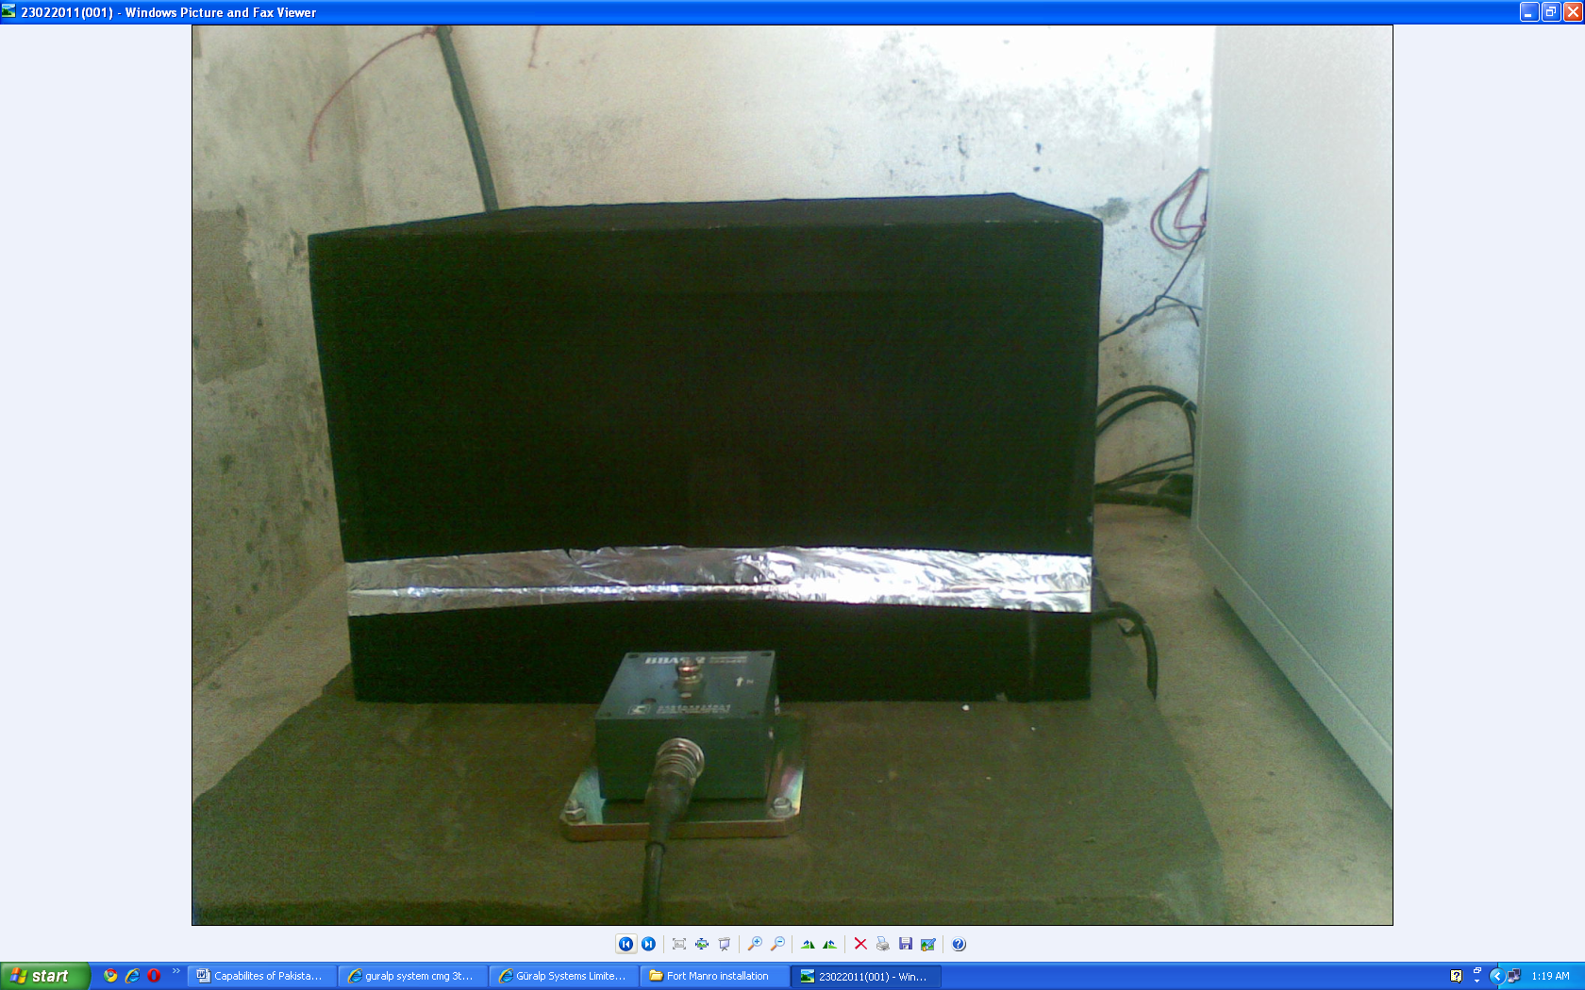
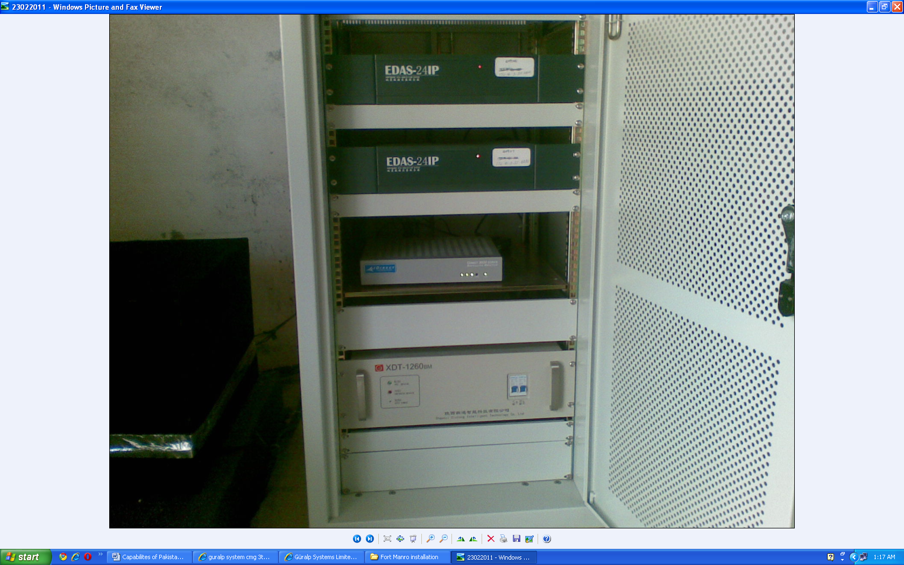
Seismic Network Instrumentation
Geo-Device Sensors and Digitizer at station

Slide 8
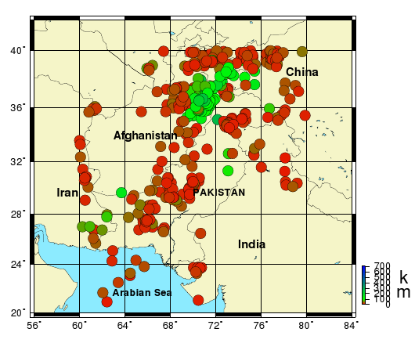
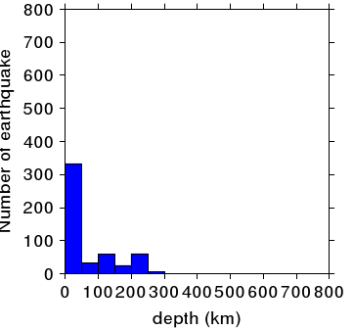
Seismic Activities in Pakistan

Slide 9
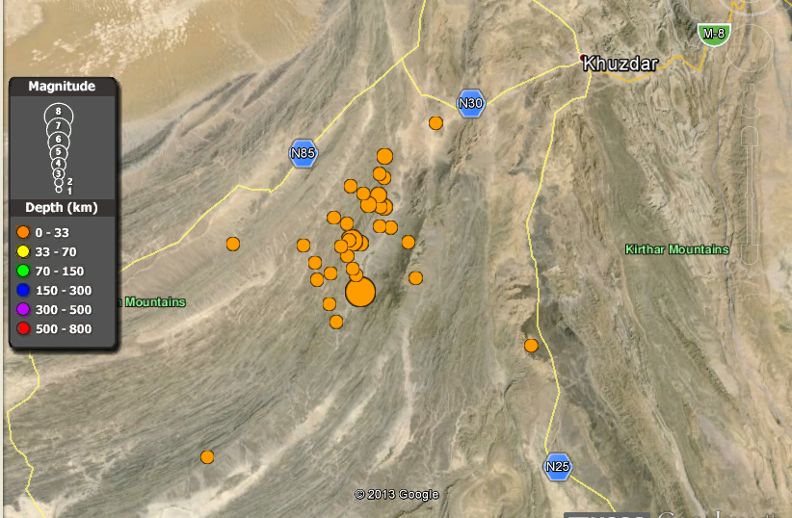
Seismic Activities in Pakistan
M 7.2
AWARAN
M 7.7
AWARAN Earthquake Pakistan M 7.7 dated 24-09-2013

Slide 10
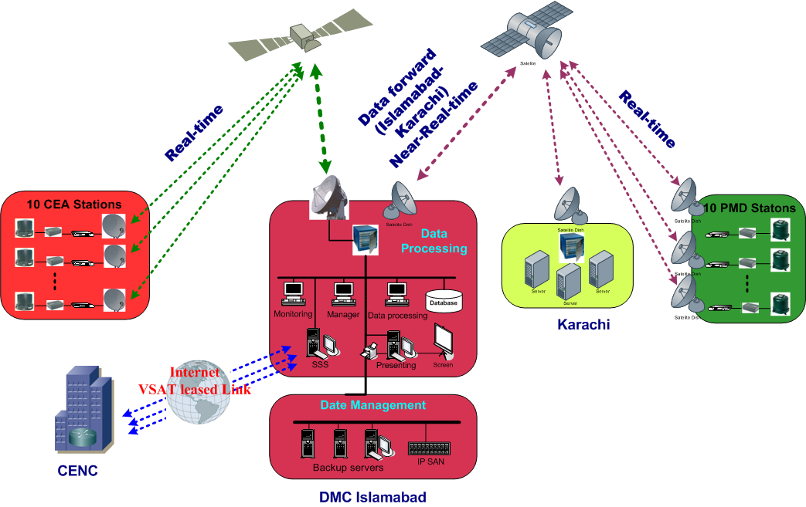
Satellite Communication System

Slide 11
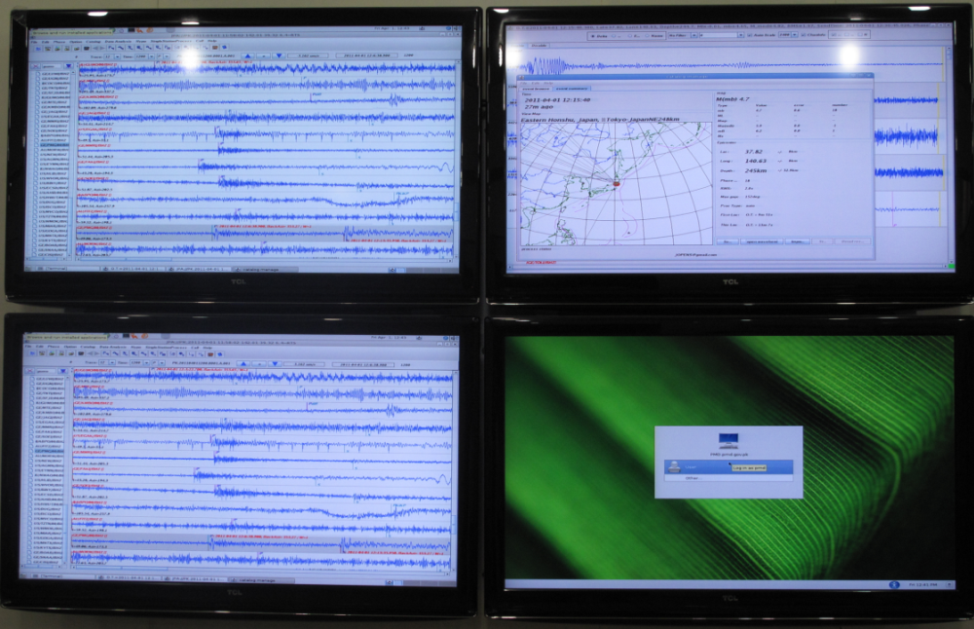
Realtime Earthquake Analysis
Includes 20 Pakistani Stations
100 BB international stations
Earthquake Analysis Results

Slide 12
SEISCOMP3 Analysis System

Slide 13
THANK YOU

