Slide 1
Understanding SEED Headers

Slide 2
What is SEED?
SEED is an international standard for the exchange of digital seismological data
SEED was designed for use by the earthquake research community, primarily for the exchange between institutions of unprocessed earth motion data
SEED is a format for digital data measured at one point in space and at equal intervals of time.
Standard for the Exchange of Earthquake Data

Slide 3
SEED History
<1985 IDA, GDSN ….
1985 IASPEI Commission on Practice
working group on digital data exchange
FDSN (International Federation of Digital Seismograph Networks)
1987 FDSN draft Standard developed by USGS
1988 FDSN Official Release (version 2.0)
1990 Version 2.1 (indexing, improved cross references)
1991 Version 2.2 (dataless SEED)
1992 version 2.3 (miniSEED, FDSN Network Codes)
2004 Version 2.4 (data quality type code)
2012 FDSN StationXML (SEED + more, in XML)
SEED is changing from a full SEED file (metadata & miniSEED) to decoupled metadata in StationXML format and time series in miniSEED

Slide 4
SEED in Practice
Recordings of digital time series data (seismic waveforms)
Exchange of waveform data (Real time, archive)
Archiving of digital waveform data (global to local)
Storage of metadata
information about the data, e.g. station information, sensor
End user ( analysis software)
Exceptions
Not for non-time series data
Not for unequal time-interval sampled data (except logs)
Parametric data possible (e.g. phase readings) but rarely used;
IASPEI Seismic Format
QuakeML

Slide 5
SEED Reference Manual

Slide 6
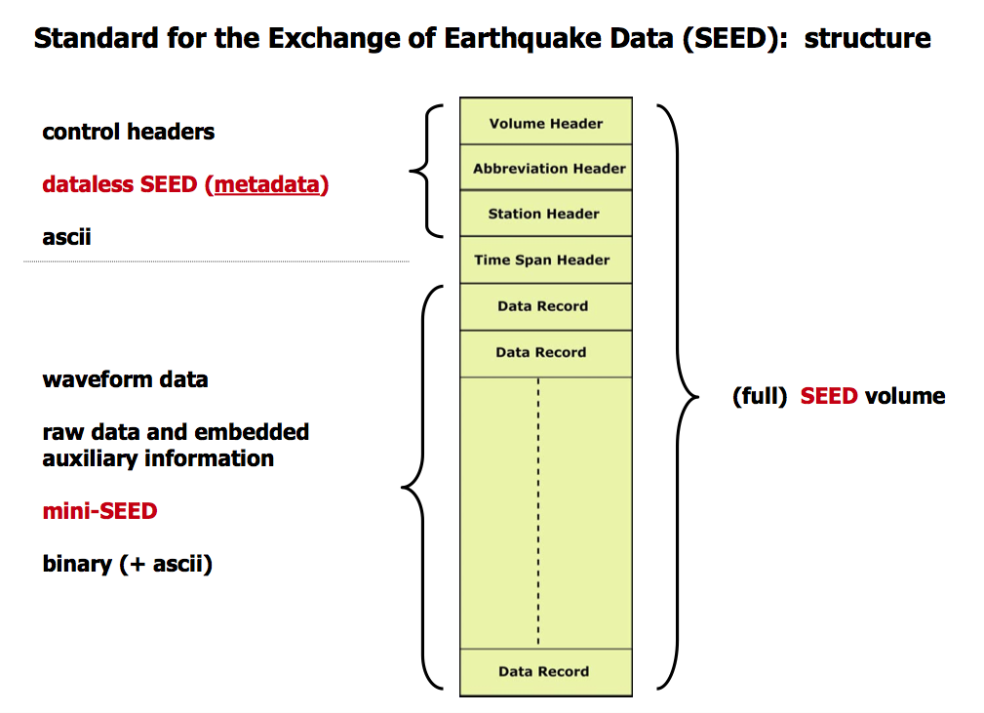
SEED: Structure

Slide 7
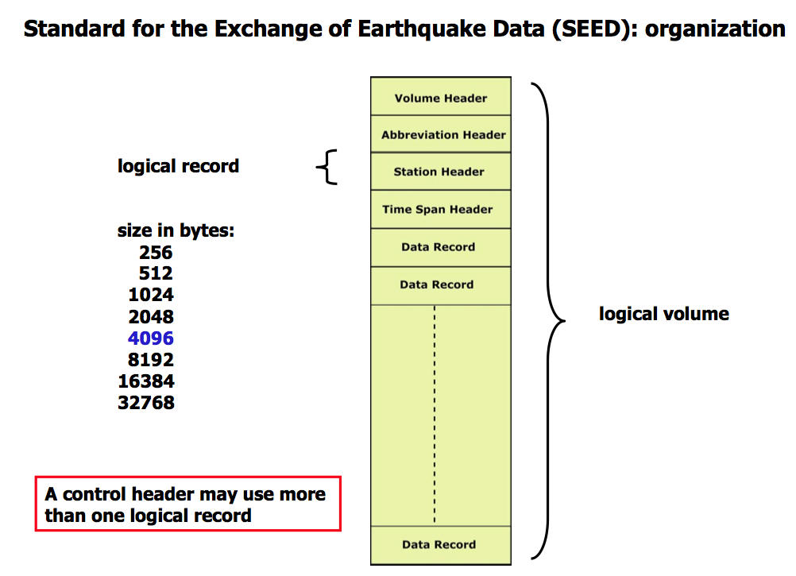
SEED:Organization

Slide 8
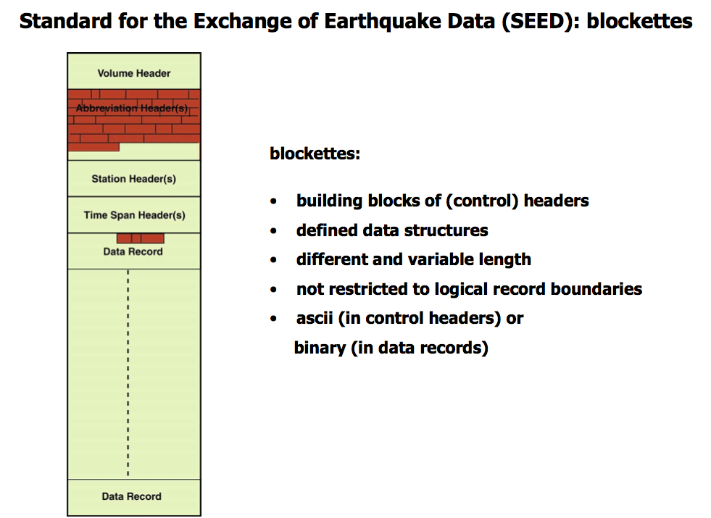
SEED: Blockettes

Slide 9
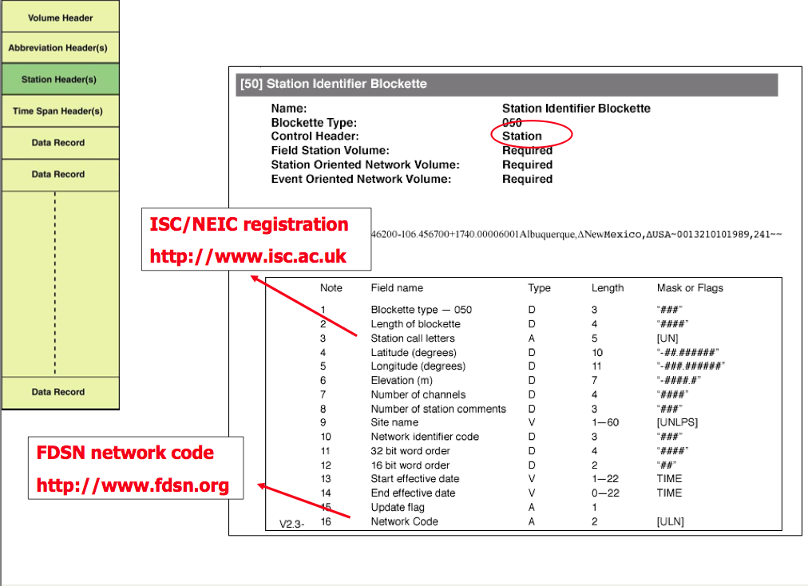
SEED: Station Header

Slide 10
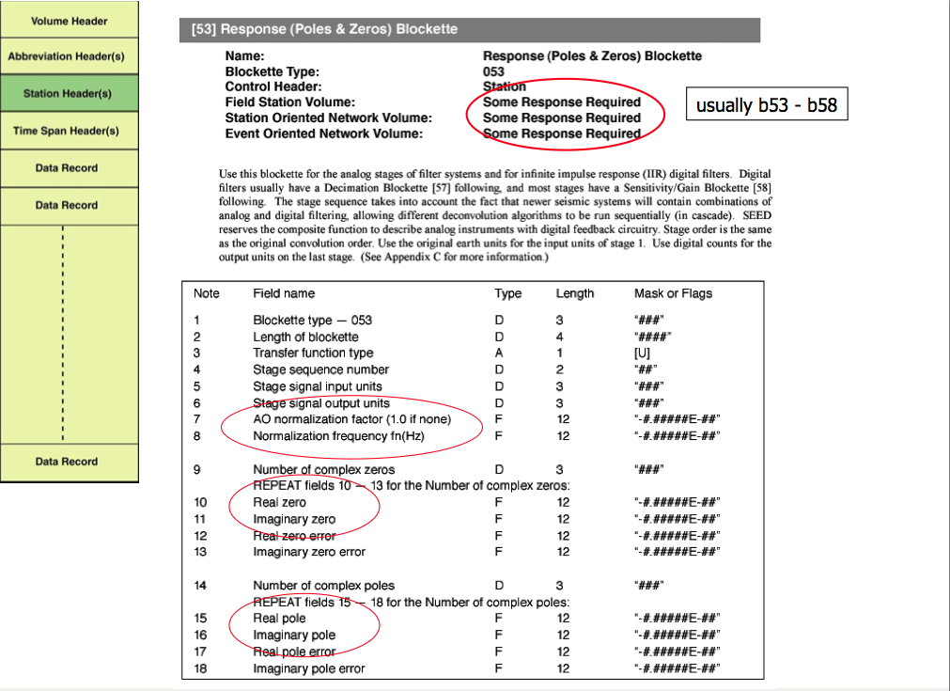
SEED: Responses

Slide 11
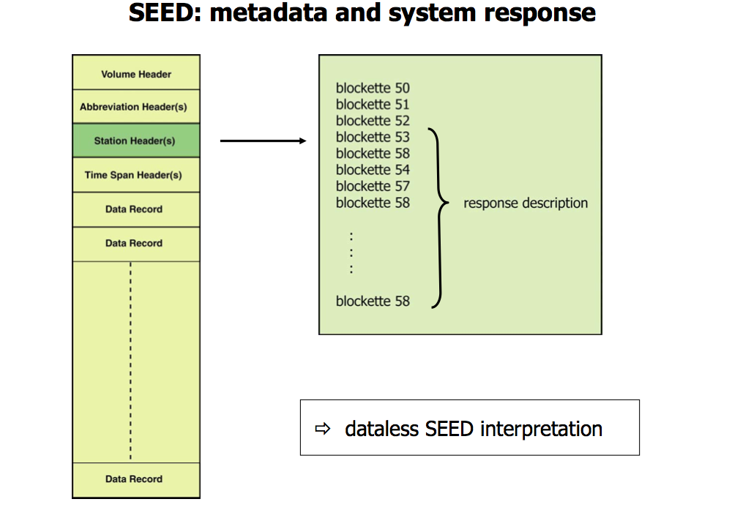
SEED: Stage Cascades

Slide 12
SEED: System Representation

Slide 13
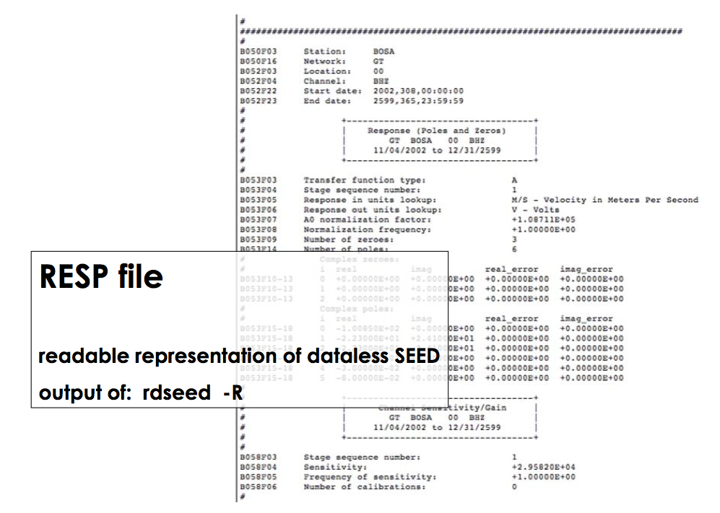
SEED: RESP Files

Slide 14
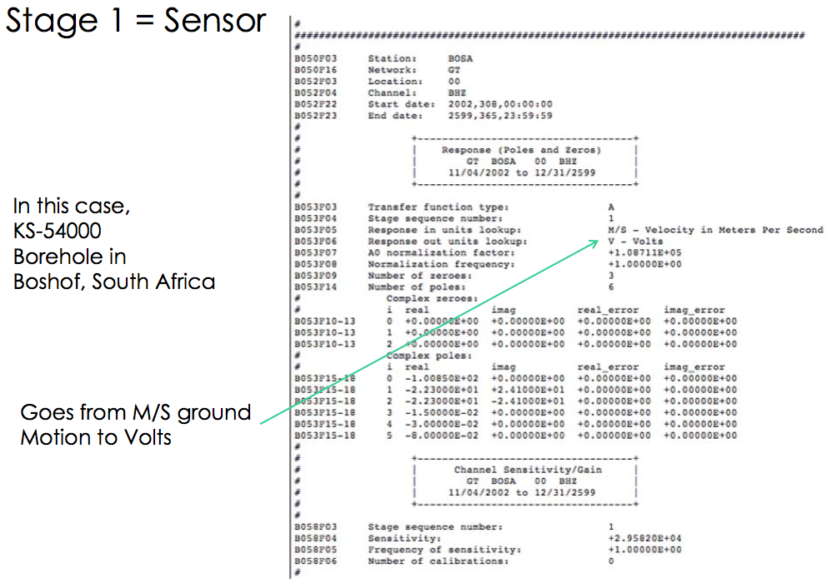
SEED: Sensor

Slide 15
SEED: Data Logger - Preamp

Slide 16
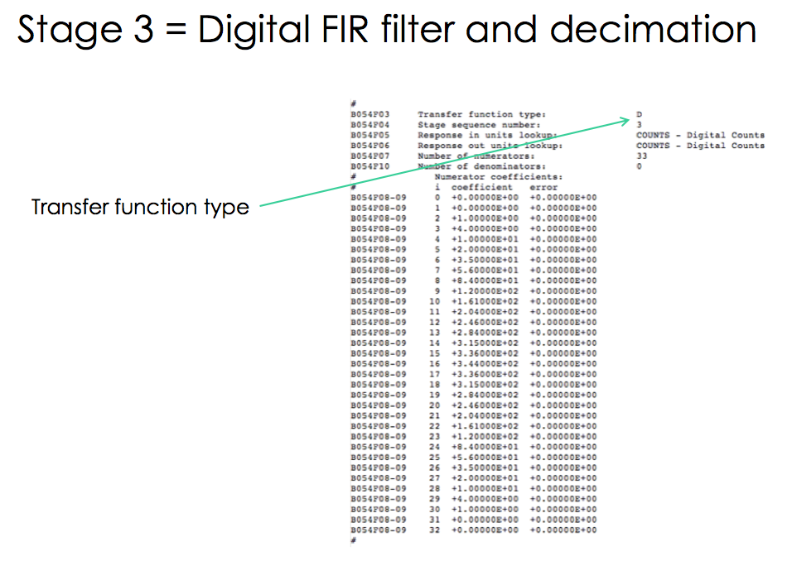
SEED: Data Logger – FIR Filters

Slide 17
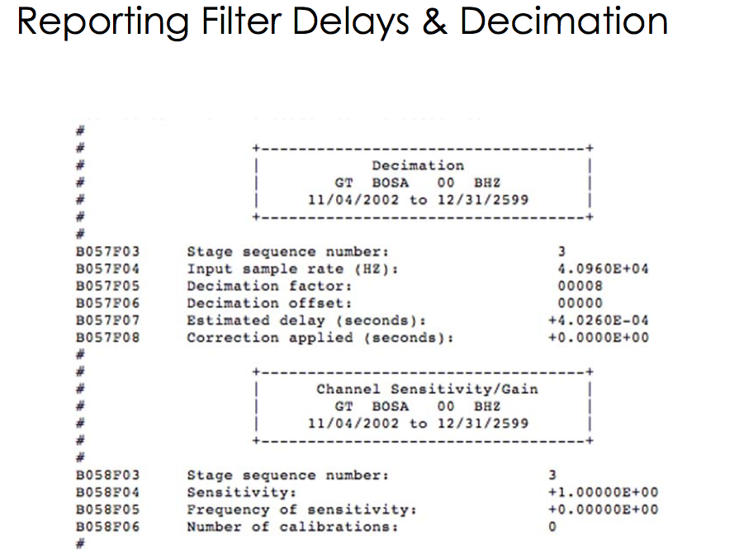
SEED: Filter Delays & Decimation

Slide 18
SEED: Overall Gain

Slide 19
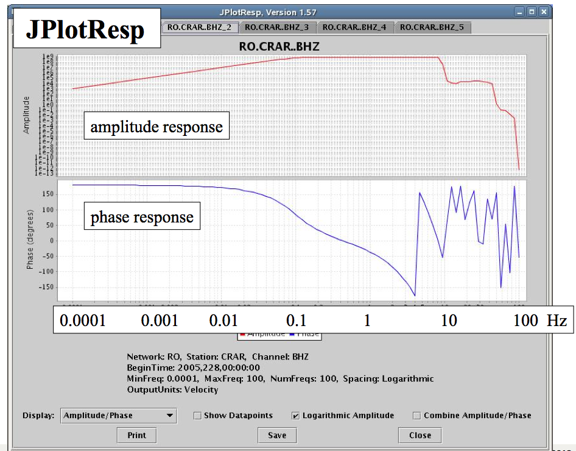
SEED: Overall Gain

Slide 20
SEED: StationXML
XML
Stands for Extensible Markup Language
Designed to transport, carry and store data
HTML was designed to display data
XML is a markup language much like HTML
XML tags are not predefined. You must define your own tags
XML is designed to be self-descriptive
XML is a W3C Recommendation
The purpose of the FDSN Station XML schema is to define an XML representation of the most important and
commonly used structures of SEED 2.4 metadata & in the future move to a more flexible metadata representation.

Slide 21
StationXML – replacing dataless SEED
Mapping between SEED 2.4 dataless SEED volumes this XML schema is possible
Simplifying station metadata presentation and adding important details that are lacking in SEED
Definitions and usage remain clarified in the SEED manual
Schema is a collaborative work between Caltech, IRIS DMC, GFZ, and NEIC and has been adopted by FDSN WG-II

Slide 22
Advantages of StationXML
Self Describing data
Integration of traditional databases and formats
XML documents support all types of data
Data presentation modifications; XML style sheets can be used to modify documents or websites without modifying actual data
One Server View; data from different databases and multiple servers can be a part of an XML document
Internationalization; multilingual documents and Unicode standards are supported by XML
Open and extensible; the XML structure is adaptable and can be modified to match specific community needs. Users can add elements when needed
Future oriented technology; the W3C has endorsed XML, which is supported by major software providers

Slide 23
Current and next version
Current version of StationXML
http://www.fdsn.org/xml/station/
Current version SttionXML 1.0
Schema definition
Differences between SEED2.4 and StationXML 1.0
StationXML version 1.1
Inclusion of Digital Object Identifiers
Versioning of metadata and waveform data
JSON output formats

