Slide 1
The Global Seismographic Network (GSN) Katrin Hafner IRIS GSN Program Manager Peter Davis, International Deployment of Accelerometers (IDA), IGPP David Wilson, Albuquerque Seismological (ASL), USGS
October 23, 2017
Baku, Azerbaijan

Slide 2
PARTNERSHIP between NSF, USGS & IRIS

Slide 3
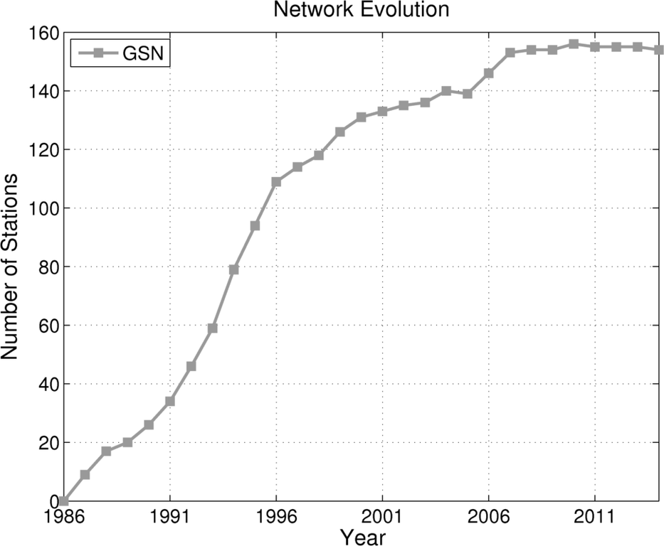
EVOLUTION OF THE GSN
GSN DESIGN GOALS
150+ stations with a Global distribution
at ~ 2000 km spacing
High dynamic range
Very Broadband (hrs to ~10 Hz)
Quiet instruments / sites / installations
Real-time telemetry

Slide 4
GSN PARTNERSHIPS
GSN is a PARTNERSHIP – NSF, USGS & IRIS
Other US government contributions have bolstered support
and reinvestment in the GSN for its multi-use capabilities
Dept of Defense Dept of Energy Dept of State
NATIONAL PARTNERSHIPS
NOAA, NEIC, PTWC, NTWC – assist with data flow & delivery
INTERNATIONAL PARTNERSHIPS
Host Country partnerships - Over 70 existing MOUs between foreign governments, private entities & universities;
Long-standing relationships between network operators and local personnel
International Federation of Digital Seismograph Networks (FDSN)

Slide 5
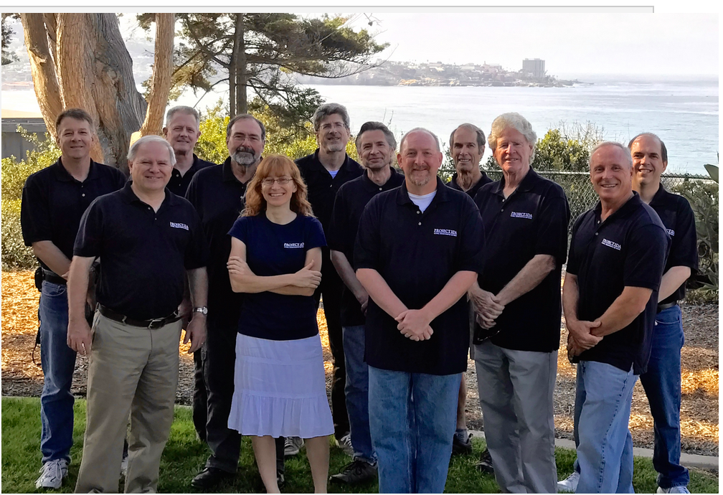
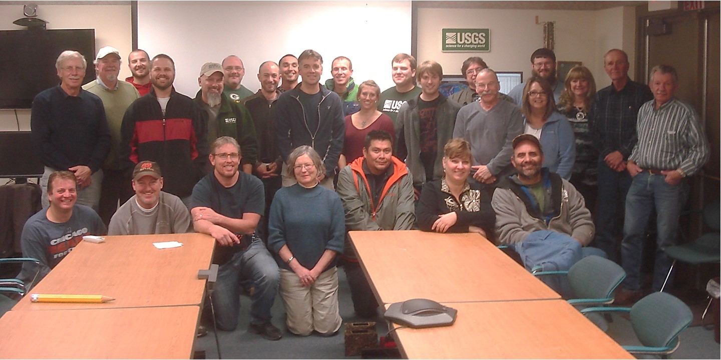
GSN OPERATIONS– DUAL OPERATORS
IRIS/IDA
Operates ~ 39 stations
DCC at UCSD
ships data to the IRIS DMC
USGS/ASL
Operates ~100 stations
DCC at USGS/NEIC
ships data to the IRIS DMC

Slide 6
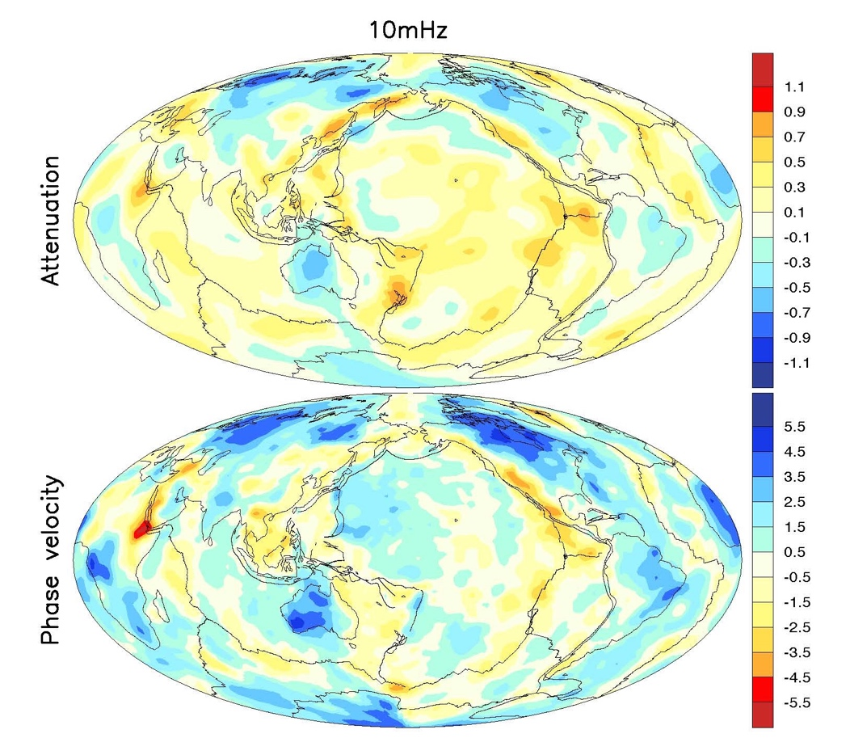
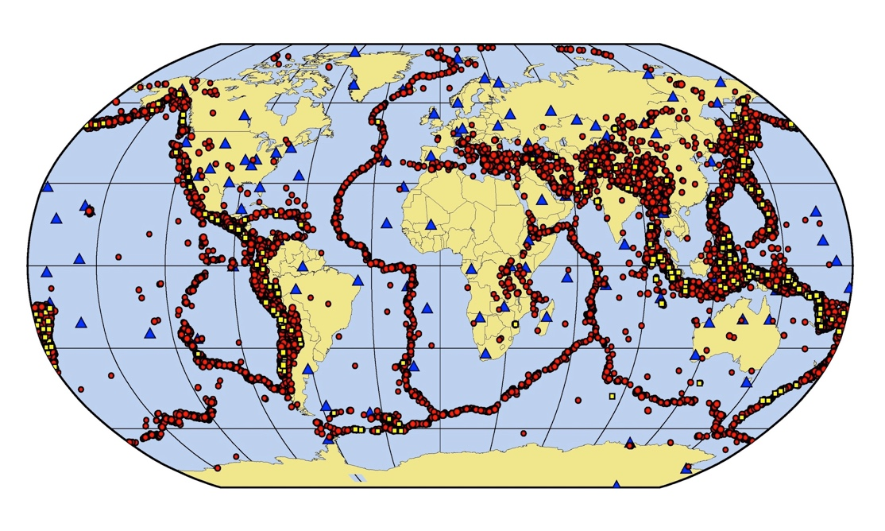
MULTI-USE SEISMIC NETWORK
GLOBAL EARTHQUAKE MONITORING
Large earthquakes (circles) recorded
by the GSN stations (2008-2016)
Black - magnitude 5.0 - 5.9
Red-magnitude 6.0 – 6.9
Yellow Magnitude 7+
Ma, Z., Masters, G. and Mancinelli, N. (2016)
FUNDAMENTAL RESEARCH
Global Tomography Studies
Notes:
GSN is fundamentally important for scientific discovery in earth sciences; earth structure and dynamics of the earth’s interior
Physics of great earthquakes (e.g. the M>9 Sumatra and Japan earthquakes and tsunamis. Has provided decade long high quality recordings.
Cornerstone facility for seismology
Isocontours of mantle plumes identified using waveform modeling of GSN data. A few weeks ago in Nature → GSN still enabling cutting edge science!

Slide 7
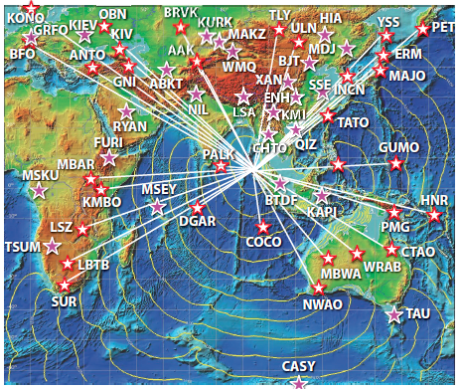
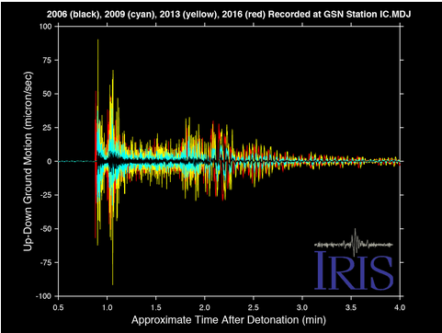
OTHER APPLICATIONS OF GSN DATA
Verification seismology (CTBTO)
~50 auxiliary seismic stations are contributed by GSN
to nuclear explosion monitoring
GSN stations used in real-time Tsunami Warning for the Magnitude 9.1 Sumatra-Andaman Earthquake.
Tsunami warning
~100 GSN stations are used for real-time analyses by the NTWC; coverage in oceans and international areas is key – sparse coverage by other networks
Seismograms of Korean nuclear explosions
recorded on GSN station MDJ

Slide 8
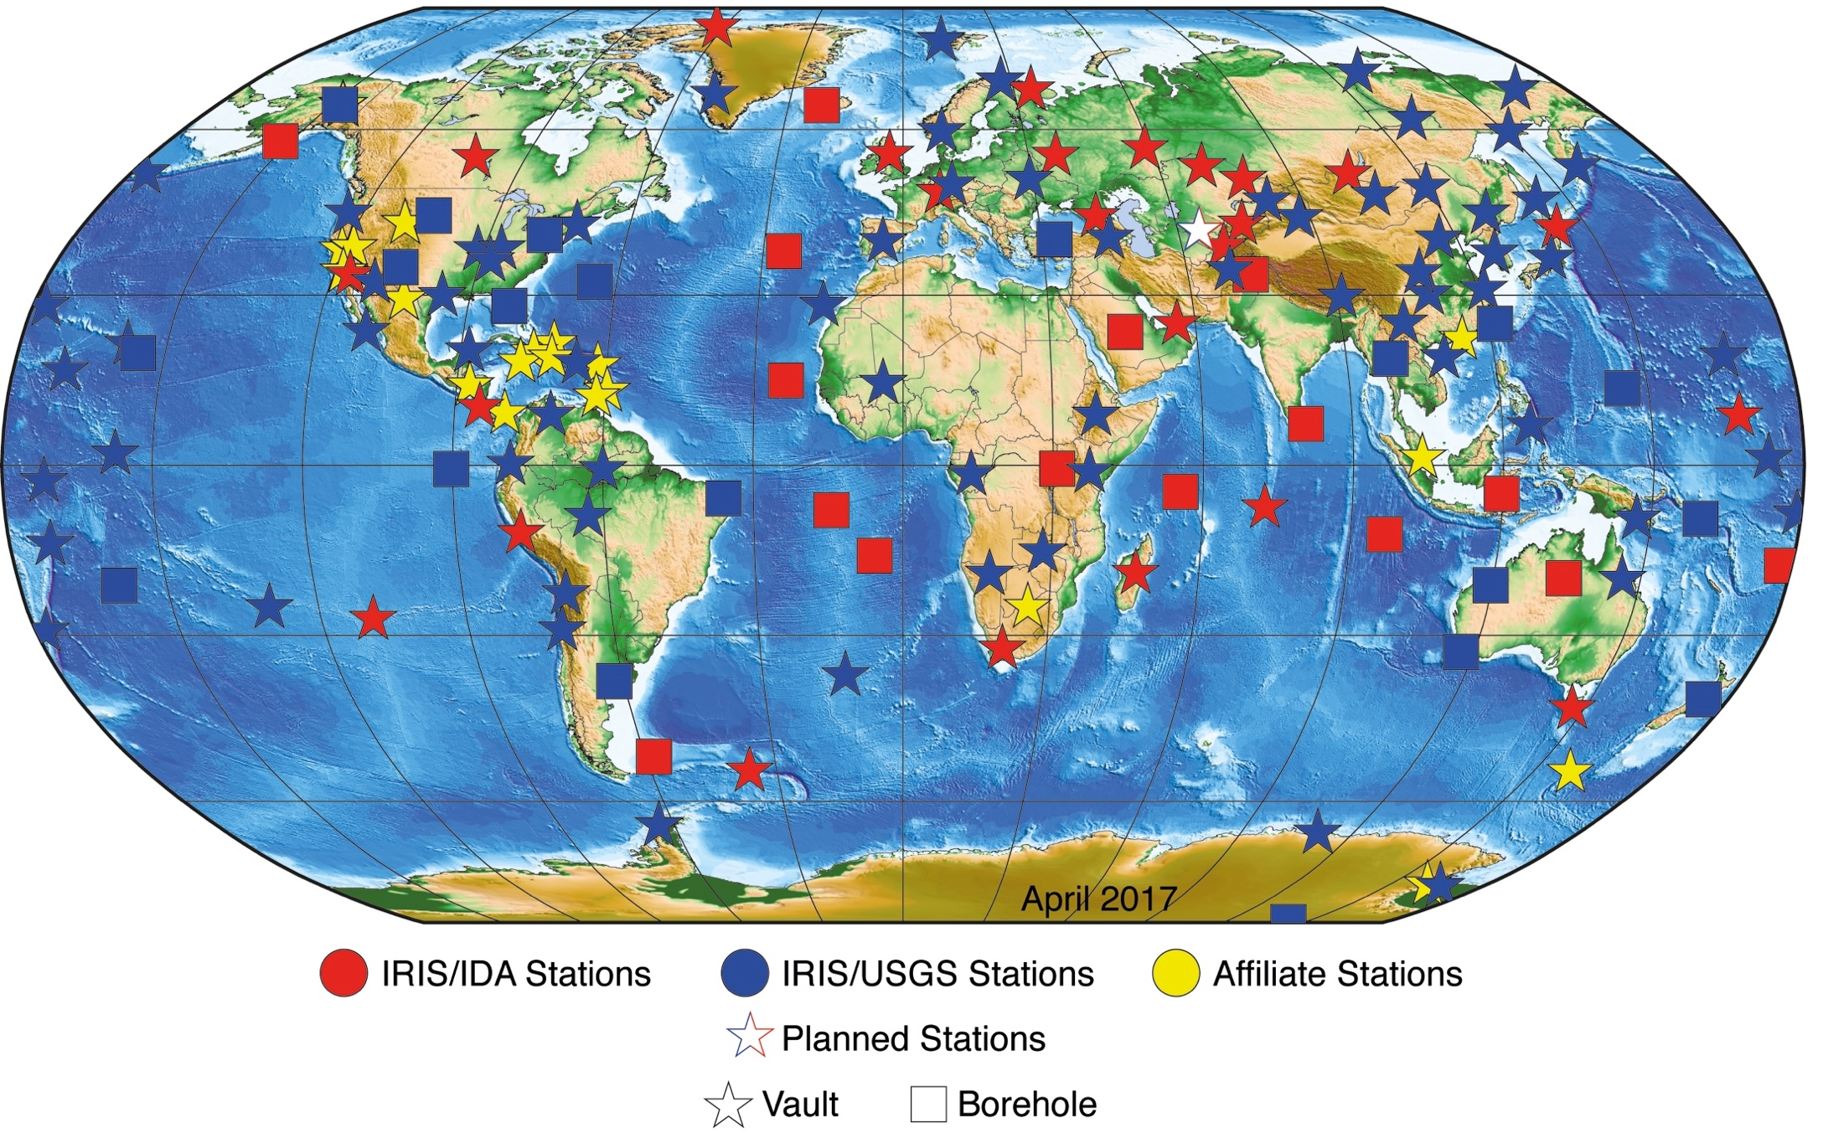
INSTALLATIONS: BOREHOLES & VAULTS

Slide 9
TYPICAL GSN STATIONS

Slide 10
GSN DESIGN GOALS
“a global network of uniformly spaced stations (~2000 km spacing”), capable of recording the full range of seismic signals, with data collection in real time”
Notes:
Original design goals were : a global network of uniformly spaced stations, capable of recording the full range of seismic signals in real time. The GSN deploys multiple sensors at each station in order to
meet the network’s very broad frequency band and high dynamic
range design goals. No single seismic sensor can currently
capture all signals of interest.
The primary (very broadband) seismometers used to capture
long period (< 0.003Hz) free oscillations and teleseismic
body and surface waves are paired in secondary (broadband
sensors that record high-frequency (> 10 Hz) regional
signals.)

Slide 11
NEXT GENERATION OF VBB SENSORS
The GSN primary sensors are nearly 20 years old and are no longer manufactured.
Over the last several years, the GSN has been working with Equipment Vendors on
the development of the next generation of very broadband sensors.
Notes:
The GSN has recently purchased a suite of new VBB borehole sensors to replace the failing old KS-54000 borehole sensors. The results of recent testing of these sensors indicates that they meet the GSN specifications.

Slide 12
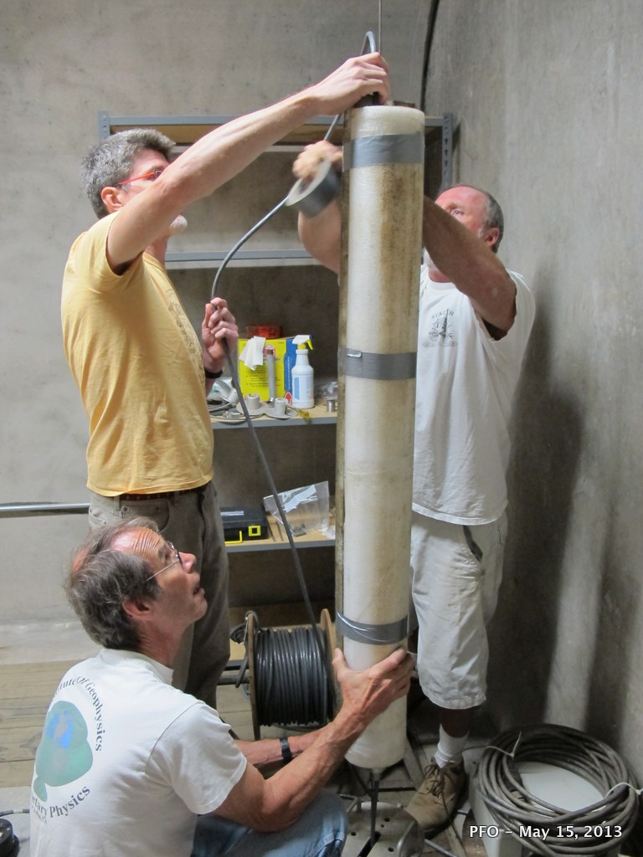
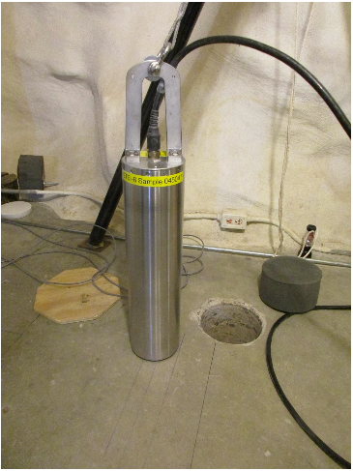
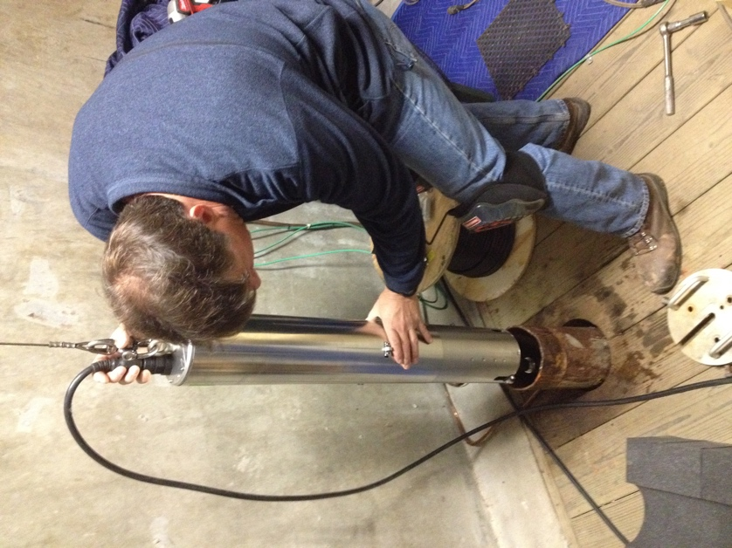
NEW VBB BOREHOLE SENSORS
Streckeisen STS-6A
Nanometrics Trillium T360
Original GSN VBB Borehole Sensor
KS54000
The smaller size reduces the number of field engineers required to deploy the instruments, and also allows for the deployment in shallow boreholes or postholes
Notes:
One important need identified by the review committee was maintaining state-of-the-art equipment in the GSN. A high priority has been replacement of the aging KS54000 borehole sensors at about 40 of the GSN sites. Progress continues on this front, part of a $5.2M interagency agreement between the DOE and USGS that IRIS helped facilitate. The first prototype VBB borehole sensor was delivered by Kinemetrics to the USGS Albuquerque Seismic Laboratory (ASL) last Fall and installed in December 2015. Testing at ASL showed that this prototype met all of the required specifications. The second phase of the project is underway with the anticipated delivery of three pre-production units in summer 2016. The USGS also received an additional $1.6M from Congress in its FY16 budget. These funds are designated for GSN infrastructure improvements and VBB borehole sensor deployments.

Slide 13
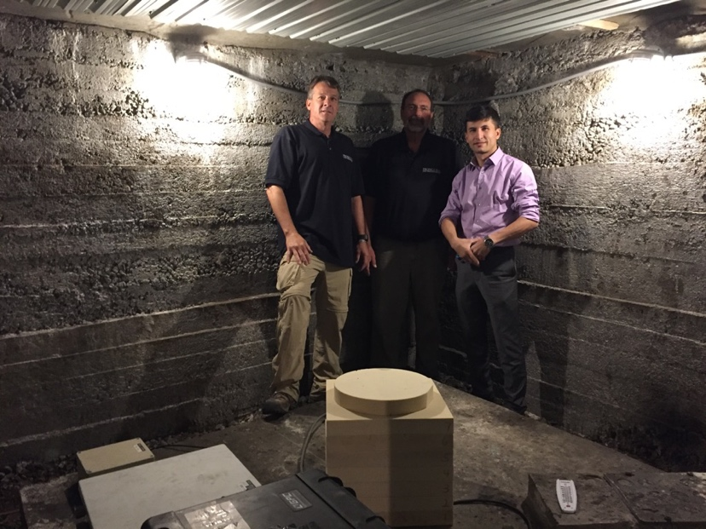
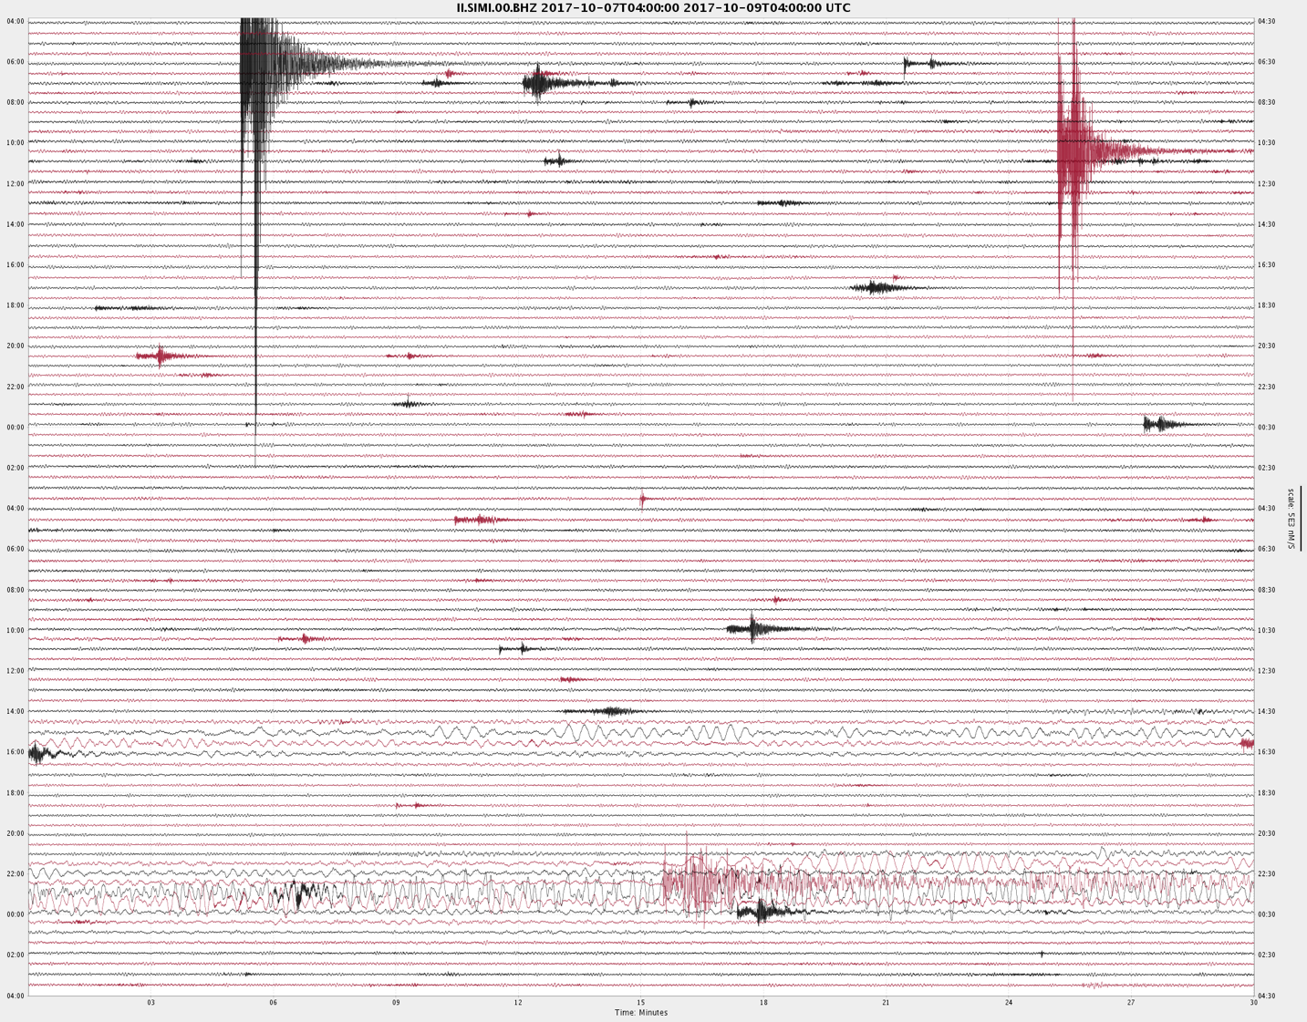
GSN-DOE-TAJIKISTAN COLLABORATION
GSN Affiliate Station II.SIMI
Transitioned to operation by Tajikistan Institute
Of Geology, Earthquake Engineering and Seismology
Representatives of the Geophysical Service and
Institute of Geology, Earthquake Engineering and Seismology
located in a tunnel on a former geophysical observatory site approximately 20 km NE of Dushanbe

Slide 14
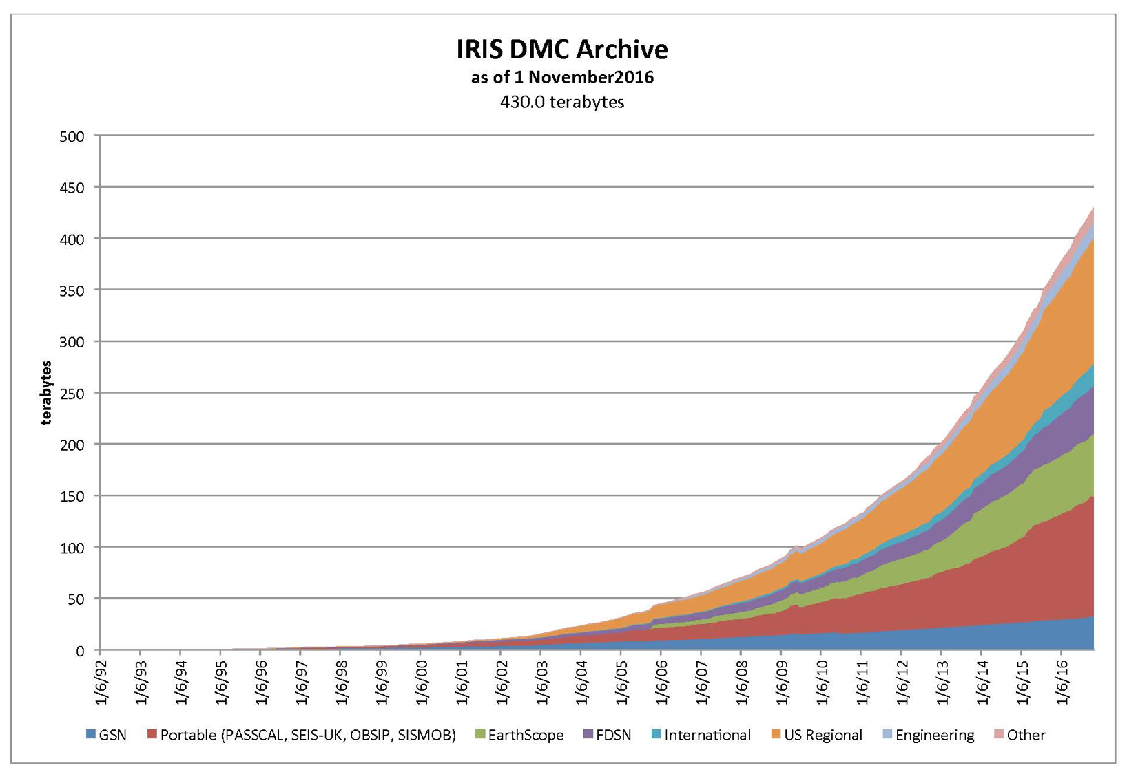
GSN DATA STORED & DISTRIBUTED at IRIS DMC
GSN data
1992
2016
All data are free and openly available!!
Notes:
An important part of IRIS’ success over the years has been its commitment to free and open exchange of data. The size of the IRIS data archive continues to grow exponentially, now totaling about 400 Tb.
To manage these incredible data volumes, IRIS has pioneered data discovery & access enabled through webservice and batch mode interface; in the coming year we will be exploring utilizing cloud services in managing these data

Slide 15
ADDITIONAL INFORMATION
THANK YOU
http://www.iris.edu/hq/programs/gsn
hafner@iris.edu

Slide 16
EQUIPMENT AT GSN STATIONS
Typical Instrumentation at GSN Stations

