Slide 1
Network reports
Laura Hutchinson, IRIS DMC

Slide 2
What are Network Reports?
Network Reports are for Network Operators to understand the health of the network and make improvements if possible.
How IRIS staff QAs networks
Past: certain networks had manual waveform review
Now: use automated processes to make it less staff-intensive
Thanks to the Global Seismic Network (GSN) and the Alaska Regional Network (AK) for feedback as we tested the new approach.

Slide 3
What are Network Reports?
Premise: use combinations of MUSTANG metrics to highlight problem areas
Method:
R scripts retrieve metrics, compare combinations of values to find issues
Analyst examines the issues to determine if they are real
Ticketing system for real issues
Use R scripts to generate report for the network

Slide 4
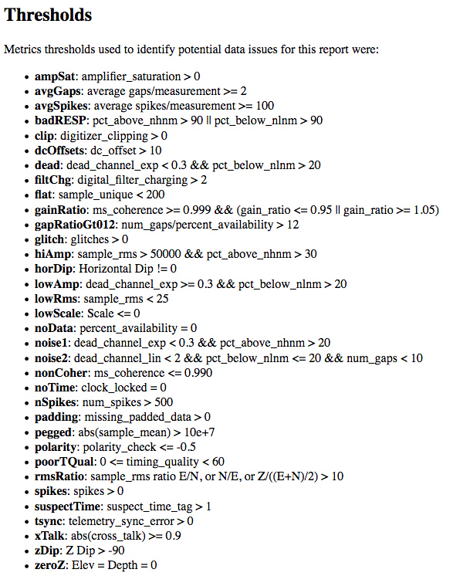
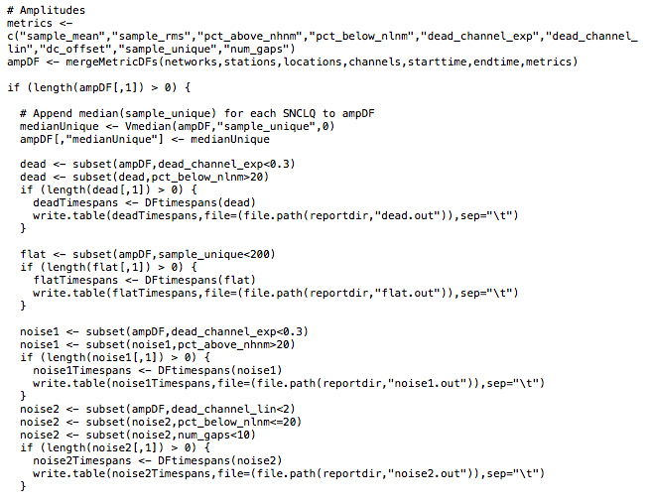
Finding Issues
Combinations that we have found helpful:
Code to grab metric values and compare to our thresholds (written in R):

Slide 5
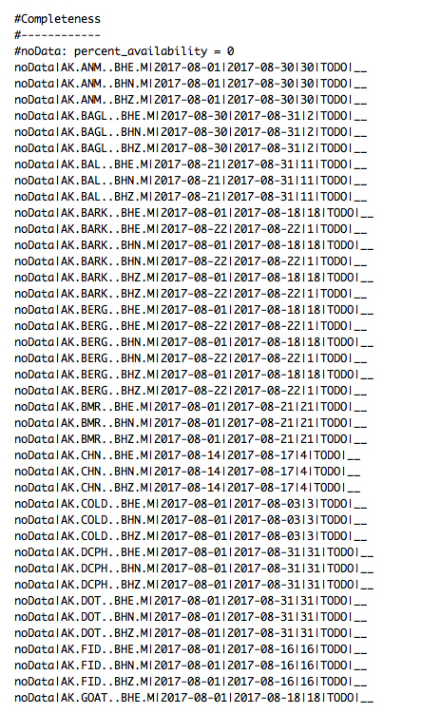
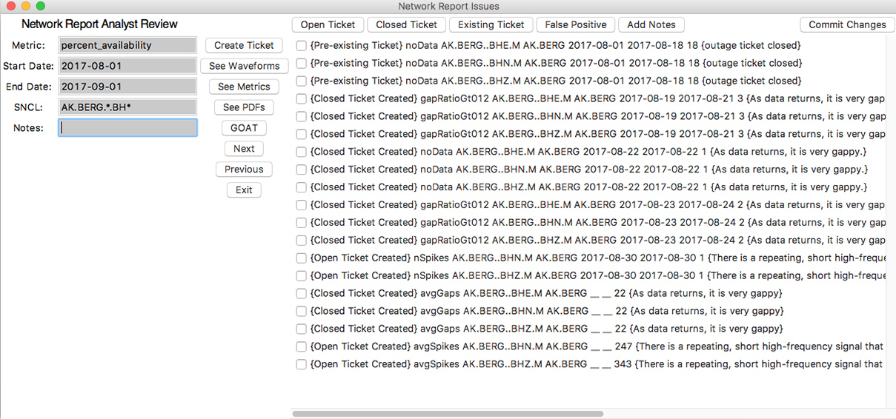
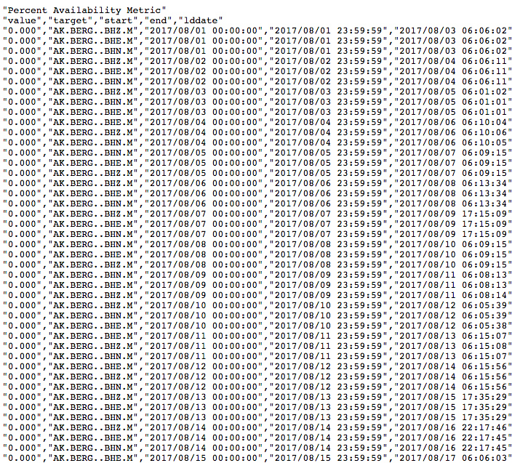
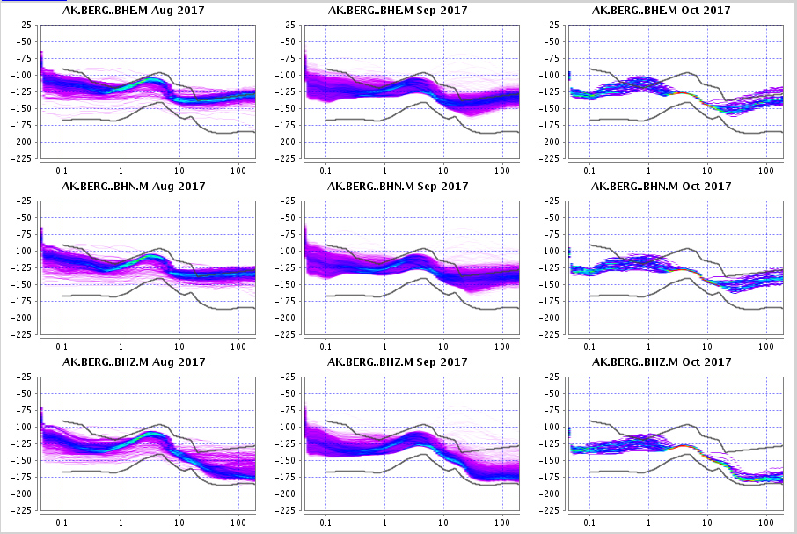
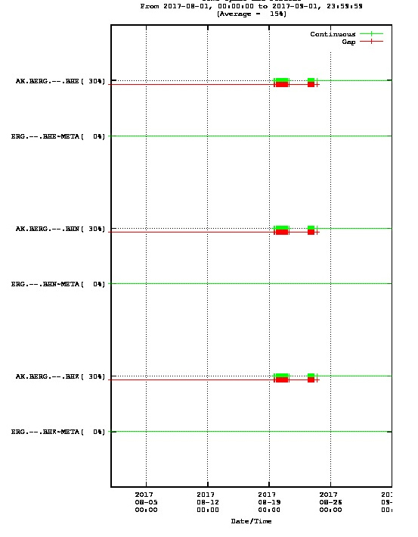
Verifying Issues

Slide 6
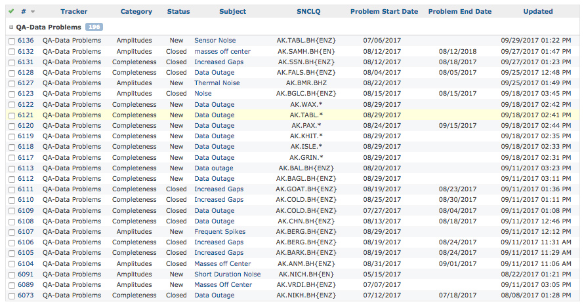
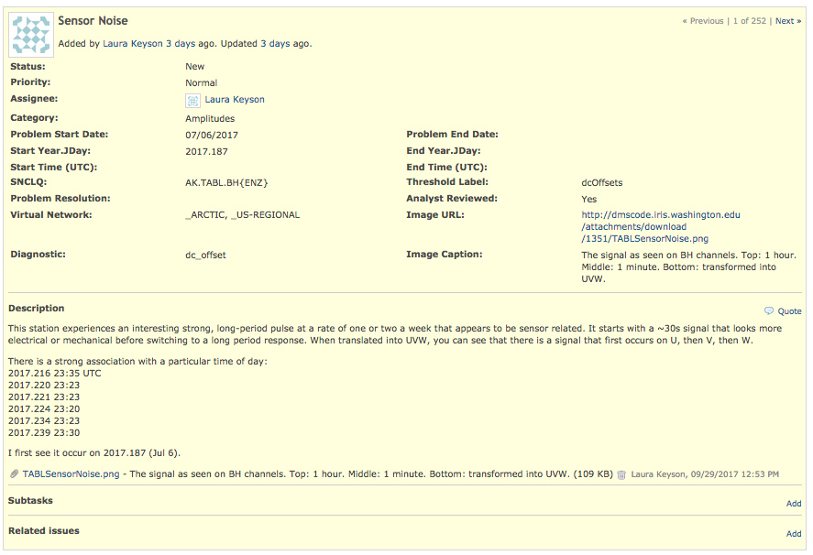
Tracking Issues
Issue tracking via “tickets” with key information
Tickets include information about the SNCL(s), start, end, status, as well as a description and/or images

Slide 7
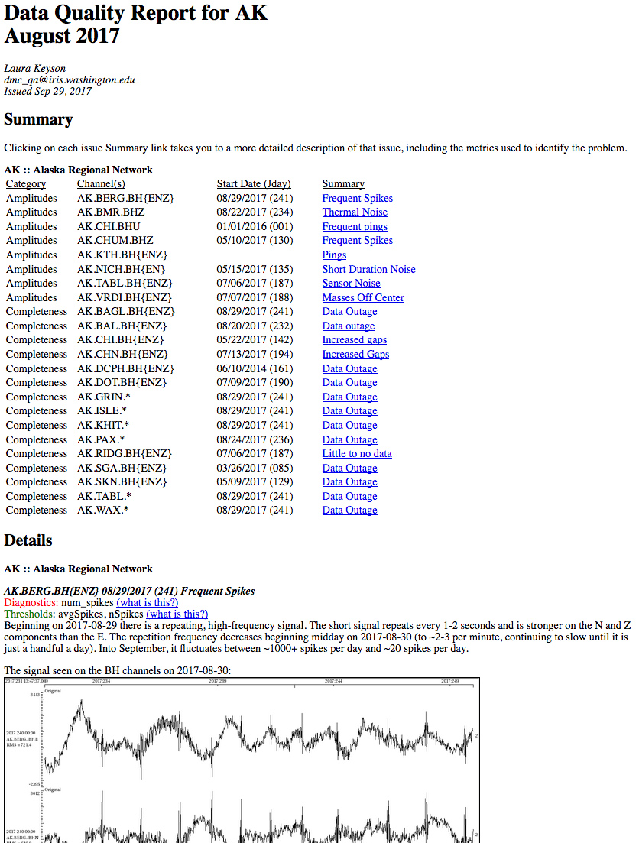
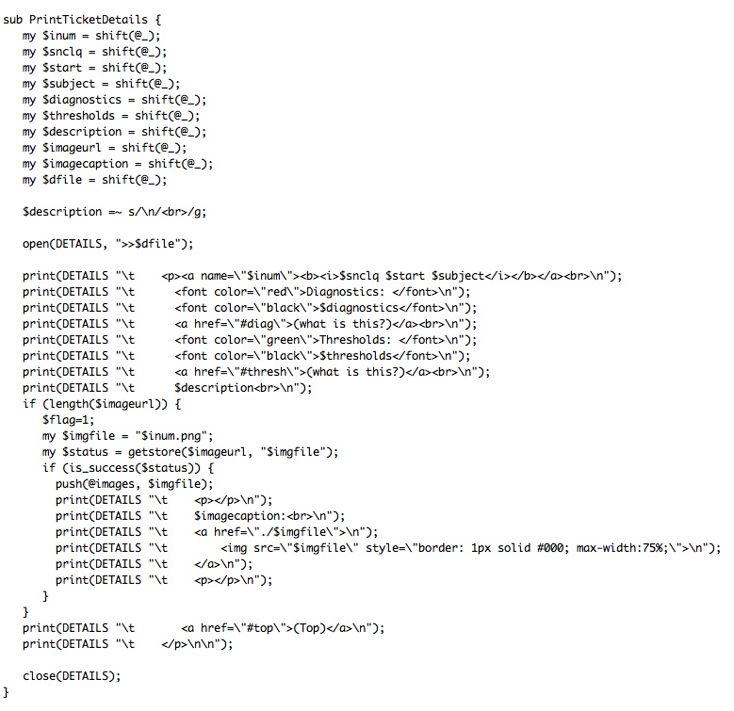
Reporting Issues
perl script generates the report from the tickets

Slide 8
Doing QA on Other Networks
None of this requires being at IRIS: anyone can set up something similar
Pick your favorite language to grab the metric values through web services, perform comparisons, and then output potential issues
wget
curl
R
If the data isn’t at the DMC (or MUSTANG) then you can use ISPAQ to perform the calculations

