Slide 1
IRIS QA Network Reports - Evaluating Issues
Tools to better understand what the metrics are telling us

Slide 2
QA Reports – A Brief Outline
Now that we have a list of issues…
Cover some common issues and the thresholds that find them
Knowing what issues arise from certain thresholds can make the evaluation process quicker
Go over the GUI used to keep track of issues
This was created as a mechanism to simplify the evaluation process, allowing easy access to tools like PDFs and MUSTANG metrics
Delve into the code so that you can adapt it where necessary
Adapting the code to your own network and own needs can make it a more useful tool
A quick look at the ticketing system we use at the DMC
While we use our own ticketing system, you may want to include similar information

Slide 3
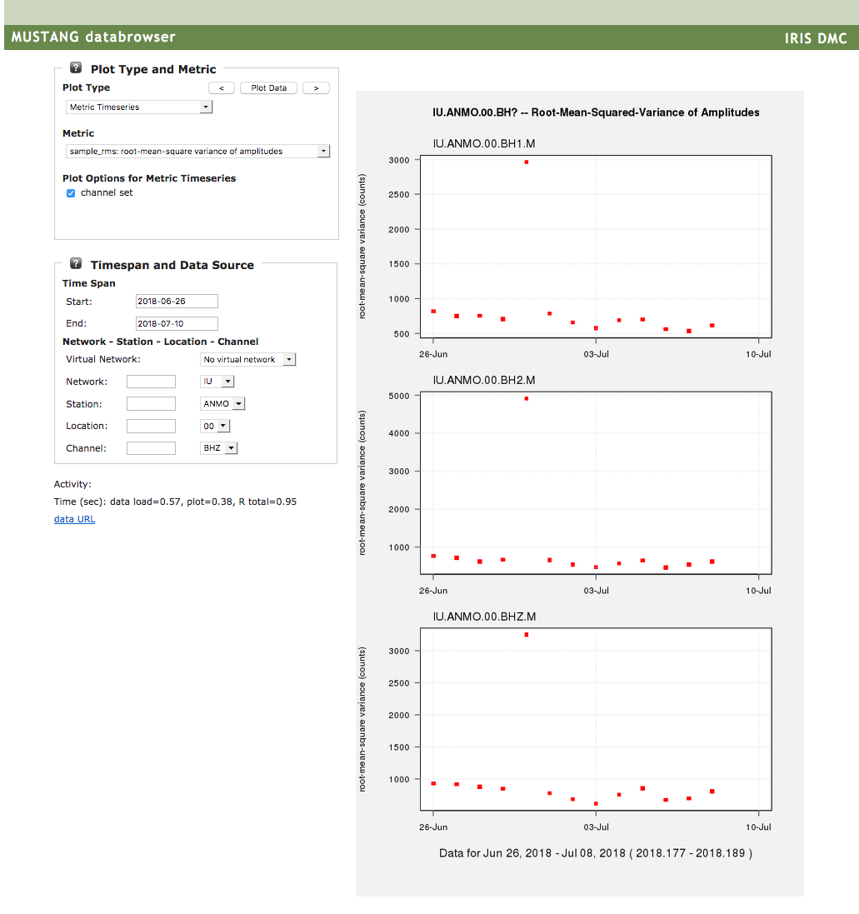
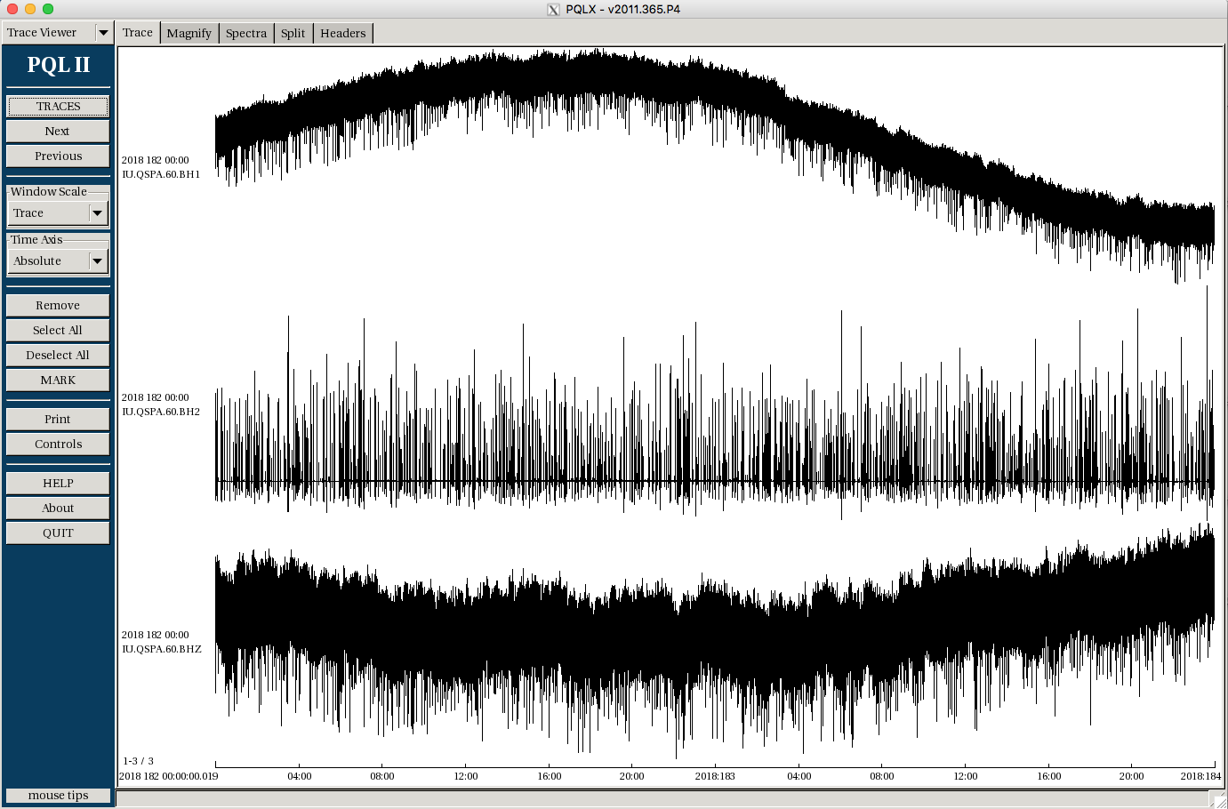
QA Reports – Evaluating Issues
Process:
Find Issues
Evaluate Issues
Generate Report
Process:
Find Issues
Evaluate Issues
Generate Report
Use web services and waveform review to look at issues

Slide 4
QA Reports – Evaluating Issues
Common Issues
Some issues come up more frequently – dependent on network, environmental difficulties, instrumentation, telemetry setups, etc, etc.
Completeness:
Gaps and outages
Amplitudes:
Masses off center, re-centering, or hitting stops
Shifting vaults and seasonal fluctuations
Metadata issues
Instrument damage
Signal fluctuations and losses
Power cycles

Slide 5
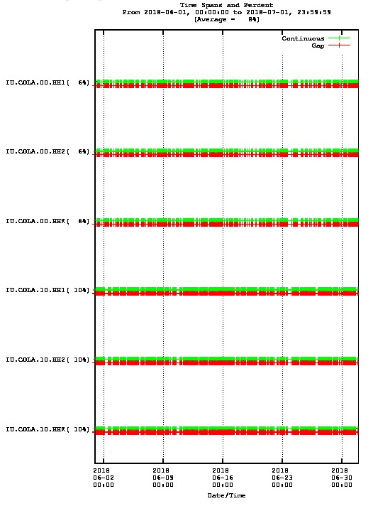
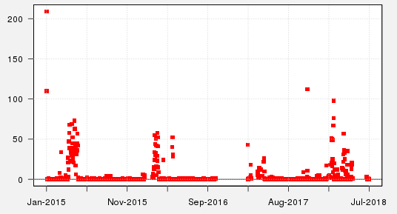
QA Reports – Evaluating Issues
Common Issues
Completeness: gaps and outages
Common thresholds:
noData
gapRatioGt012
avgGaps
GOAT and Databrowser are useful for finding patterns in outages and gaps
Sensor vs transmission: spatial patterns, signals in the data
http://ds.iris.edu/data_available/IU/ANMO/*/BH*?scaling=time_range&byday=off&timewindow=2018/01/01-2018/07/01

Slide 6
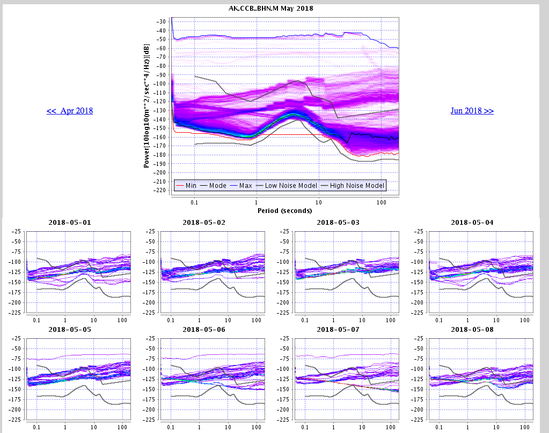
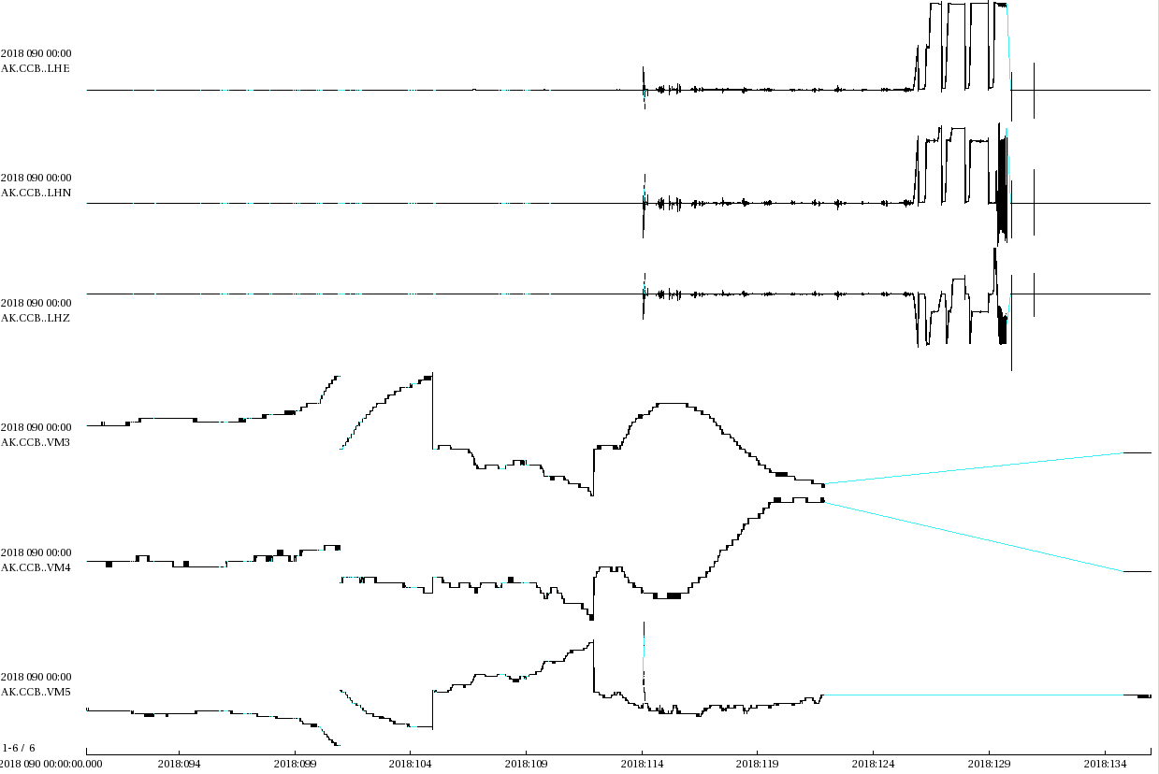
QA Reports – Evaluating Issues
Common Issues
Masses off center or hitting stops
Common thresholds:
xTalk
nSpikes
noise1
noise2
dcOffsets
hiAmp

Slide 7
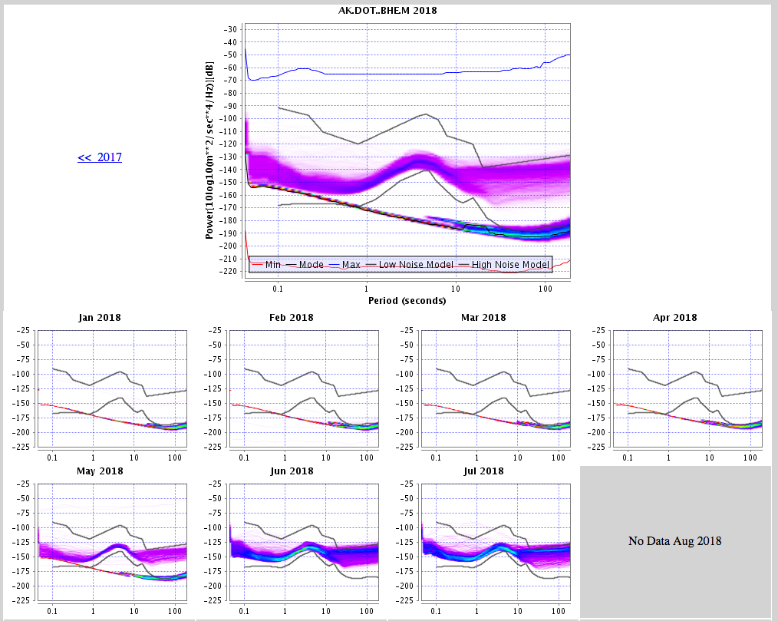
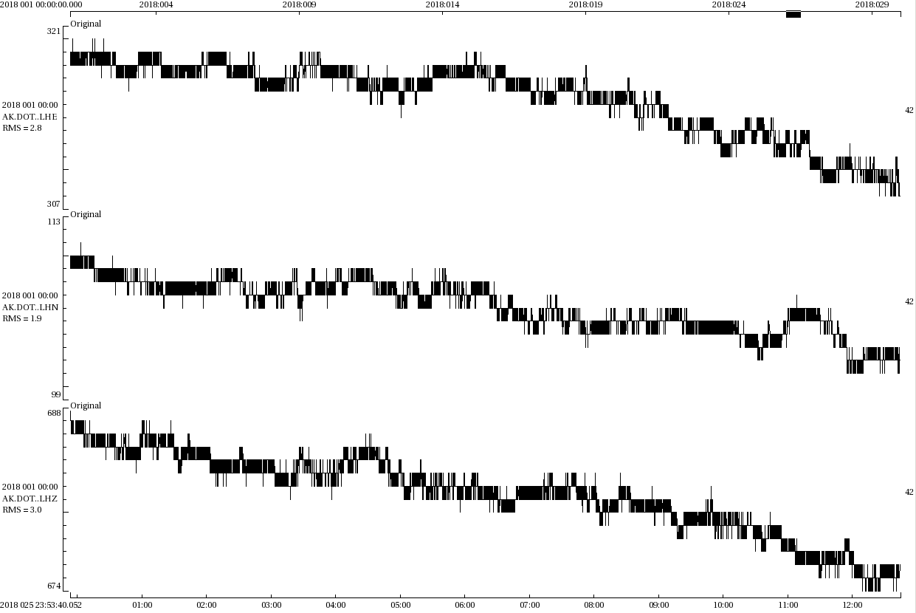
QA Reports – Evaluating Issues
Common Issues
Dead channels
Common thresholds:
lowAmp
lowRms
Dead
Flat

Slide 8
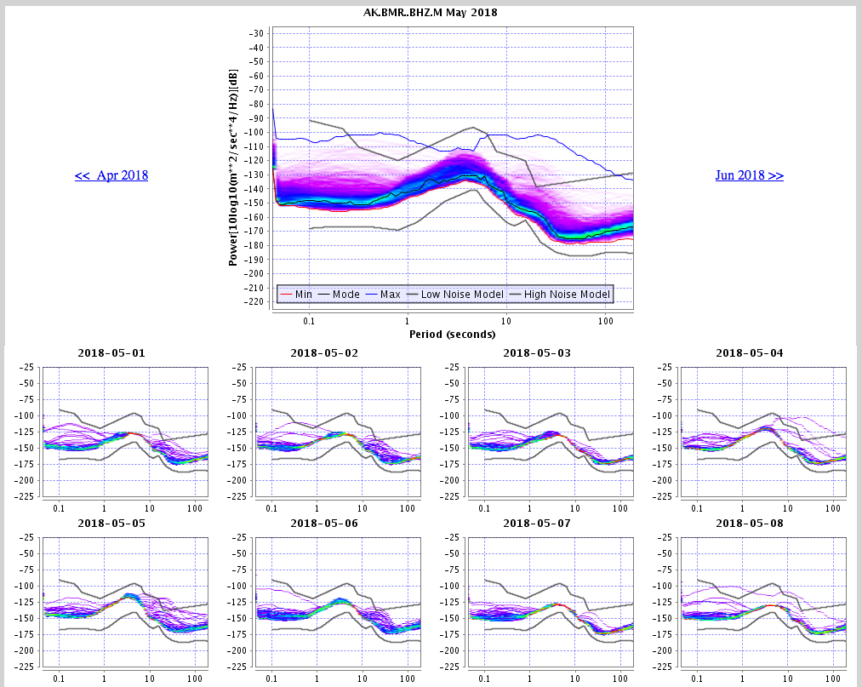
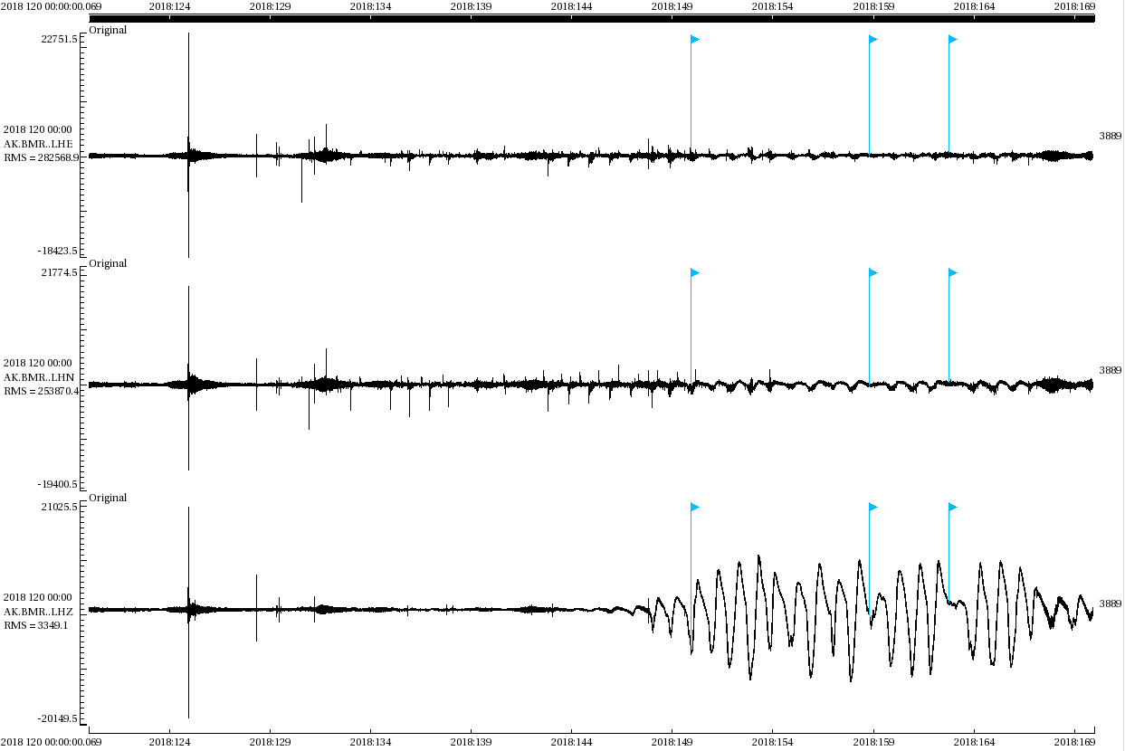
QA Reports – Evaluating Issues
Common Issues
Diurnal signals and seasonal fluctuations
Common thresholds:
xTalk
rmsRatio
dcOffsets

Slide 9
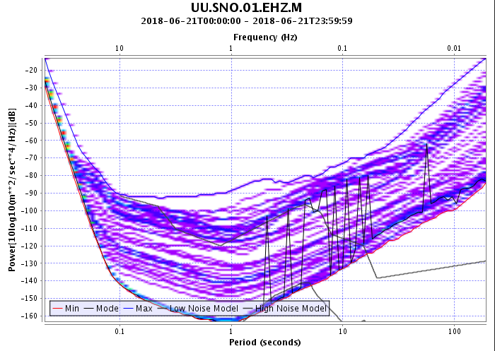
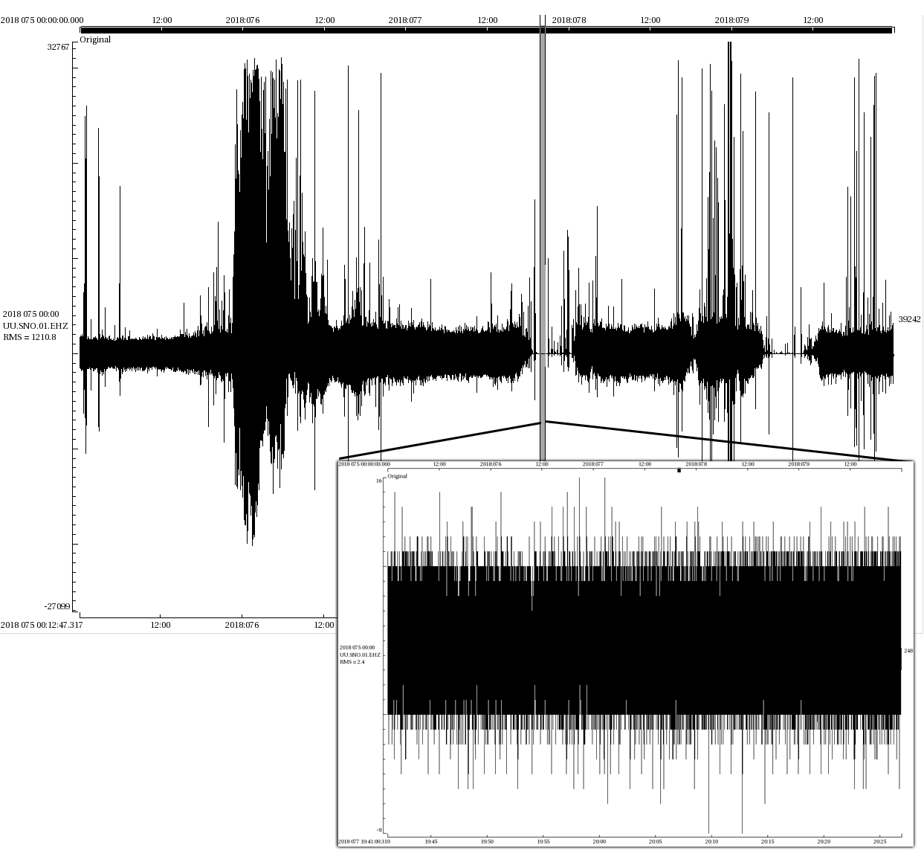
QA Reports – Evaluating Issues
Common Issues
Signal Fluctuations
Common thresholds:
lowAmp
lowRms

Slide 10
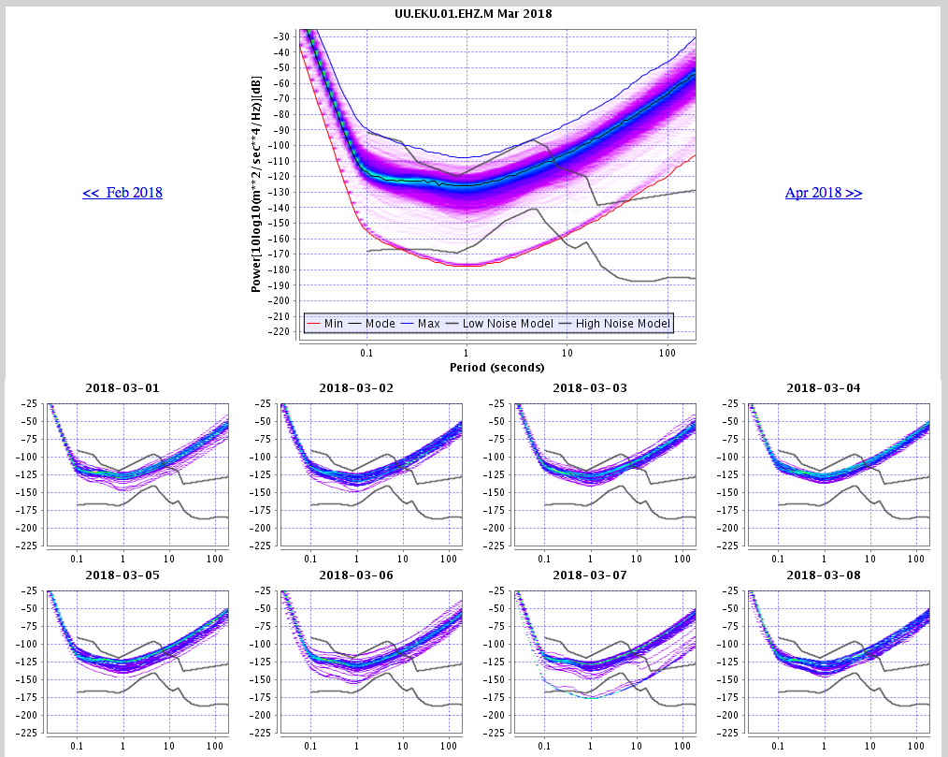
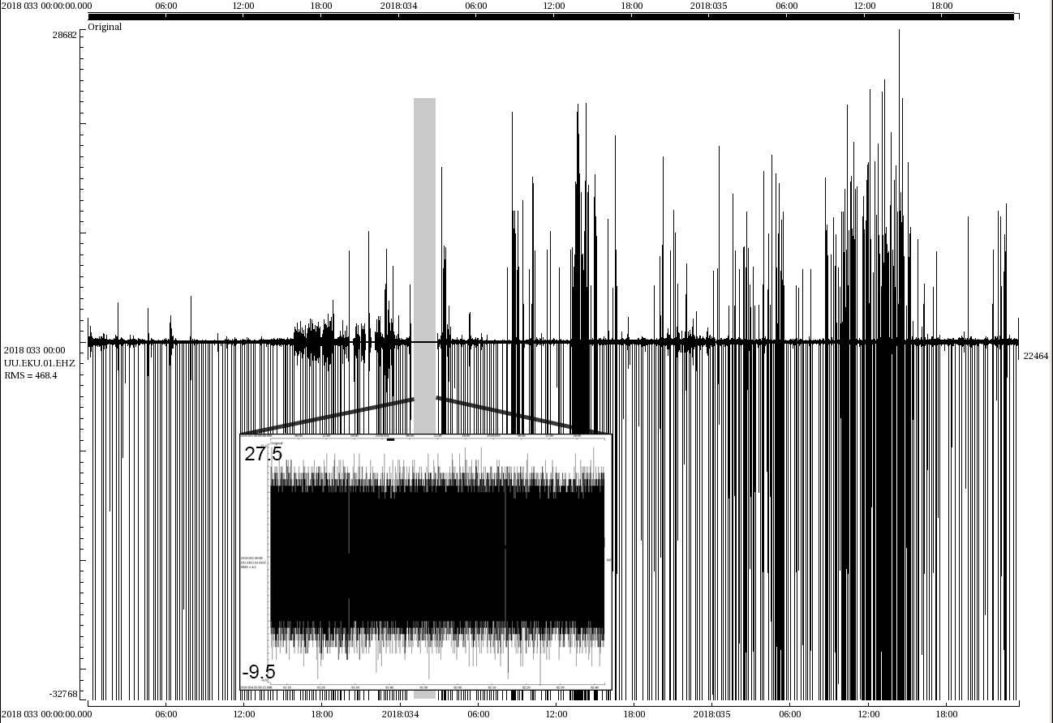
QA Reports – Evaluating Issues
Common Issues
Signal Fluctuations
Common thresholds:
hiAmp
lowAmp

Slide 11
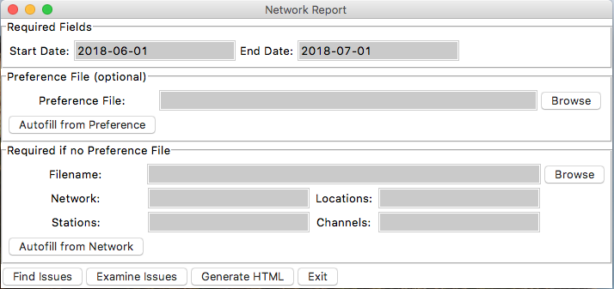
QA Reports – Evaluating Issues
doQA
Examining Issues
GUI to facilitate manual look at flagged issues
Python code
Preference file optional
OR: python QuARG.py /path/to/report.txt
Preference
File
Examine Issues
Issues File
Issues File
(altered)

Slide 12
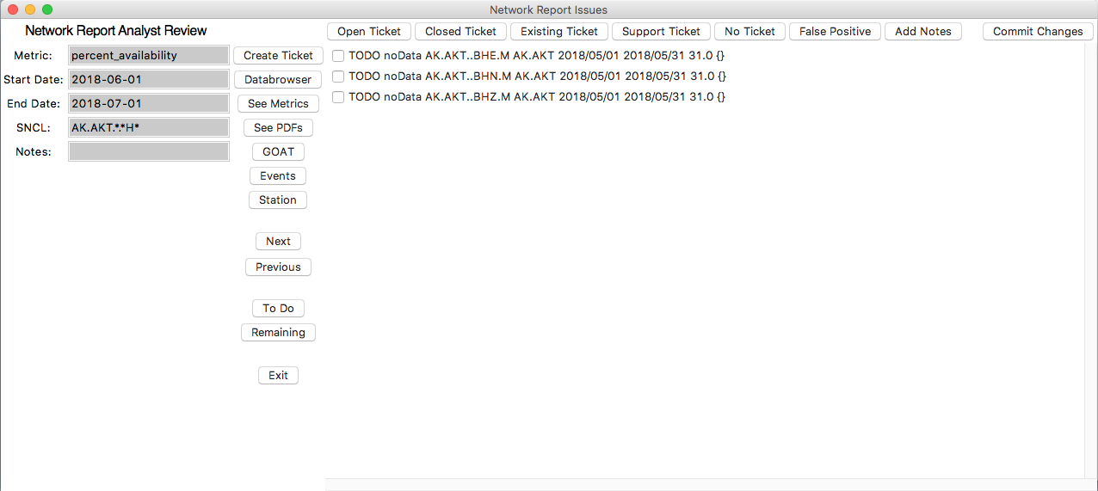
QA Reports – Evaluating Issues
QuARG
QuARG as a utility
The MUSTANG thresholds have indicated an issue, now what?
Different issues have different tools that are more readily useful
Data availability
Web Services
Databrowser
GOAT
Amplitudes
PDFs
Waveform review
Databrowser
The most common tools I use are included in the GUI, but it’s not an exhaustive list

Slide 13
QA Reports – Evaluating Issues
QuARG
Preference
File
Examine Issues
Issues File
QuARG.py
Issues File
(altered)
List of issues
Status
Threhold
Target
N.S.
Start date
End date
N days
Notes
Check boxes to select particular lines
Issues Pane
./QuARG.py /Users/laura/QA_REPORTS/AK_reports/AK/201805/report.orig

Slide 14
QA Reports – Evaluating Issues
QuARG
Preference
File
Examine Issues
Issues File
QuARG.py
Metric – used to look up MUSTANG metrics. Default: percent_availability
Issues File
(altered)
Start Date – beginning of timespan. Default: first day of last month
End Date – end of timespan. Default: first day of this month
Input Pane
SNCL – target, including wildcards. Defaults to NET.STA.*.*H*
Notes – field to add notes
./QuARG.py /Users/laura/QA_REPORTS/AK_reports/AK/201805/report.orig

Slide 15
QA Reports – Evaluating Issues
QuARG
Preference
File
Examine Issues
Issues File
QuARG.py
Create Ticket – opens a web page to our ticketing system
Issues File
(altered)
Databrowser – opens a web page with databrowser
See Metrics – web page with the listed metrics for the SNCL and dates specified
See PDFs – web page of the PDF browser for SNCL specified
Next – next station
GOAT – web page with GOAT availability for SNCL and dates specified
Previous – previous station
Events – web page to the USGS event service for dates specified, >5.5M
Station – web page to IRIS station service for station specified
Exit – exit (make sure to save first)
Tool Pane
Todo – toggle; see only TODO issues, grouped by station like normal
Remaining – toggle; see all TODO issues in one list
./QuARG.py /Users/laura/QA_REPORTS/AK_reports/AK/201805/report.orig

Slide 16
QA Reports – Evaluating Issues
QuARG
Preference
File
Examine Issues
Issues File
QuARG.py
Mark status as Open
Mark status as pre-existing ticket
Issues File
(altered)
Mark status as Closed
Mark status as support ticket
Mark status as Not Ticketing
Status Pane
Save work (to report.txt)
Add Notes to selected lines
Mark status as False Positive
./QuARG.py /Users/laura/QA_REPORTS/AK_reports/AK/201805/report.orig

Slide 17
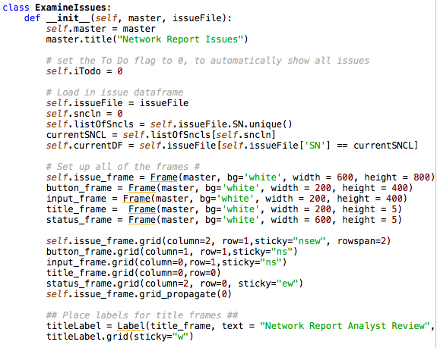
QA Reports – Evaluating Issues
QuARG
Preference
File
Examine Issues
Issues File
QuARG.py
Goal: understand the structure enough to make changes if necessary to adapt to your network and your reports.
Issues File
(altered)
Dependencies:
sys, os, pandas, numpy, Tkinter, webbrowser, datetime
The ExamineIssues class is where the GUI is created. Within there, there are these main sections:
Set up the “Frames” for each section
Create buttons and input fields, place them in the layout
Define tasks for the buttons

Slide 18
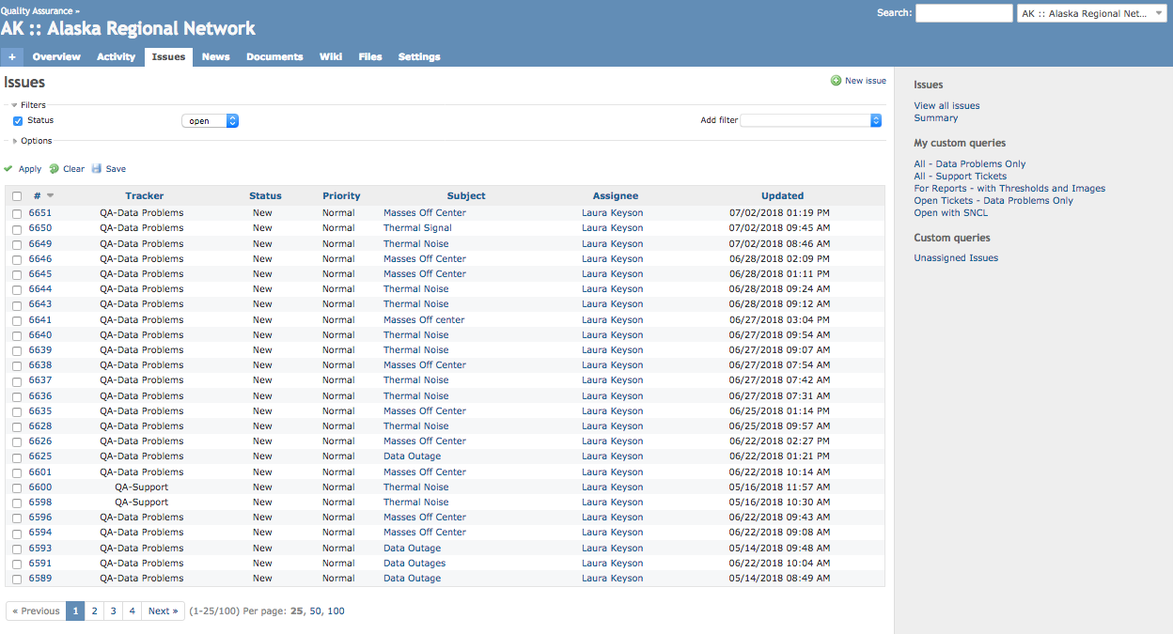
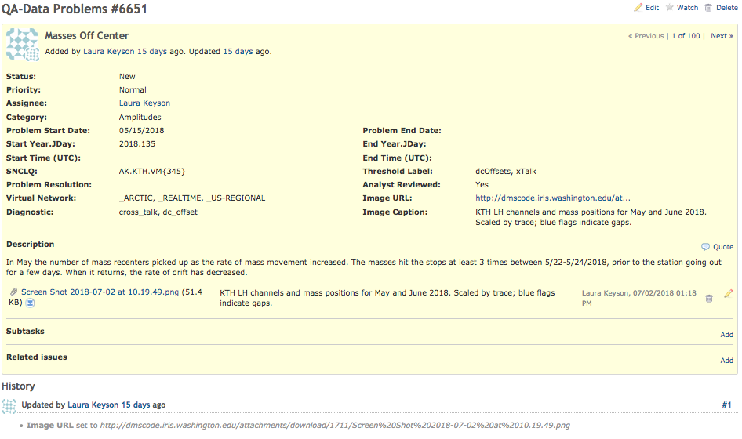
QA Reports – Evaluating Issues
The ticketing system we use
Powered by Redmine
Project for each network
Custom queries
Easy to track
Fields for:
Start and end
Status
Metrics used
Descriptions
Images

