Slide 1
IRIS QA Network Reports - Creating a Report

Slide 2
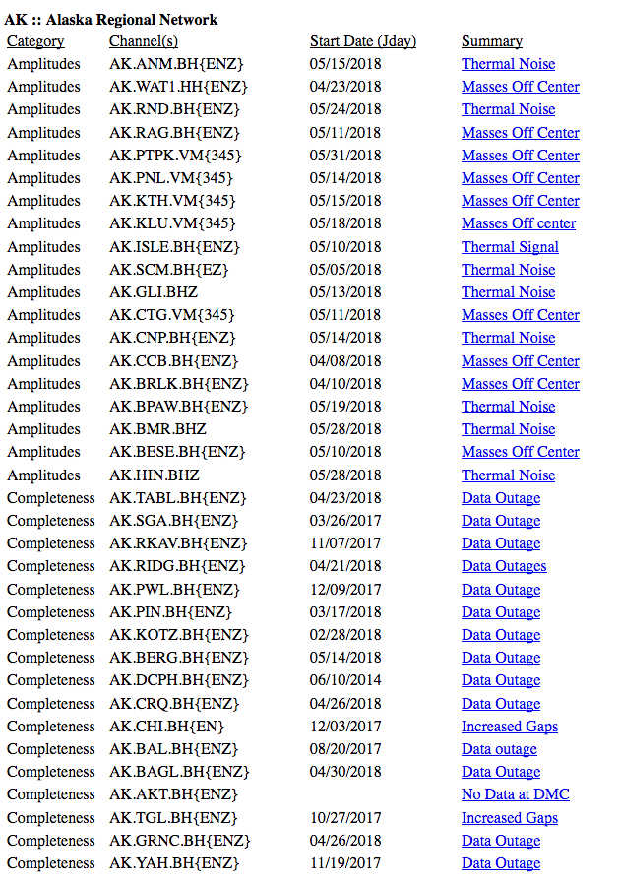
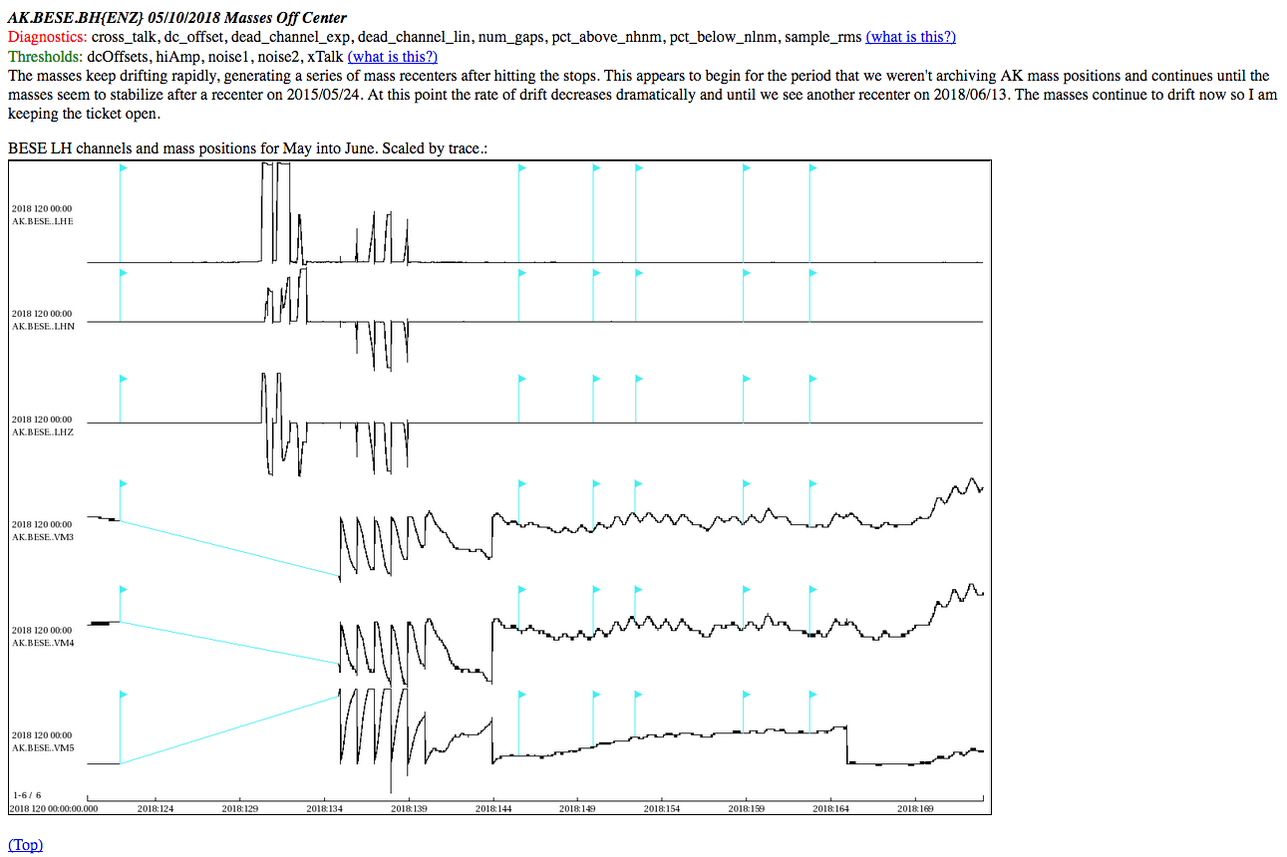
QA Reports – Generating Report
Process:
Find Issues
Evaluate Issues
Generate Report
Process:
Find Issues
Evaluate Issues
Generate Report
Create an HTML report that summarizes findings

Slide 3
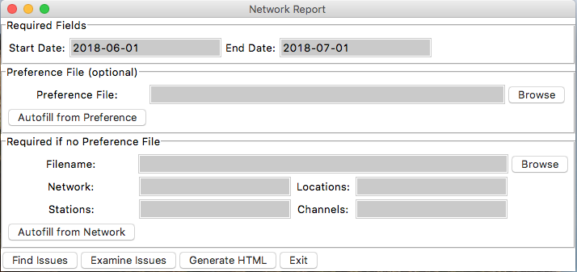
QA Reports
Generate Report
Generating Report
Creates HTML report
Python code
Requires CSV input file
OR: python QA_generateHTML.py NET YYYYMM
Issue CSV
Generate HTML
HTML Report

Slide 4
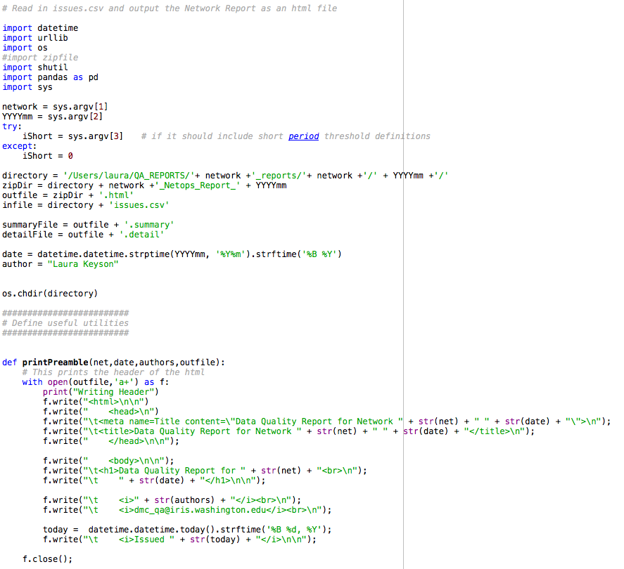
QA Reports
Generate Report
Issue CSV
Generate HTML
QA_generateHTML.py
HTML Report
Takes a specific CSV format and converts to HTML
Produces two temporary files before combining into the final report
Series of functions that produce various parts of the report
Allows for images

Slide 5
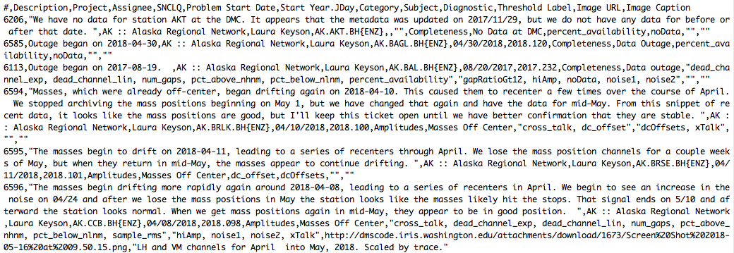
QA Reports
Generate Report
Issue CSV
Generate HTML
issues.csv
This file comes from our dmscode ticketing system, but can be created any other way and work fine.
Alternatively, you can change the code in generateHTML.py to accept the formatting you want
Ticket number, issue description, project name, assignee, SNCLQ, start date, start jday, category, metrics used, threshold, link to image, image caption
HTML Report

Slide 6
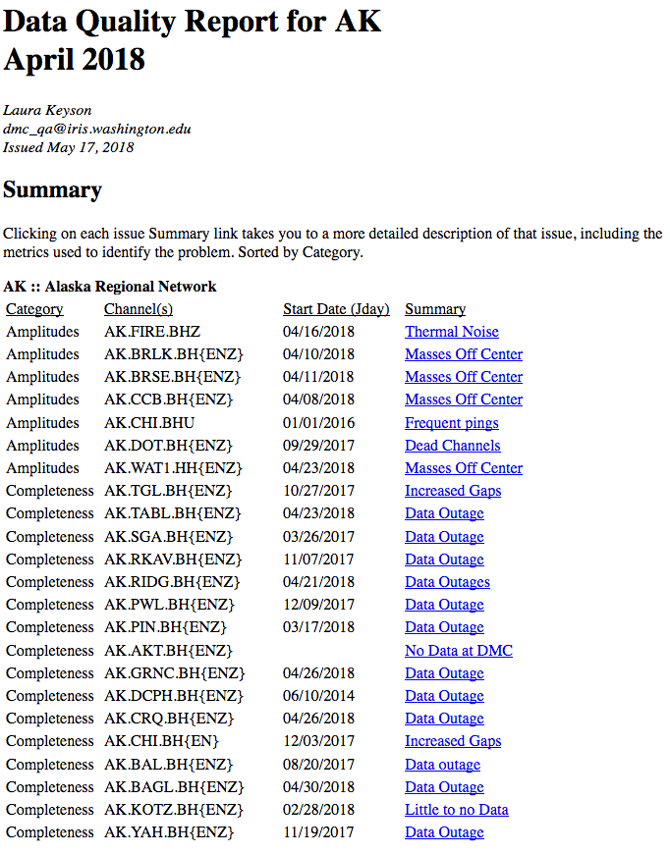
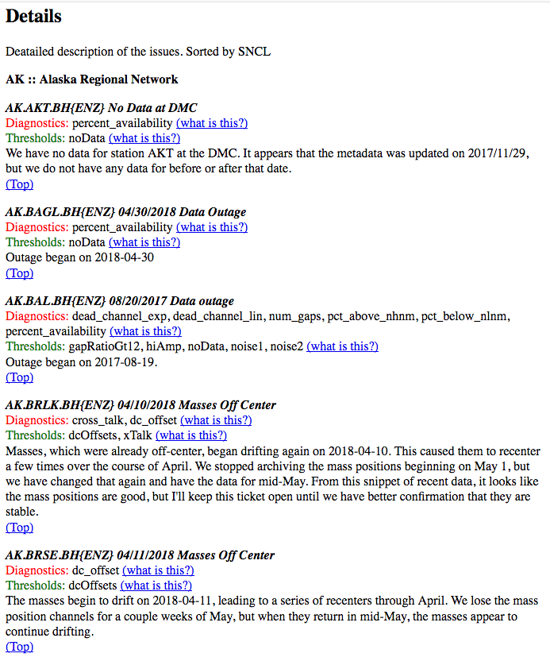
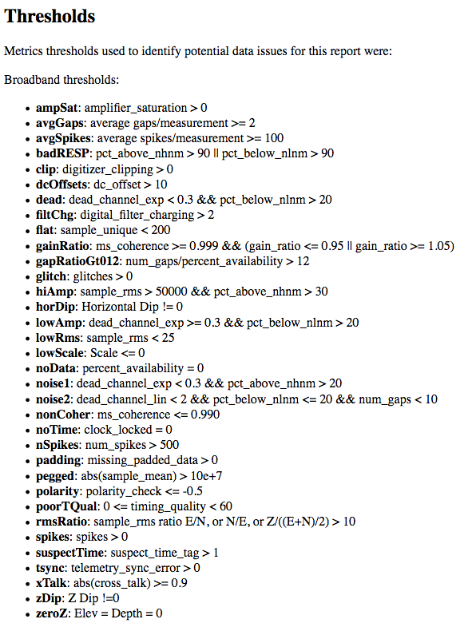
QA Reports
Generate Report
Issue CSV
Generate HTML
NET_Netops_Report_YYYYMM.html
The report is divided into three sections:
summary, detailed description, diagnostic information
HTML Report

