Slide 1
Quality Assurance and Examples from the Transportable Array (TA)
Gillian Sharer
North American Seismic Network Training Workshop, Quality Assurance
August 1-2, 2018

Slide 2
What is quality assurance?
What does “quality assurance” mean
to you as a network operator?
Notes:
Methods for ensuring that a product is “fit for purpose” -> basic research, hazard assessment, education

Slide 3
Reasons for performing quality assurance
Find station problems in a timely manner so that they can be fixed and/or documented
Provide correct response information to maximize data utility
Mitigate environmental conditions and inform station siting, installation, and maintenance
Assess the effect of station upgrades
Document the “goodness” of the network
Determine data suitability for research objectives

Slide 4
Categories of quality assurance
Sensor and digitizer health
Metadata accuracy
Timing quality and GPS
Availability and telemetry
Environmental conditions and noise
Compliance with data format standards

Slide 5
Station examples
Station quality examples from the USArray Transportable Array

Slide 6
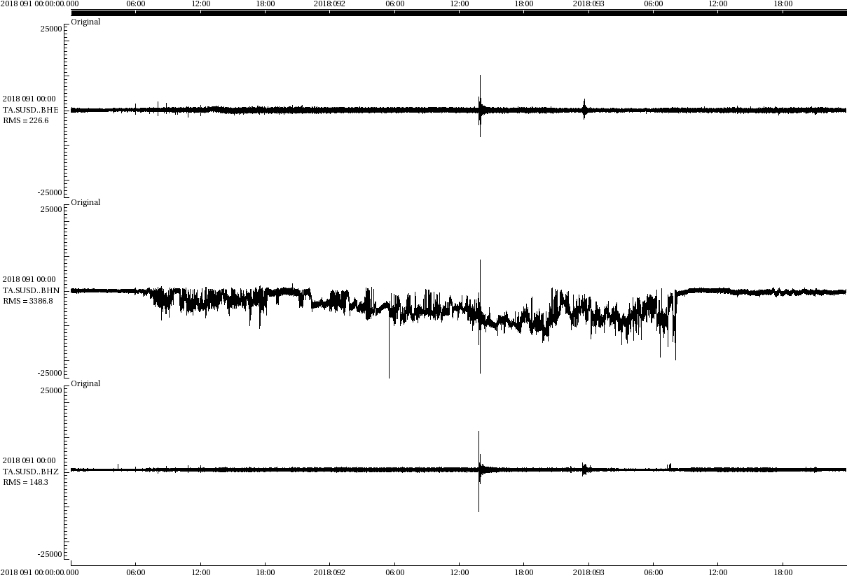
Corrosion-related noise
TA.SUSD
A service visit on 2018/05/03 found "Damp concrete, damp bedding sand, white corrosion in plug"
The noise resolved after cleaning the sensor connectors and mating plug and drying out the vault
BHE
BHN
BHZ
2018/04/01
2018/04/02
scale +25000/-25000 counts
Notes:
Water and humidity is the enemy of electronic equipment
Noise tends to be intermittent
Metrics : dead_channel_lin, num_spikes, dc_offsets

Slide 7
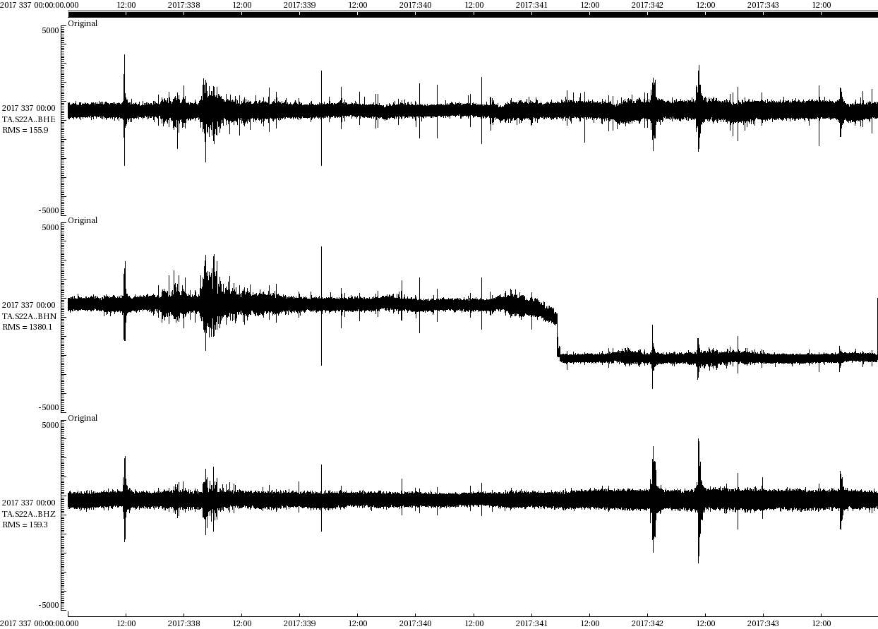
Loss of differential output
TA.S22A
BHN experienced a sudden drop in DC offset of -2500 counts and began recording amplitudes ~50% lower than normal.
This can be the result of damage to the sensor, digitizer, or cables.
The sensor was replaced on 2018/06/14, fixing the problem.
BHE
BHN
BHZ
2017/12/03
2017/12/09
scale +5000/-5000 counts
Notes:
Sensors often use differential signaling to minimize electromagnetic noise.
Wikipedia: "Differential signaling is a method for electrically transmitting information using two complementary signals. The technique sends the same electrical signal as a differential pair of signals, each in its own conductor... The receiving circuit responds to the electrical difference between the two signals... external electromagnetic interference tends to affect both conductors identically. Since the receiving circuit only detects the difference between the wires, the technique resists electromagnetic noise”
Metrics: dc_offset

Slide 8
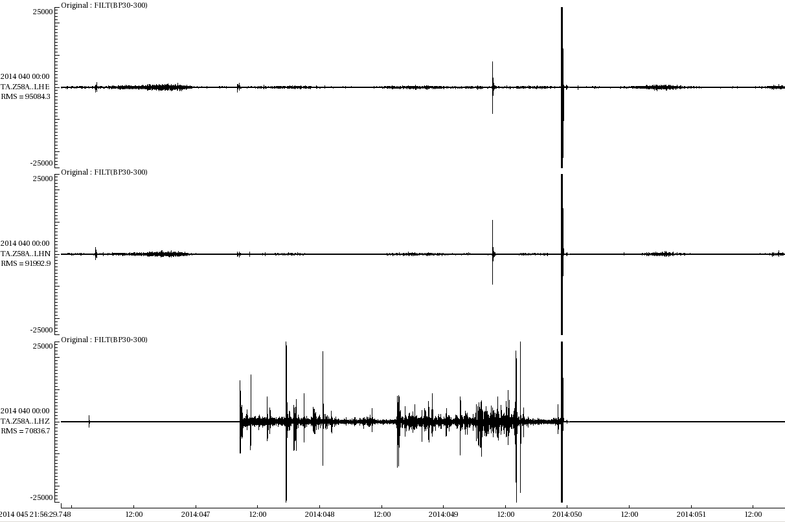
Guralp CMG-3T sensor noise - SNOFLU
TA.Z58A
Sudden
Noise
Onset
Fixed (by mass)
Lock and
Unlock
LHE
LHN
LHZ
2014/02/15
2014/02/20
scale +25000/-25000 counts, bandpass filtered 30-300 seconds
Notes:
Long period noise > 10 seconds, best seen filtered but large amplitude noise can be seen unfiltered

Slide 9
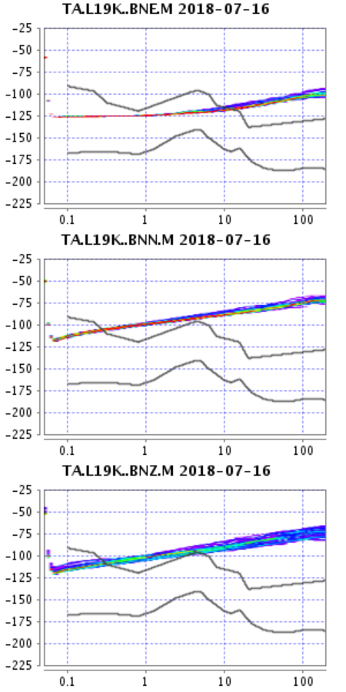
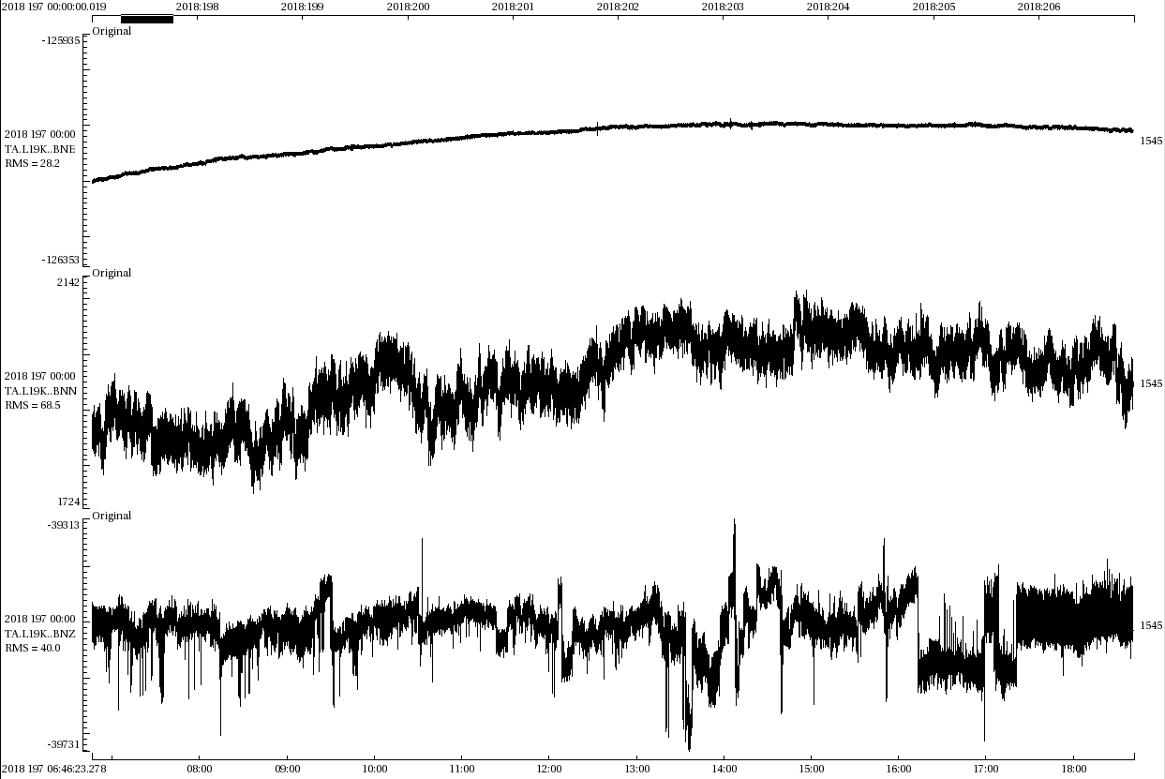
Kinematics EpiSensor "zinc whiskers"
PDFs
Waveforms
BNE
BNN
BNZ
TA.L19K..BNN and BNZ have sensor noise that has been traced to the use of zinc plating material which can deform in high temperature and humidity environments (e.g., Anderson et al., 2015)
Kinematics has since switched to using nickel plating for new instruments which eliminates this issue

