Slide 1
Threshold Discussion
Using MUSTANG metrics in combination

Slide 2
Thresholds
a very brief outline
What are “thresholds” and how did we come up with them?
Came out of doing QA and wanting to make the process more efficient
Broadband thresholds
Walk through the thresholds and what they may find
Short period thresholds
Differences between broadband thresholds and short period ones
A quick dip into QA for strong motion
We have not been doing QA on strong motion yet, but there are some suggestions

Slide 3
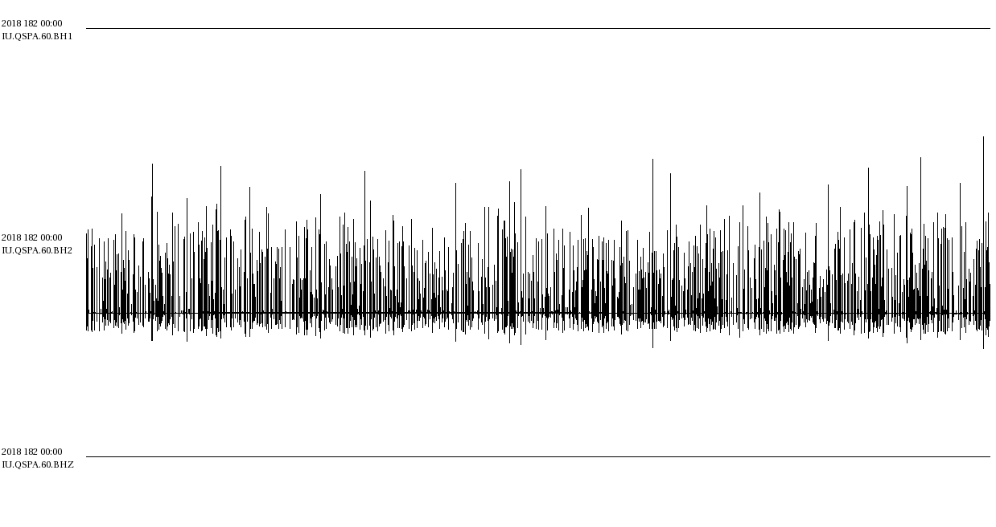
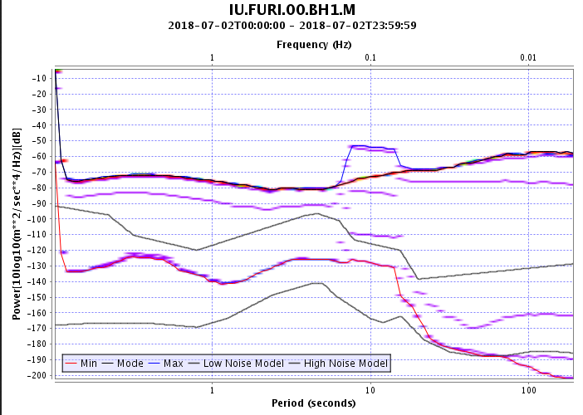
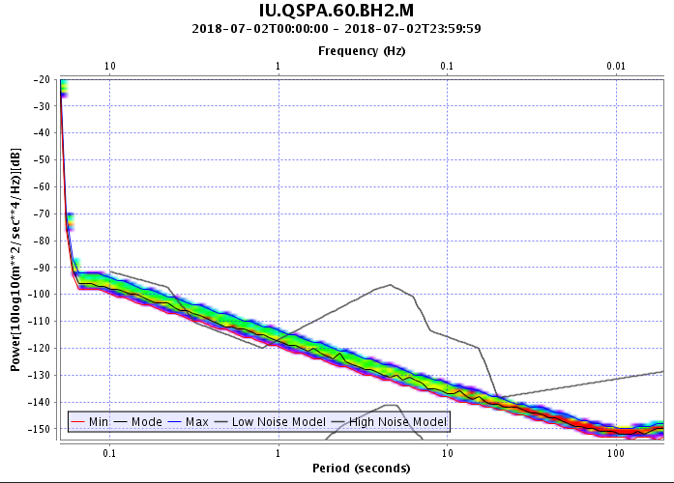
Thresholds
Introduction
Concept: different data or instrument problems produce different metric values.
dead_channel_lin: 4.216
pct_below_nlnm: 0.743
pct_above_nhnm: 94.078
num_gaps: 0
num_spikes: 117
sample_rms: 33388578.000
dead_channel_lin: 0.64
pct_below_nlnm: 0
pct_above_nhnm: 17.287
num_gaps: 0
num_spikes: 1464
sample_rms: 2654.565
Notes:
These are just two examples, there are plenty more issues that also register on different metrics in different combinations.

Slide 4
Thresholds
Introduction
Through our history of doing QA, we have come up with thresholds (combinations of one or more metrics) to catch recurring and more common problems.
Broadband thresholds
ampSat: amplifier_saturation > 0
avgGaps: average gaps/measurement >= 2
avgSpikes: average spikes/measurement >= 100
badRESP: (pct_above_nhnm > 90 || pct_below_nlnm > 90) && dead_channel_lin > 2.0
clip: digitizer_clipping > 0
dcOffsets: dc_offset > 10
dead: dead_channel_lin < 3.5 && pct_below_nlnm > 20
filtChg: digital_filter_charging > 2
flat: sample_unique < 200
gainRatio: ms_coherence >= 0.999 && (gain_ratio <= 0.95 || gain_ratio >= 1.05)
gapRatioGt012: num_gaps/percent_availability > 12
glitch: glitches > 0
hiAmp: sample_rms > 50000 && pct_above_nhnm > 30
horDip: Horizontal Dip != 0
lowAmp: dead_channel_lin >= 3.5 && pct_below_nlnm > 20
lowRms: sample_rms < 25
lowScale: Scale <= 0
noData: percent_availability = 0
noise1: dead_channel_lin < 2.25 && pct_above_nhnm > 20
noise2: dead_channel_lin < 2 && pct_below_nlnm <= 20 && num_gaps < 10
nonCoher: ms_coherence <= 0.990
noTime: clock_locked = 0
nSpikes: num_spikes > 500
padding: missing_padded_data > 0
pegged: abs(sample_mean) > 10e+7
polarity: polarity_check <= -0.5
poorTQual: 0 <= timing_quality < 60
rmsRatio: sample_rms ratio E/N, or N/E, or Z/((E+N)/2) > 10
spikes: spikes > 0
suspectTime: suspect_time_tag > 1
tsync: telemetry_sync_error > 0
xTalk: abs(cross_talk) >= 0.9
zDip: Z Dip !=0
zeroZ: Elev = Depth = 0
This list is not exhaustive and may be improved by tweaking for your particular network
Notes:
Note: different instrument types (broadband, short period, strong motion) have different expected signals and therefore have different threshold definitions
Note: these were defined to provide a trade-off between finding issues and preventing too many false-positives

Slide 5
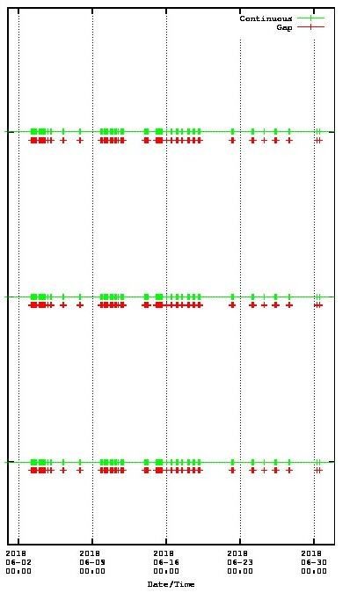
Thresholds
Broadband
Completeness
avgGaps: average gaps/measurement >= 2
Persistent gaps or a few very high gap days.
gapRatioGt012: num_gaps/percent_availability > 12
Larger gaps or high density of gaps.
noData: percent_availability = 0
No data for the day.
tsync: telemetry_sync_error > 0
Data dropouts due to telemetry synchronization errors.

Slide 6
Thresholds
Broadband
Metadata, from the station service
horDip: Horizontal Dip != 0
Simple check to make sure horizontals are horizontal.
zDip: Z Dip > -90
Simple check to make sure that the vertical is vertical.
lowScale: Scale <= 0
Response scale should be positive, but are occasionally negative to reverse polarity when the phase is 180 degrees.
If scale=0, cannot compute PDFs
zeroZ: Elev = Depth = 0
Make sure the elevation and depth have been set.

Slide 7
Thresholds
Broadband
Metadata, from waveform data
badRESP: (pct_above_nhnm > 90 || pct_below_nlnm > 90) && dead_channel_lin > 2.0
Very high or very low signals could indicate an issue with the response.
nonCoher: ms_coherence <= 0.990
Coincident sensors don’t record the same signal - there may be a problem with the response.
gainRatio: ms_coherence >= 0.999 && (gain_ratio <= 0.95 || gain_ratio >= 1.05)
Coincident sensors record same signal, but the empirically-derived gain ratio doesn’t match the metadata-derived gain ratio.
polarity: polarity_check <= -0.5
If nearby stations record opposite polarity, could indicate issue in channel orientation.

Slide 8
Thresholds
Broadband
Amplitudes
rmsRatio: sample_rms ratio E/N, or N/E, or Z/((E+N)/2) > 10
One channel has much greater amplitudes than the others.
noise1: dead_channel_lin < 2.25 && pct_above_nhnm > 20
“Flat” and high amplitude: high noise floor, signal may be recorded but hidden within the noise.
noise2: dead_channel_lin < 2 && pct_below_nlnm <= 20 && num_gaps < 10
“Flat” and midrange amplitude: situation where you would expect to see events and microseisms recorded, but they appear to be absent.
dead: dead_channel_lin < 3.5 && pct_below_nlnm > 20
“Flat” and low amplitude: lack of seismic signal in a lower noise floor.
lowRms: sample_rms < 25
Low variation in signal amplitude. Sample_rms is in counts, so could indicate metadata issue or could be characteristic of the instrument.

Slide 9
Thresholds
Broadband
Amplitudes
hiAmp: sample_rms > 50000 && pct_above_nhnm > 30
Large variations in amplitude that exceed the NHNM, but don’t necessarily have linear PSDs.
lowAmp: dead_channel_lin >= 3.5 && pct_below_nlnm > 20
PSDs are not linear but a significant portion of the PSD lies below the NLNM; perhaps part of signal has cut out.
flat: sample_unique < 200
Catches channels with very few unique amplitude values, generally indicating that the channel isn’t recording. Truly flat (sample_unique = 1) cannot compute PSDs, so those that are flat will not have PSD-derived metrics associated.

Slide 10
Thresholds
Broadband
Amplitudes
spikes: spikes > 0
Datalogger has signaled spikes
avgSpikes: average num_spikes/measurement >= 100
Data is spikey over a long time period, or has a concentrated large number of spikes, as measured from timeseries
nSpikes: num_spikes > 500
A particular day is very spikey, as measured from timeseries
glitch: glitches > 0
Datalogger has indicated glitches, if written

Slide 11
Thresholds
Broadband
Amplitudes
pegged: abs(sample_mean) > 10e+7
Mass is pegged, not going to record properly
clip: digitizer_clipping > 0
Datalogger is causing clipping, indicating hardware problem
dcOffsets: dc_offset > 10
Sudden, and general persistent, shifts in mean amplitude
padding: missing_padded_data > 0
Gaps have been padded, not all dataloggers record this
xTalk: abs(cross_talk) >= 0.9
Two channels look quite similar, could indicate cross talk between the channels

Slide 12
Thresholds
Broadband
Timing
suspectTime: suspect_time_tag > 1
Time tag is questionable
poorTQual: 0 <= timing_quality < 60
Average of timing quality is less than 60, so not as many GPS locks. Will get flagged if not recorded in blockette 1001.
noTime: clock_locked = 0
Clock hasn’t locked, timing could be iffy. Will get flagged if not recorded in miniSEED header.

Slide 13
Thresholds
Broadband
Remaining State of Health thresholds
ampSat: amplifier_saturation > 0
Preamplifier has been overdriven. Not all dataloggers write this, and the exact meaning varies.
filtChg: digital_filter_charging > 2
This flag indicates that data samples were acquired while parameters were still loading (such as after a reboot).

Slide 14
Thresholds
Short period
Short Period
Not all thresholds work for all instrument types: we have different thresholds for short period instruments
ampSat: amplifier_saturation > 0
avgGaps: average gaps/measurement >= 2
badRESP: pct_above_nhnm > 90 || pct_below_nlnm > 90
clip: digitizer_clipping > 0
dcOffsets: dc_offset > 10
filtChg: digital_filter_charging > 2
flat: sample_unique < 50
gapRatioGt012: num_gaps/percent_availability > 12
glitch: glitches > 0
hiAmp: pct_above_nhnm > 40
horDip: Horizontal Dip != 0
lowAmp: pct_below_nlnm > 0
lowRms: sample_rms < 10
lowScale: Scale <= 0
noData: percent_availability = 0
noTime: clock_locked = 0
padding: missing_padded_data > 0
polarity: polarity_check <= -0.5
poorTQual: 0 <= timing_quality < 60
rmsRatio: sample_rms ratio E/N, or N/E, or Z/((E+N)/2) > 10
suspectTime: suspect_time_tag > 1
tsync: telemetry_sync_error > 0
zDip: Z Dip !=0
zeroZ: Elev = Depth = 0
Short period instruments tend to have a higher noise profile than broadbands, as well as lower RMS.
Note: fewer threshold definitions
This means that there is a greater reliance on PDF review

Slide 15
Thresholds
Strong motion
Strong Motion
We have not created threshold definitions for strong motion data yet
Using network boxplots for the following metrics provides some useful information, when combined with PDF and waveform review
percent_availability
Useful to know how complete the data is before analyzing metrics like pct_below_nlnm
num_gaps
Fragmented data can cause high/low PDF values
pct_below_nlnm
Strong motion data has high noise and should not fall below the broadband nlnm – it can be useful for spotting incorrect responses
clock_locked
Useful if the datalogger writes it to data header
timing_quality
Useful if datalogger writes it to blockette 1001
Notes:
Go through Mary’s example(s)

Slide 16
Thresholds
Recap
Take-away points:
Different issues (data or metadata) generate different values for different metrics
By combining certain metrics and applying cutoff values, we are able to create “thresholds” to help highlight various issues with the data
These thresholds have been defined through use, and therefore may be improved for your particular by altering the associated values or metrics used
Some networks or stations will not record certain flags (such as tsync or glitches) and thresholds using those metrics wont be useful
These thresholds are the basis for QA Network Reports

