Slide 1

MUSTANG Web Services
Gillian Sharer
North American Seismic Network Training Workshop, Quality Assurance
August 1-2, 2018
Notes:
We are going to start off talking about the nuts and bolts of MUSTANG web services: what metrics and tools are available and how to use them

Slide 2
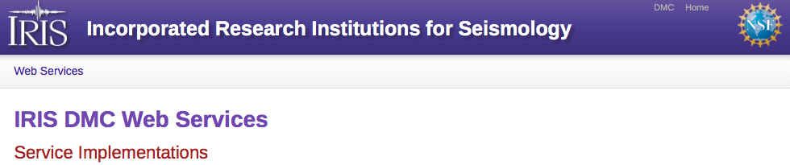
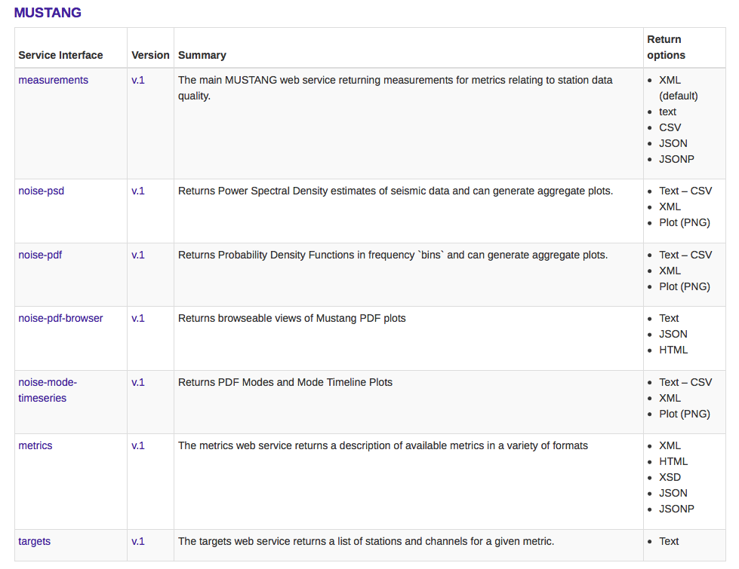
http://service.iris.edu/
Notes:
MUSTANG is just one of several web services implementations available at IRIS: FDSNWS, IRISWS, PH5WS

Slide 3
http://service.iris.edu/
Notes:
MUSTANG is just one of several web services implementations available at IRIS: FDSNWS, IRISWS, PH5WS

Slide 4
MEASUREMENTS
MUSTANG WEB SERVICES
http://service.iris.edu/mustang/measurements/1/

Slide 5
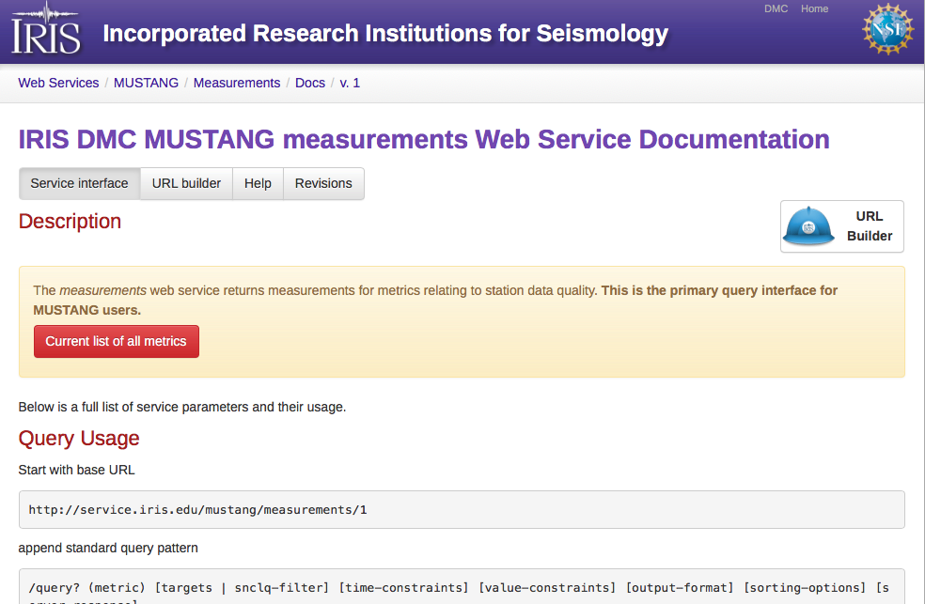
http://service.iris.edu/mustang/measurements/1/
Notes:
Click image to go to website, go through current list of all metrics

Slide 6
What kinds of metrics are available?
MiniSEED Flag Counts
amplifier saturation
calibration signal
clock locked
digital filter charging
digitizer clipping
event begin/end
event in progress
glitches
missing padded data
spikes
suspect time tag
telemetry sync error
timing correction
Other
timing quality (blockette 1001)
metric error
Data Latency
real time data latency
real time feed latency
real time total latency
Data Availability
percent available
channel up time
maximum gap length
maximum overlap length
number of gaps
number of overlaps
Simple Data Statistics
maximum sample value
minimum sample value
median sample value
mean sample value
sample rms variance
unique sample count
Noise Analysis
Power Spectral Density (PSD)*
Probability Density Function (PDF)*
PSD/PDF statistics*
percent above high noise model
percent below low noise model
dead channel indicators
Signal Anomalies
cross talk
DC offset change
signal-to-noise ratio
maximum STA/LTA
number of spikes
pressure effects
Metadata Checks
orientation check
polarity check
transfer function
http://service.iris.edu/mustang/measurements/1/

Slide 7
What kinds of metrics are available?
MiniSEED Flag Counts
amplifier saturation
calibration signal
clock locked
digital filter charging
digitizer clipping
event begin/end
event in progress
glitches
missing padded data
spikes
suspect time tag
telemetry sync error
timing correction
Other
timing quality (blockette 1001)
metric error
Data Latency
real time data latency
real time feed latency
real time total latency
Data Availability
percent available
channel up time
maximum gap length
maximum overlap length
number of gaps
number of overlaps
Simple Data Statistics
maximum sample value
minimum sample value
median sample value
mean sample value
sample rms variance
unique sample count
Noise Analysis
Power Spectral Density (PSD)*
Probability Density Function (PDF)*
PSD/PDF statistics*
percent above high noise model
percent below low noise model
dead channel indicators
Signal Anomalies
cross talk
DC offset change
signal-to-noise ratio
maximum STA/LTA
number of spikes
pressure effects
Metadata Checks
orientation check
polarity check
transfer function
http://service.iris.edu/mustang/measurements/1/

Slide 8
Data latency metrics
Measured on data arriving at IRIS in near-real-time only
One of the few metrics that are not calculated on archived data
One measurement every 4 hours
time data is
written
to IRIS disk
start time of
latency
measurement
data timestamp
data_latency
feed_latency
total_latency
Notes:
Arrival at IRIS = write to our BUD (Buffer of Uniform Data), which is our place to store near real time data before it is archived
There are several reasons why data might arrive at IRIS but not get archived; #1 is that there is no metadata corresponding to the data

Slide 9
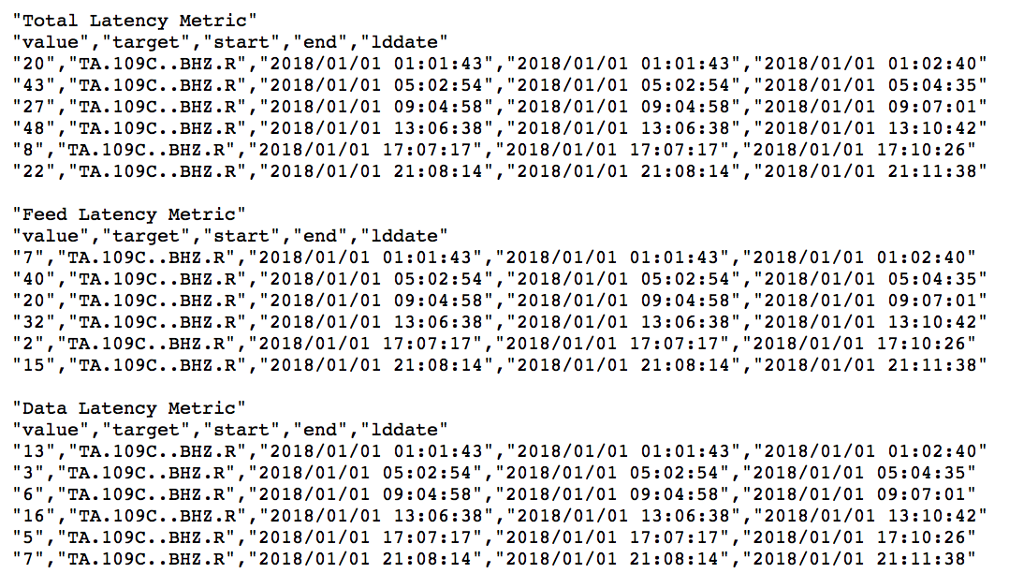
Data latency metrics - example
http://service.iris.edu/mustang/measurements/1/query?
metric=data_latency,feed_latency,total_latency&
net=TA&sta=109C&loc=*&cha=BHZ&format=text&
timewindow=2018-01-01,2018-01-02&nodata=404
Notes:
These are instantaneous measurements, so the start and end dates are the same. The lddate is when it is loaded into the database (later than the measurement time)
Example of using a list for metrics in a MUSTANG query

Slide 10
Data latency metrics – script example
Retrieve recent total_latency values greater than 6 hours duration and send email
#!/usr/bin/perl
use LWP::Simple;
my $cdate = `date -u -d "-5 hours" +%Y-%m-%dT%T`; $cdate =~ s/\n*$//g;
my $net = "TA";
my $url="http://service.iris.edu/mustang/measurements/1/query?" .
"&metric=data_latency&net=$net&channel=BHZ&start=$cdate" .
"&value_gt=21600&format=text&nodata=404";
&sendmsg(get $url);
sub sendmsg {
my $msg = shift;
open ( MAIL, "|sendmail x@iris.washington.edu" );
print MAIL "Subject: Station latency greater than 6 hours\n";
print MAIL "From: x\@iris.washington.edu\n";
print MAIL $msg;
close MAIL;
}

Slide 11
Data latency metrics – script example
Retrieve recent total_latency values greater than 6 hours duration and send email
#!/usr/bin/perl
use LWP::Simple;
my $cdate = `date -u -d "-5 hours" +%Y-%m-%dT%T`; $cdate =~ s/\n*$//g;
my $net = "TA";
my $url="http://service.iris.edu/mustang/measurements/1/query?" .
"&metric=data_latency&net=$net&channel=BHZ&start=$cdate" .
"&value_gt=21600&format=text&nodata=404";
&sendmsg(get $url);
sub sendmsg {
my $msg = shift;
open ( MAIL, "|sendmail x@iris.washington.edu" );
print MAIL "Subject: Station latency greater than 6 hours\n";
print MAIL "From: x\@iris.washington.edu\n";
print MAIL $msg;
close MAIL;
}

Slide 12
Data latency metrics – script example
Retrieve recent total_latency values greater than 6 hours duration and send email
#!/usr/bin/perl
use LWP::Simple;
my $cdate = `date -u -d "-5 hours" +%Y-%m-%dT%T`; $cdate =~ s/\n*$//g;
my $net = "TA";
my $url="http://service.iris.edu/mustang/measurements/1/query?" .
"&metric=data_latency&net=$net&channel=BHZ&start=$cdate" .
"&value_gt=21600&format=text&nodata=404";
&sendmsg(get $url);
sub sendmsg {
my $msg = shift;
open ( MAIL, "|sendmail x@iris.washington.edu" );
print MAIL "Subject: Station latency greater than 6 hours\n";
print MAIL "From: x\@iris.washington.edu\n";
print MAIL $msg;
close MAIL;
}

Slide 13
Data latency metrics – script example
Retrieve recent total_latency values greater than 6 hours duration and send email
#!/usr/bin/perl
use LWP::Simple;
my $cdate = `date -u -d "-5 hours" +%Y-%m-%dT%T`; $cdate =~ s/\n*$//g;
my $net = "TA";
my $url="http://service.iris.edu/mustang/measurements/1/query?" .
"&metric=data_latency&net=$net&channel=BHZ&start=$cdate" .
"&value_gt=21600&format=text&nodata=404";
&sendmsg(get $url);
sub sendmsg {
my $msg = shift;
open ( MAIL, "|sendmail x@iris.washington.edu" );
print MAIL "Subject: Station latency greater than 6 hours\n";
print MAIL "From: x\@iris.washington.edu\n";
print MAIL $msg;
close MAIL;
}

Slide 14
Data latency metrics – script example
Retrieve recent total_latency values greater than 6 hours duration and send email
#!/usr/bin/perl
use LWP::Simple;
my $cdate = `date -u -d "-5 hours" +%Y-%m-%dT%T`; $cdate =~ s/\n*$//g;
my $net = "TA";
my $url="http://service.iris.edu/mustang/measurements/1/query?" .
"&metric=data_latency&net=$net&channel=BHZ&start=$cdate" .
"&value_gt=21600&format=text&nodata=404";
&sendmsg(get $url);
sub sendmsg {
my $msg = shift;
open ( MAIL, "|sendmail x@iris.washington.edu" );
print MAIL "Subject: Station latency greater than 6 hours\n";
print MAIL "From: x\@iris.washington.edu\n";
print MAIL $msg;
close MAIL;
}

Slide 15
Data latency metrics – script example
Retrieve recent total_latency values greater than 6 hours duration and send email
#!/usr/bin/perl
use LWP::Simple;
my $cdate = `date -u -d "-5 hours" +%Y-%m-%dT%T`; $cdate =~ s/\n*$//g;
my $net = "TA";
my $url="http://service.iris.edu/mustang/measurements/1/query?" .
"&metric=data_latency&net=$net&channel=BHZ&start=$cdate" .
"&value_gt=21600&format=text&nodata=404";
&sendmsg(get $url);
sub sendmsg {
my $msg = shift;
open ( MAIL, "|sendmail x@iris.washington.edu" );
print MAIL "Subject: Station latency greater than 6 hours\n";
print MAIL "From: x\@iris.washington.edu\n";
print MAIL $msg;
close MAIL;
}

Slide 16
Data latency metrics – script example
Retrieve recent total_latency values greater than 6 hours duration and send email
#!/usr/bin/perl
use LWP::Simple;
my $cdate = `date -u -d "-5 hours" +%Y-%m-%dT%T`; $cdate =~ s/\n*$//g;
my $net = "TA";
my $url="http://service.iris.edu/mustang/measurements/1/query?" .
"&metric=data_latency&net=$net&channel=BHZ&start=$cdate" .
"&value_gt=21600&format=text&nodata=404";
&sendmsg(get $url);
sub sendmsg {
my $msg = shift;
open ( MAIL, "|sendmail x@iris.washington.edu" );
print MAIL "Subject: Station latency greater than 6 hours\n";
print MAIL "From: x\@iris.washington.edu\n";
print MAIL $msg;
close MAIL;
}

Slide 17
Data latency metrics – script example
Retrieve recent total_latency values greater than 6 hours duration and send email
#!/usr/bin/perl
use LWP::Simple;
my $cdate = `date -u -d "-5 hours" +%Y-%m-%dT%T`; $cdate =~ s/\n*$//g;
my $net = "TA";
my $url="http://service.iris.edu/mustang/measurements/1/query?" .
"&metric=data_latency&net=$net&channel=BHZ&start=$cdate" .
"&value_gt=21600&format=text&nodata=404";
&sendmsg(get $url);
sub sendmsg {
my $msg = shift;
open ( MAIL, "|sendmail x@iris.washington.edu" );
print MAIL "Subject: Station latency greater than 6 hours\n";
print MAIL "From: x\@iris.washington.edu\n";
print MAIL $msg;
close MAIL;
}

Slide 18
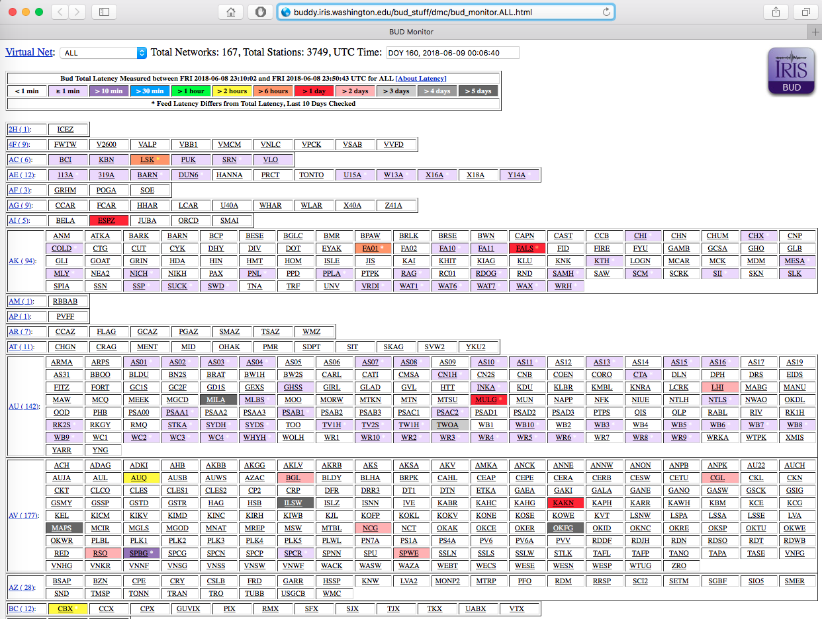
Data latency monitor
http://buddy.iris.washington.edu/bud_stuff/dmc/bud_monitor.ALL.html
Notes:
If you just want to know if your data is arriving at IRIS, you can go to the BUD Monitor. This refreshes every hour (instead of every 4 hours). But if a station has not been received within the past 2 weeks, it may drop off of the monitor.
You can use the MUSTANG version in a script to send notification if latencies get too long.

Slide 19
What kinds of metrics are available?
MiniSEED Flag Counts
amplifier saturation
calibration signal
clock locked
digital filter charging
digitizer clipping
event begin/end
event in progress
glitches
missing padded data
spikes
suspect time tag
telemetry sync error
timing correction
Other
timing quality (blockette 1001)
metric error
Data Latency
real time data latency
real time feed latency
real time total latency
Data Availability
percent available
channel up time
maximum gap length
maximum overlap length
number of gaps
number of overlaps
Simple Data Statistics
maximum sample value
minimum sample value
median sample value
mean sample value
sample rms variance
unique sample count
Noise Analysis
Power Spectral Density (PSD)*
Probability Density Function (PDF)*
PSD/PDF statistics*
percent above high noise model
percent below low noise model
dead channel indicators
Signal Anomalies
cross talk
DC offset change
signal-to-noise ratio
maximum STA/LTA
number of spikes
pressure effects
Metadata Checks
orientation check
polarity check
transfer function
http://service.iris.edu/mustang/measurements/1/

Slide 20
Availability measurements are made on archived data only
Currently there are 2 versions:
Data availability metrics
Original
percent_availability
max_gap
num_gaps
num_overlaps
Next Generation
ts_percent_availability
ts_max_gap
ts_num_gaps
ts_gap_length
ts_channel_up_time
Calculated over 24 hour periods 00:00:00-23:59:59.9999 UTC
Notes:
Why would data latencies be low, but there is no data reported by the availability metrics? Check that there is metadata that covers the timespan. If there is no metadata then the data will sit in our purgatory directory and not get archived.

Slide 21
Metric name | Description
(ts_)percent_availability | percentage of data available per day
(ts_)max_gap | length of the largest gap per day
(ts_)num_gaps | number of gaps per day
num_overlaps | number of overlaps per day
ts_gap_length | sum total length of gaps per day
ts_channel_up_time | time durations of continuous data by day

Slide 22
Availability measurements are made on archived data only
Data availability metrics
Original
percent_availability
max_gap
num_gaps
num_overlaps
Calculated directly from miniSEED, at the same time as the other metrics
Lag between archiving and metric value
Calculated for all seismic channels and mass position channels
Calculated over 24 hour periods 00:00:00-23:59:59.9999 UTC

Slide 23
Availability measurements are made on archived data only
Data availability metrics
Next Generation
ts_percent_availability
ts_max_gap
ts_num_gaps
ts_gap_length
ts_channel_up_time
Calculated on-the-fly using time series information from the availability web service http://service.iris.edu/irisws/availability
Always the most recent information in our database
Available for all archived channels
In beta-testing
Calculated over 24 hour periods 00:00:00-23:59:59.9999 UTC
Notes:
Ts_* metrics are available as soon as the data is archived. It's more up to date and accurate than the original versions. Will replace the original versions when we are finished testing.

Slide 24
Data availability metrics
Known issues with the new ts_* metrics
The ts_* metrics do not access station metadata currently
If there is no data available for a station-channel for the entire requested time span, then the ts_* metrics will not return any results for that station-channel
If there is data available for at least one day for a station-channel for the requested time span, then all days that have no data will return ts_percent_availability=0 regardless of whether those days are outside the metadata time span

Slide 25
Data availability metrics
Newest capability: arbitrary time periods
ts_percent_availability_total
ts_max_gap_total
ts_num_gaps_total
ts_gap_length_total
ts_channel_up_time ts_channel_continuity
Calculated over period defined by requested start and end
Notes:
*_total metrics return single value, instead of daily value

Slide 26
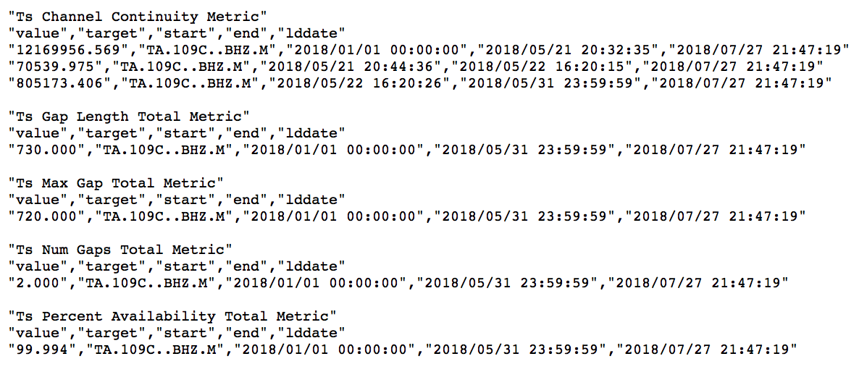
Data availability metrics
http://service.iris.edu/mustang/measurements/1/query?
metric=ts_percent_availability_total,ts_num_gaps_total,ts_max_gap_total,
ts_gap_length_total,ts_channel_continuity&target=TA.109C..BHZ.M
&format=text&starttime=2018-01-01&endtime=2018-06-01&nodata=404
Notes:
Click on link, then modify to day-long metrics

Slide 27
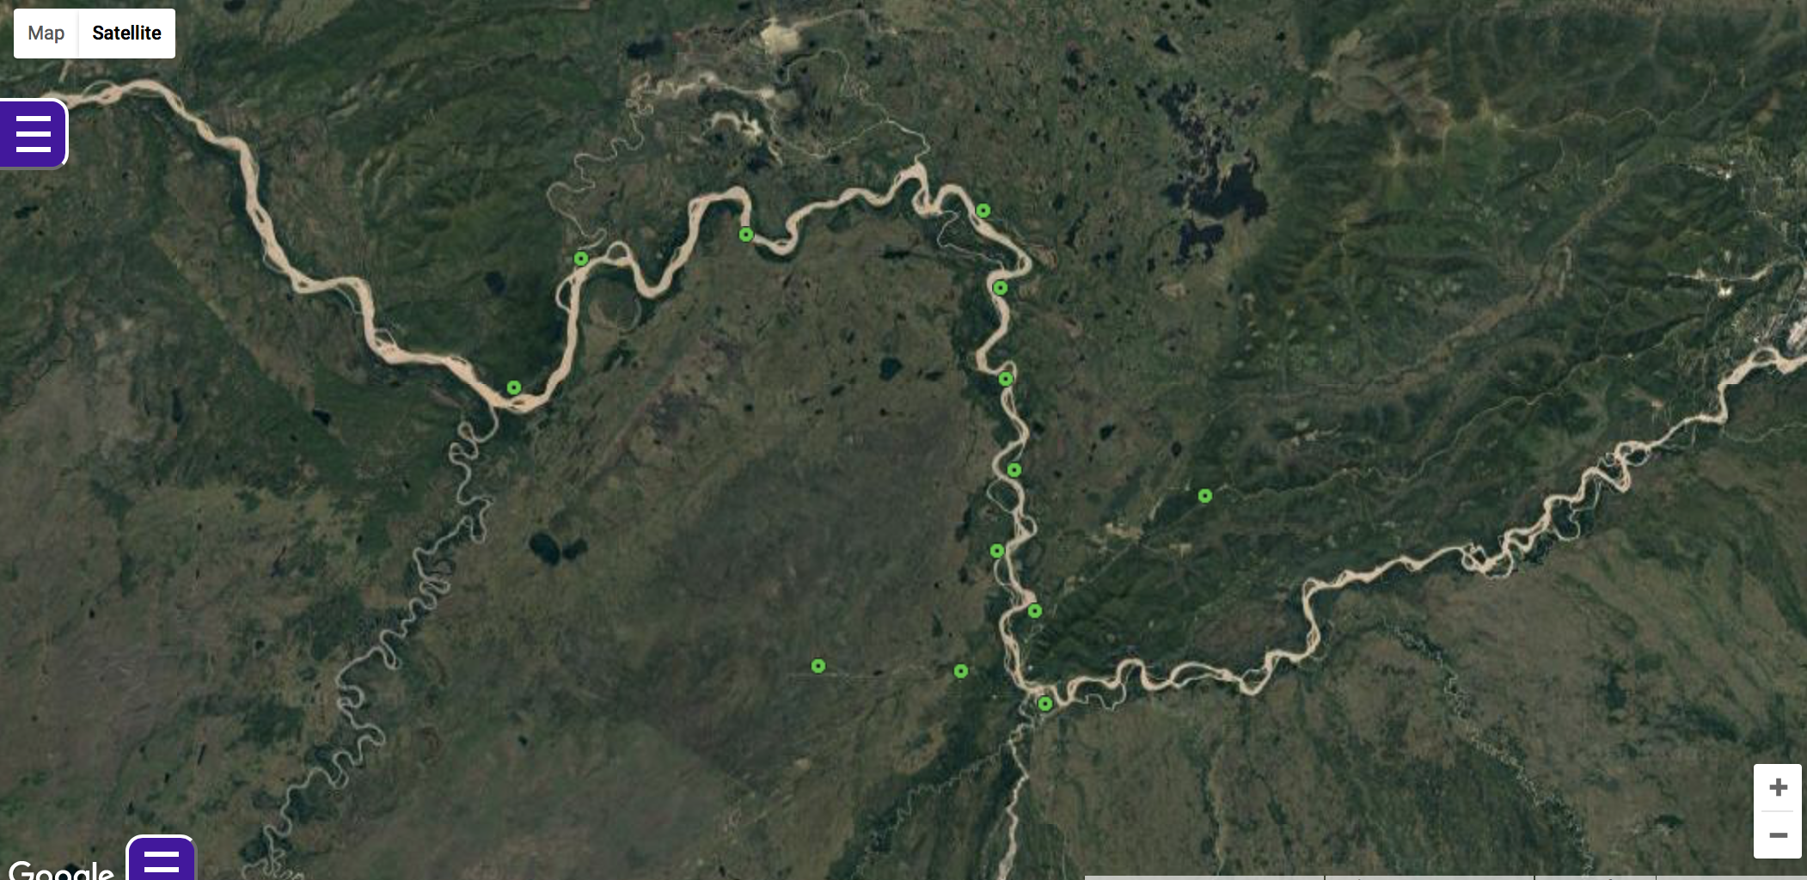
Data availability metrics - example
FLATS Experiment 2014-2019
Tanana River, Nenana Basin, AK
PI Carl Tape, University of Fairbanks, AK

Slide 28
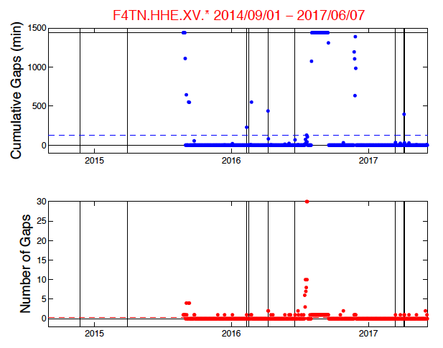
Data availability metrics - example
plot by Kyle Smith, University of Alaska Fairbanks
Gap Metrics and Telemetry
FLATS Experiment, University of Alaska Fairbanks
XV.F4TN installed on 2015-08-27
AK.NEA2 shares a radio receiver with F4TN
Vertical lines indicate days when NEA2 had cumulative gaps > 30 minutes
Notes:
Plot by Kyle Smith, University of Alaska Fairbanks
Cumulative gaps = ts_gap_length (in seconds)

Slide 29
Data availability metrics - example
plot by Kyle Smith, University of Alaska Fairbanks
Gap Metrics and Telemetry
FLATS Experiment, University of Alaska Fairbanks
XV.F4TN installed on 2015-08-27
AK.NEA2 shares a radio receiver with F4TN
Vertical lines indicate days when NEA2 had cumulative gaps > 30 minutes
Notes:
Plot by Kyle Smith, University of Alaska Fairbanks
Cumulative gaps = ts_gap_length (in seconds)

Slide 30
Data availability metrics - example
plot by Kyle Smith, University of Alaska Fairbanks
Gap Metrics and Telemetry
FLATS Experiment, University of Alaska Fairbanks
XV.F4TN installed on 2015-08-27
AK.NEA2 shares a radio receiver with F4TN
Vertical lines indicate days when NEA2 had cumulative gaps > 30 minutes
Notes:
Plot by Kyle Smith, University of Alaska Fairbanks
Cumulative gaps = ts_gap_length (in seconds)
Increased number of gaps was the first sign that something bad was happening at the station

Slide 31
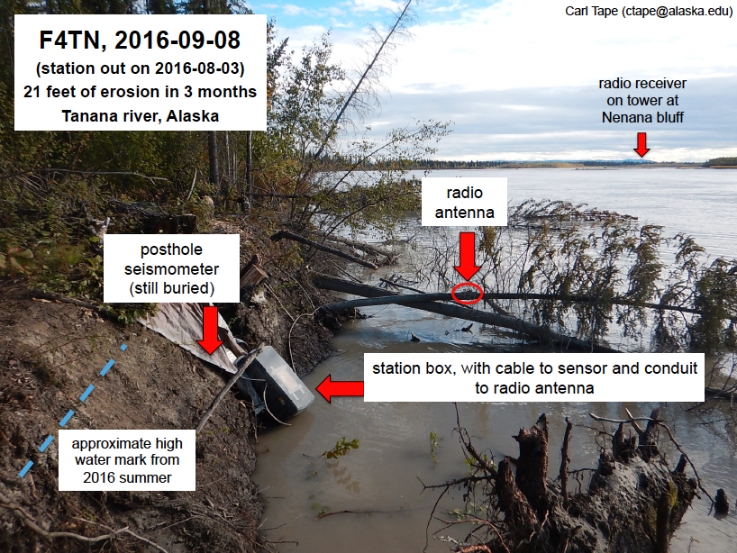
Data availability metrics - example
Gap Metrics and Telemetry
FLATS Experiment, University of Alaska Fairbanks
Gaps increased as lateral erosion of bank caused tree displacement
Station stopped sending data when battery was submerged
Data resumed after the station was relocated
Notes:
Antenna still had sight line to the radio receiver, so it kept sending until the station lost power
The increasing number of gaps was the first indication that the station needed a service visit

Slide 32
What kinds of metrics are available?
MiniSEED Flag Counts
amplifier saturation
calibration signal
clock locked
digital filter charging
digitizer clipping
event begin/end
event in progress
glitches
missing padded data
spikes
suspect time tag
telemetry sync error
timing correction
Other
timing quality (blockette 1001)
metric error
Data Latency
real time data latency
real time feed latency
real time total latency
Data Availability
percent available
channel up time
maximum gap length
maximum overlap length
number of gaps
number of overlaps
Simple Data Statistics
maximum sample value
minimum sample value
median sample value
mean sample value
sample rms variance
unique sample count
Noise Analysis
Power Spectral Density (PSD)*
Probability Density Function (PDF)*
PSD/PDF statistics*
percent above high noise model
percent below low noise model
dead channel indicators
Signal Anomalies
cross talk
DC offset change
signal-to-noise ratio
maximum STA/LTA
number of spikes
pressure effects
Metadata Checks
orientation check
polarity check
transfer function
http://service.iris.edu/mustang/measurements/1/

Slide 33
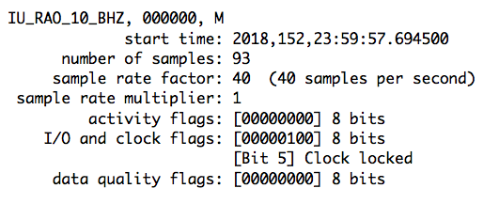
MiniSEED record header metrics
These metrics count the number of times per day that the
relevant flag is set in the miniSEED record header.
Example from miniSEED record:
Example MUSTANG metric:
Clock locked flag is set
!! Not all dataloggers add these flags to miniSEED data !!
If your data does not have flags set, then these metrics will return value=0

Slide 34
What kinds of metrics are available?
MiniSEED Flag Counts
amplifier saturation
calibration signal
clock locked
digital filter charging
digitizer clipping
event begin/end
event in progress
glitches
missing padded data
spikes
suspect time tag
telemetry sync error
timing correction
Other
timing quality (blockette 1001)
metric error
Data Latency
real time data latency
real time feed latency
real time total latency
Data Availability
percent available
channel up time
maximum gap length
maximum overlap length
number of gaps
number of overlaps
Simple Data Statistics
maximum sample value
minimum sample value
median sample value
mean sample value
sample rms variance
unique sample count
Noise Analysis
Power Spectral Density (PSD)*
Probability Density Function (PDF)*
PSD/PDF statistics*
percent above high noise model
percent below low noise model
dead channel indicators
Signal Anomalies
cross talk
DC offset change
signal-to-noise ratio
maximum STA/LTA
number of spikes
pressure effects
Metadata Checks
orientation check
polarity check
transfer function
http://service.iris.edu/mustang/measurements/1/

Slide 35
Metric name | Description
sample_max | maximum sample value per day
sample_min | minimum sample value per day
sample_median | median sample value per day
sample_mean | mean sample value per day
sample_rms | root-mean-square variance of sample values per day (standard deviation)
sample_unique | count of unique sample values per day

Slide 36
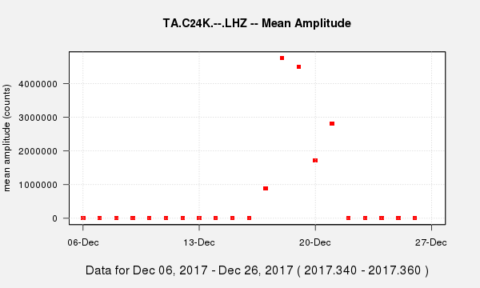
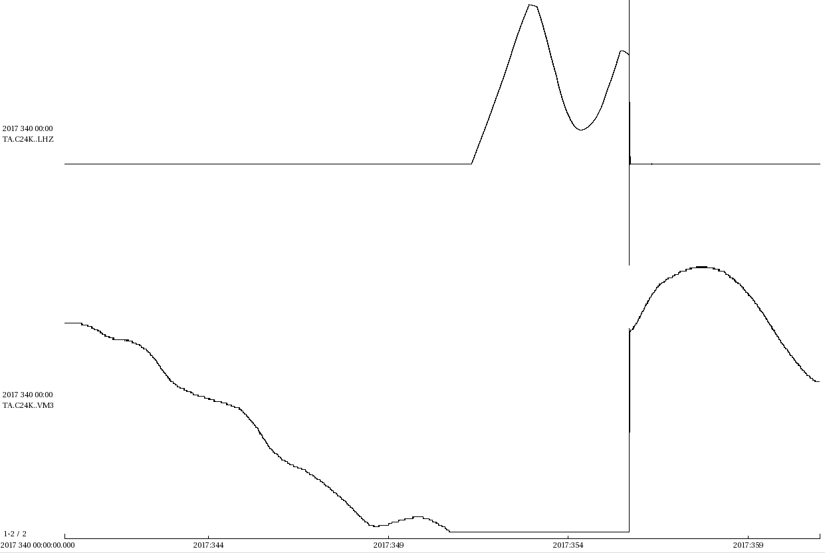
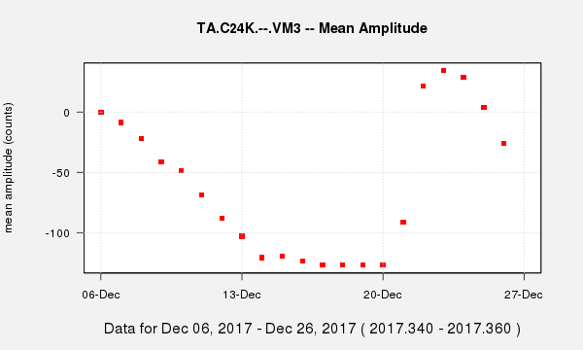
Sample_mean metric example
Trace plot, December 6-27, 2017
TA.C24K..LHZ
+6e+6/-4e+6 counts
TA.C24K..VM3
+36/-127 counts
Masses hit the stops on December 15
Corrected by mass recenter December 21
Notes:
STS-2, mass at stops= 12.7 volts = 127 counts

Slide 37
What kinds of metrics are available?
MiniSEED Flag Counts
amplifier saturation
calibration signal
clock locked
digital filter charging
digitizer clipping
event begin/end
event in progress
glitches
missing padded data
spikes
suspect time tag
telemetry sync error
timing correction
Other
timing quality (blockette 1001)
metric error
Data Latency
real time data latency
real time feed latency
real time total latency
Data Availability
percent available
channel up time
maximum gap length
maximum overlap length
number of gaps
number of overlaps
Simple Data Statistics
maximum sample value
minimum sample value
median sample value
mean sample value
sample rms variance
unique sample count
Noise Analysis
Power Spectral Density (PSD)*
Probability Density Function (PDF)*
PSD/PDF statistics*
percent above high noise model
percent below low noise model
dead channel indicators
Signal Anomalies
cross talk
DC offset change
signal-to-noise ratio
maximum STA/LTA
number of spikes
pressure effects
Metadata Checks
orientation check
polarity check
transfer function
http://service.iris.edu/mustang/measurements/1/

Slide 38
Metric name | Description
cross_talk | cross-correlation coefficient of pairs of channels from the same sensor, e.g., BHE:BHN, BHN:BHZ, BHZ:BHE for event magnitudes > 5.5
dc_offset | statistical indicator of likelihood of DC offset shift using a comparison of daily sample_mean values
sample_snr | signal-to-noise ratio for event magnitudes > 5.5
max_stalta | maximum short-term-average/long-term-average ratio
num_spikes | count of spikes determined by identifying outliers using a median-absolute-deviation (MAD) method with a 41-second sliding window
pressure_effects | cross correlation coefficient of an LDO barometer channel with an LHZ seismic channel
Notes:
Max_stalta : rolling window of 3 second and 30 seconds

Slide 39
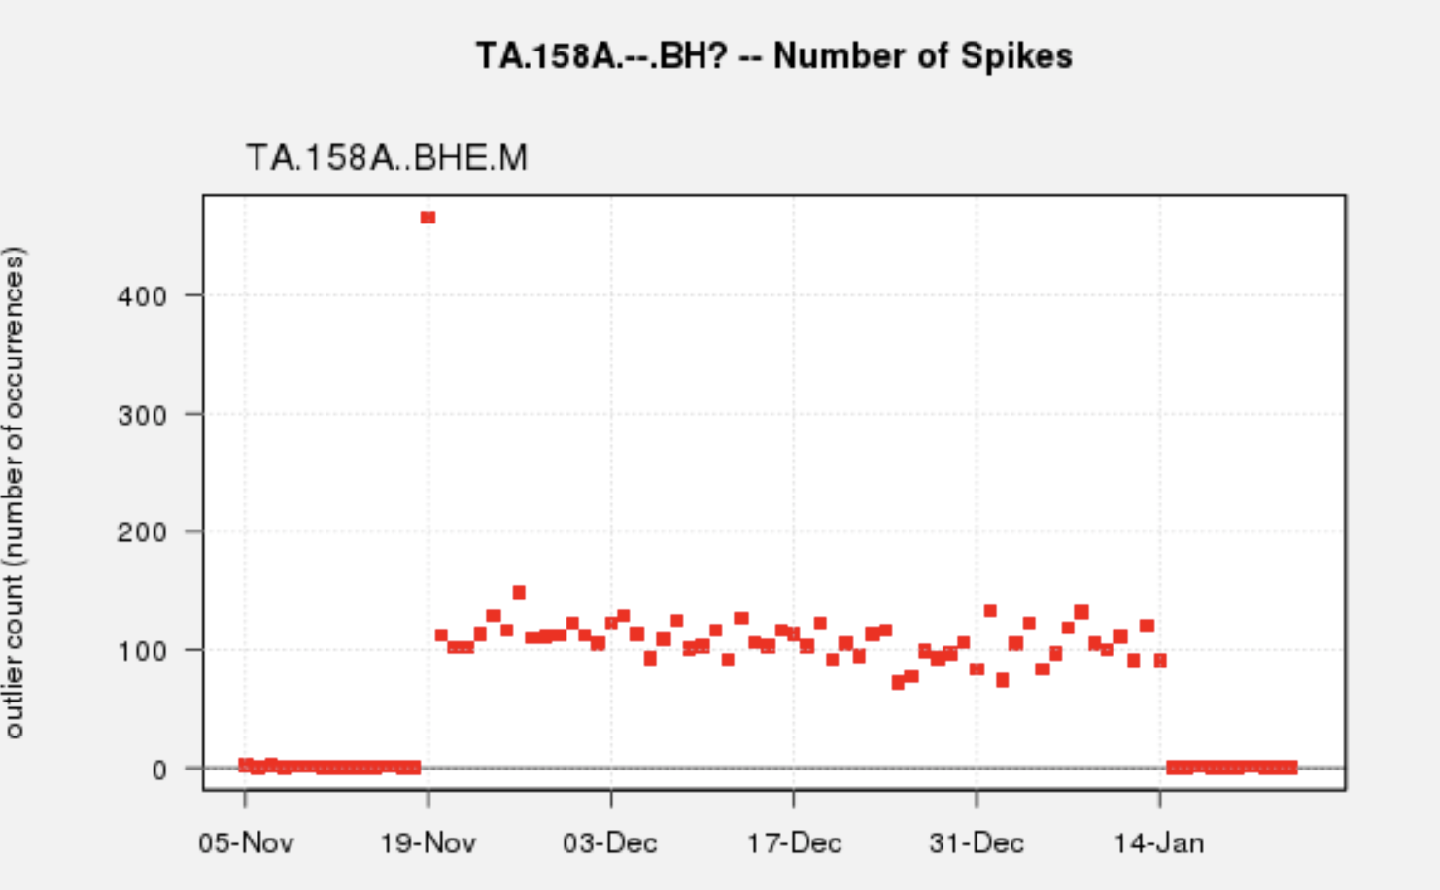
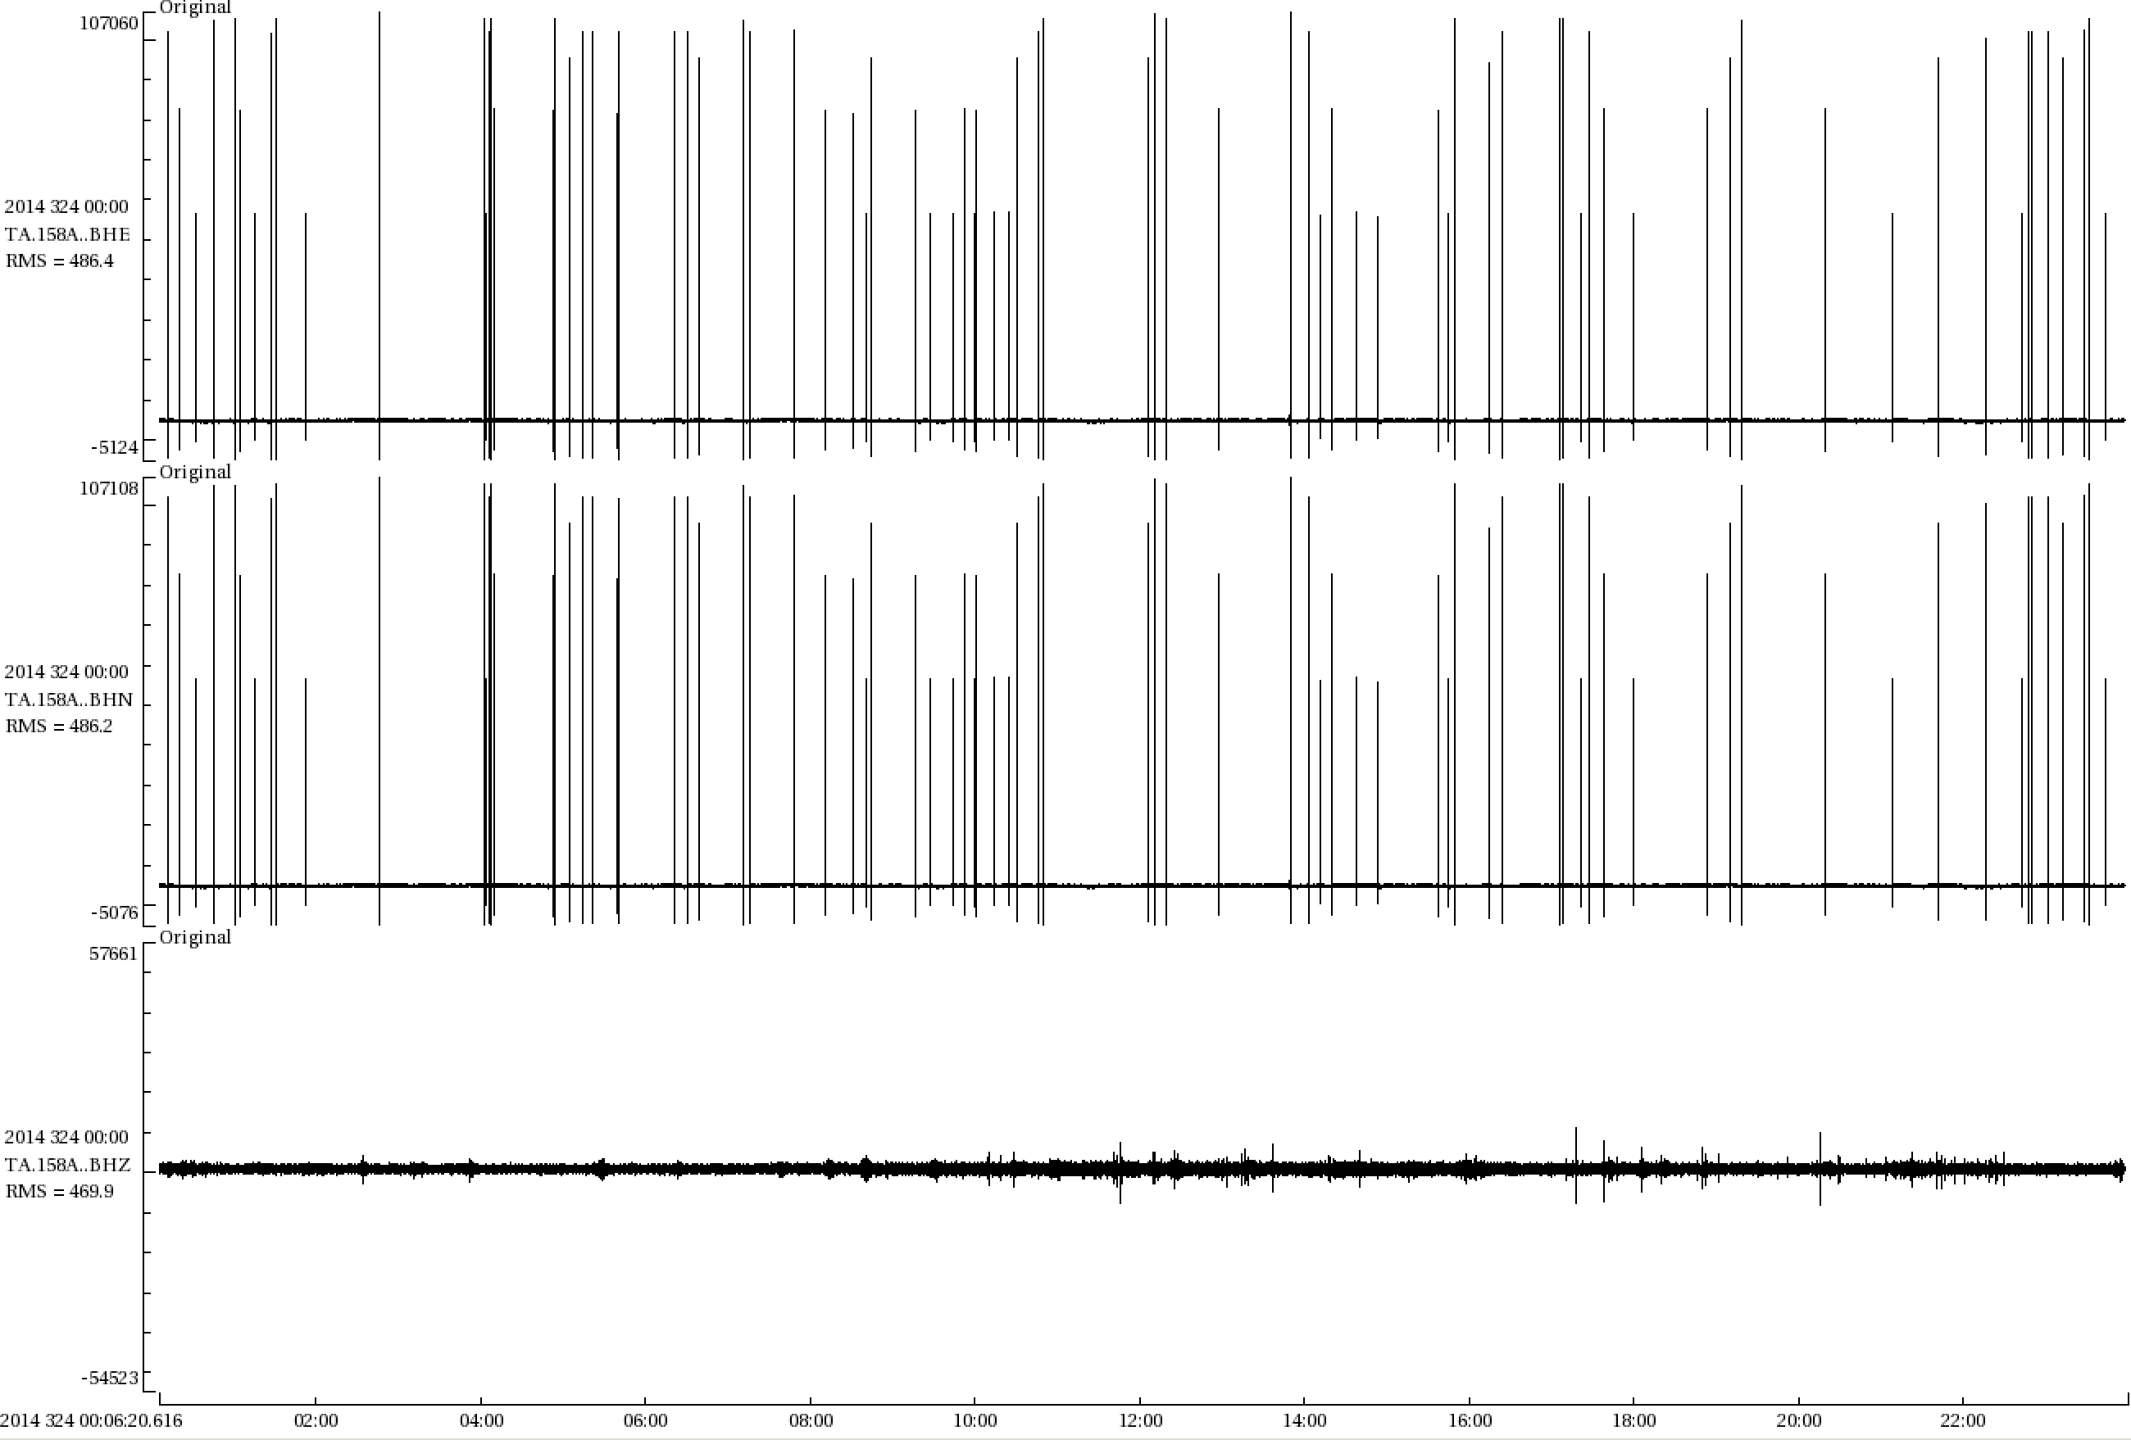
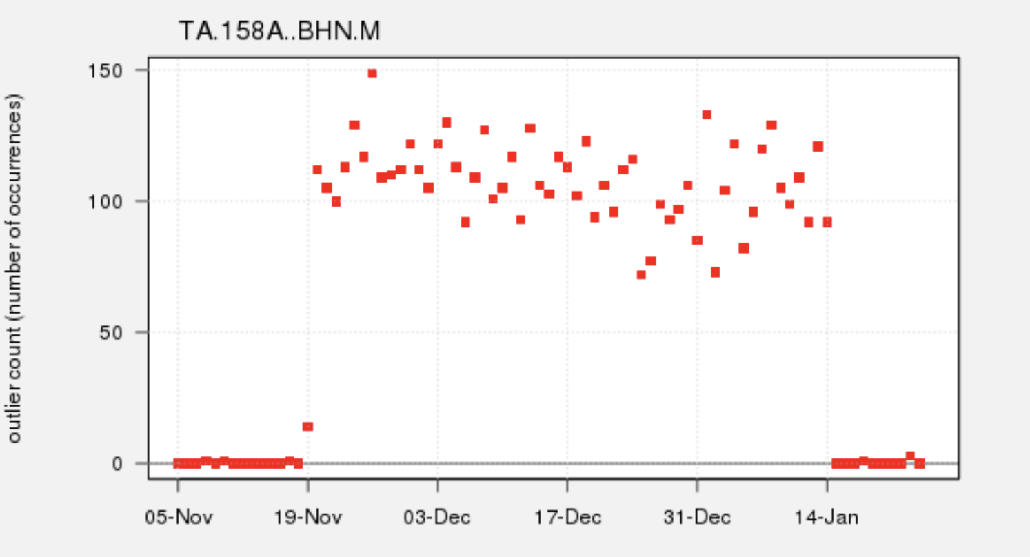
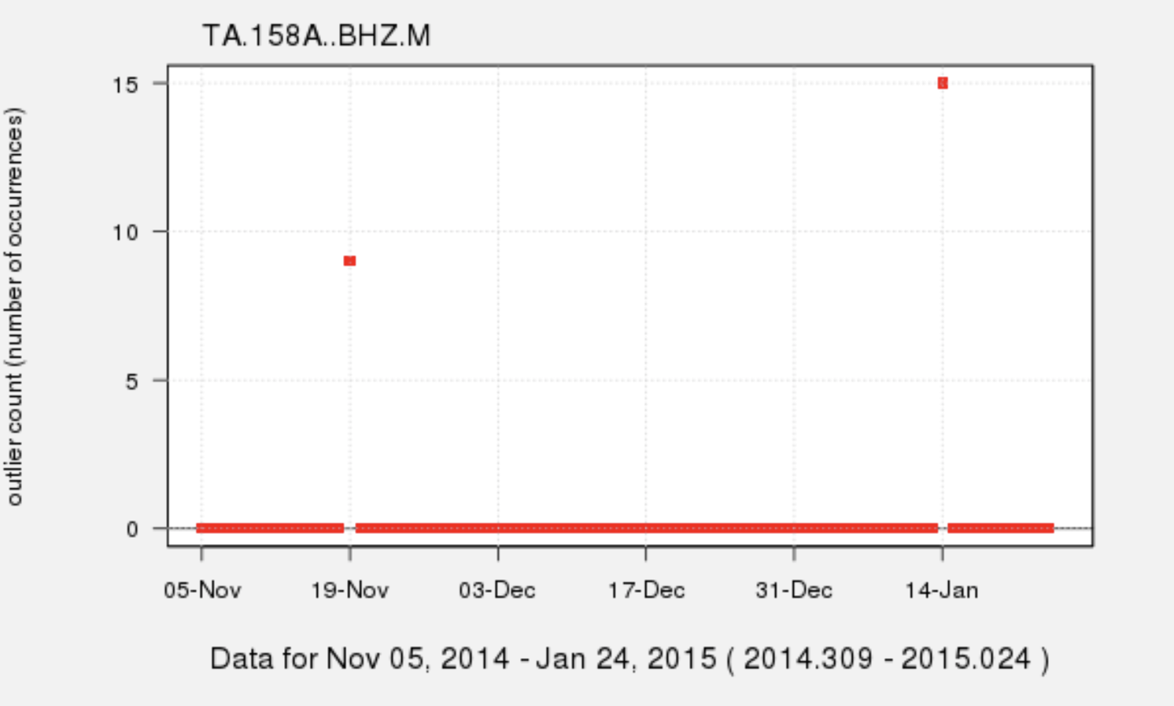
Num_spikes metric example
TA.158A number of spikes
TA.158A trace plot
BHE
BHN
BHZ
November 20, 2014
TA.158A stopped recording seismic energy and started returning spikes on BHE,BHN directly after a calibration pulse on November 19, 2014. It was fixed by a mass re-center on January 14, 2015.
11/05/2014 – 01/25/2015
Notes:
STS-2

Slide 40
What kinds of metrics are available?
MiniSEED Flag Counts
amplifier saturation
calibration signal
clock locked
digital filter charging
digitizer clipping
event begin/end
event in progress
glitches
missing padded data
spikes
suspect time tag
telemetry sync error
timing correction
Other
timing quality (blockette 1001)
metric error
Data Latency
real time data latency
real time feed latency
real time total latency
Data Availability
percent available
channel up time
maximum gap length
maximum overlap length
number of gaps
number of overlaps
Simple Data Statistics
maximum sample value
minimum sample value
median sample value
mean sample value
sample rms variance
unique sample count
Noise Analysis
Power Spectral Density (PSD)*
Probability Density Function (PDF)*
PSD/PDF statistics*
percent above high noise model
percent below low noise model
dead channel indicators
Signal Anomalies
cross talk
DC offset change
signal-to-noise ratio
maximum STA/LTA
number of spikes
pressure effects
Metadata Checks
orientation check
polarity check
transfer function
http://service.iris.edu/mustang/measurements/1/

Slide 41
Metric name | Description
orientation_check | horizontal channel orientation estimates based on Rayleigh-wave polarization as described in Stachnik, et. al., for event magnitudes > 7.0 and depth < 100 km
polarity_check | cross-correlation coefficient of station-channel with nearest neighbor station-channel for event magnitudes > 6.5
transfer_function | Gain ratio, phase difference, and magnitude-squared coherence between co-located sensors
Stachnik, J.C., Sheehan, A.F., Zietlow, D.W., Yang, Z, Collins, J. and Ferris, A, 2012, Determination of New Zealand Ocean Bottom Seismometer Orientation via Rayleigh-Wave Polarization, Seismological Research Letters, v. 83, no. 4, p 704-712, DOI: 10.1785/0220110128

Slide 42
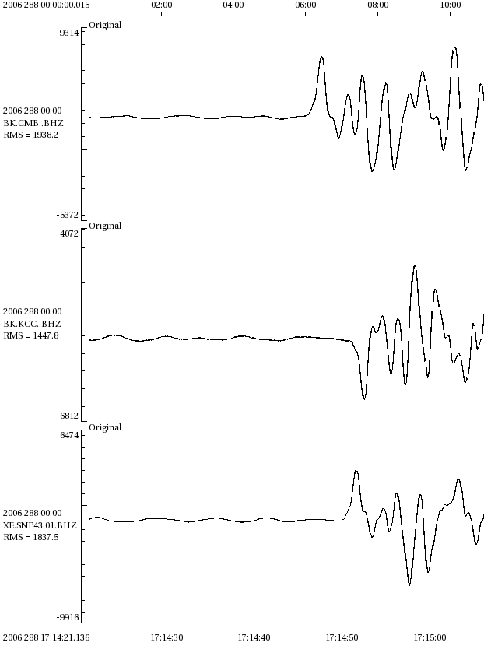
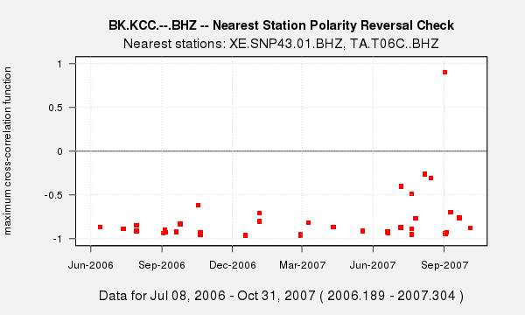
Polarity_check metric example
10-15-2006 Hawaii Mw 6.7
BK.KCC..BHZ corrects for the reversed polarity by using a negative sensitivity in its metadata
BK.CMB..BHZ
BK.KCC..BHZ
XE.SNP42.01.BHZ
the polarity_check metric does not apply the response
(but it does correct for azimuth/dip sign)

Slide 43
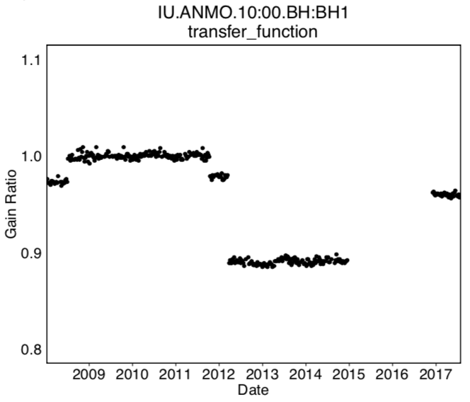
Transfer_function metric example
Transfer function gain ratio values for coherence > 0.999
Metrics query December 2017
Metrics query April 2018
(metadata updates in February, March)
Gain ratio < 0.9
Time gap in values plotted
because coherence < 0.999

Slide 44
Transfer_function metric example
Transfer function gain ratio values for coherence > 0.999
Metrics query December 2017
Metrics query April 2018
(metadata updates in February, March)
Metadata typo in A0 gain fixed
for IU.ANMO.00.BH1
Orientation re-measured
for both loc 00 and 10 sensors,
resulting in coherence > 0.999
Notes:
orientation metadata changes:
10.BH1 343 -> 340 degrees, 10.BH2 73 -> 70 degrees
00.BH1 18 - > 17, 00.BH2 -> 108-107

Slide 45
Retrieving MUSTANG Measurements
How to build web service queries

Slide 46
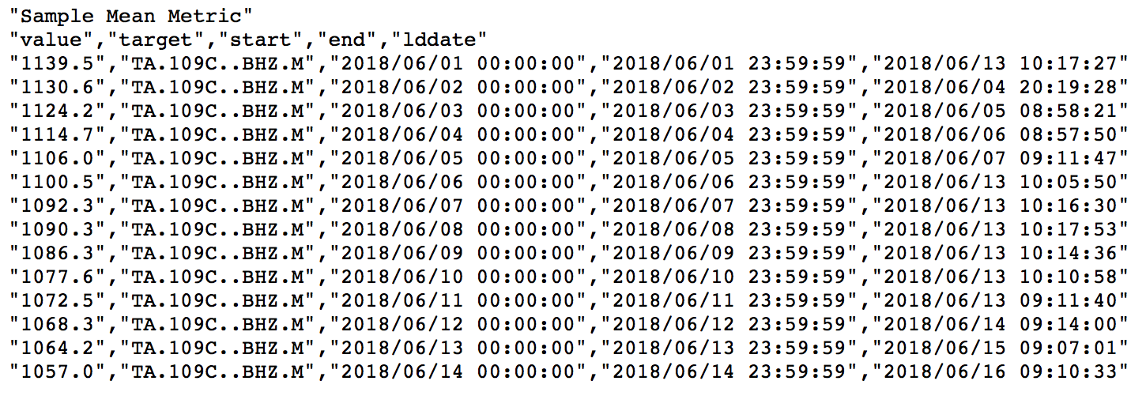
MUSTANG measurements queries
Web service queries take the form of a URL
Example:
http://service.iris.edu/mustang/measurements/1/query?
metric=sample_mean&target=TA.109C..BHZ.M
&start=2018-06-01&end=2018-06-15&format=text&nodata=404
Notes:
Columns are metric specific

Slide 47
MUSTANG measurements queries
The URL always starts with:
http://service.iris.edu/mustang/measurements/1/query?

Slide 48
MUSTANG measurements queries
The URL always starts with:
http://service.iris.edu/mustang/measurements/1/query?
Add a metric name:
.../query?metric=sample_mean (example)

Slide 49
MUSTANG measurements queries
The URL always starts with:
http://service.iris.edu/mustang/measurements/1/query?
Add station information:
.../query?metric=sample_mean
&target=TA.109C..BHZ.M
OR
&network=TA&station=109C&location=--&channel=BHZ
OR
&net=TA&sta=109C&loc=--&cha=BHZ
You can leave out any of network, station, location, channel and it has the effect of wildcard “*” for that element of the query.
Notes:
Quality is also an option, but we now only return results for “M” quality data

Slide 50
MUSTANG measurements queries
Target Format: Network.Station.Location.Channel.Quality
NSLCQ, sometimes called SNCLQ or SNCL (“snickel”)
Quality code is almost always “M” (“merged”)
  Latency metrics quality code will be "R" ("real-time")

Slide 51
MUSTANG measurements queries
Target Format: Network.Station.Location.Channel.Quality
NSLCQ, sometimes called SNCLQ or SNCL (“snickel”)
Quality code is almost always “M” (for “merged”)
  Latency metrics quality code will be "R" or "D"
Note: three metrics have non-standard target formats
cross_talk : Network.Station.Location.Channel1:Channel2.M
IU.CCM.10.LH1:LH2.M
pressure_effects : Network.Station.Location1:Location2.LDO:LH?.M
IU.CCM.30:00.LDO:LH1.M
transfer_function : Network.Station.Location1:Location2.ChannelGroup:Channel.M
IU.CCM.60:00.BH:BHZ.M

Slide 52
MUSTANG measurements queries
The URL always starts with:
http://service.iris.edu/mustang/measurements/1/query?
Add date and time information:
.../query?metric=sample_mean&target=TA.109C..BHZ.M
&starttime=2018-07-01T00:00:00.0000
&endtime=2018-08-01T00:00:00.0000
OR
&start=2018-07-01
&end=2018-08-01
Other date and time options are available such as timewindow, startbefore, startafter, endbefore, endafter

Slide 53
MUSTANG measurements queries
The URL always starts with:
http://service.iris.edu/mustang/measurements/1/query?
Add output format information:
.../query?metric=sample_mean&target=TA.109C..BHZ.M
&start=2018-07-01&end=2018-01-01
&format=text
Other format options are available:
xml (default, some browsers will not display)
csv, json, jsonp

Slide 54
MUSTANG measurements queries
The URL always starts with:
http://service.iris.edu/mustang/measurements/1/query?
What is the nodata option?
.../query?metric=sample_mean&target=TA.109C..BHZ.M
&start=2018-07-01&end=2018-01-01&format=text
&nodata=404
When you make a request that has no results, the default http return code is 204 (No Content)
Some browsers will not refresh and it looks like nothing happened
Asking for a 404 (Not Found) code will result in some kind of return that depends on the format requested and/or the browser

Slide 55
MUSTANG measurements queries
Example: &nodata=204 for query that returns no results:
http://service.iris.edu/mustang/measurements/1/query?
metric=sample_mean&target=TA.109C..BHZ.M&format=text
&start=2001-01-01&end=2001-01-02&nodata=204
Example: &nodata=404 for query that returns no results:
http://service.iris.edu/mustang/measurements/1/query?
metric=sample_mean&target=TA.109C..BHZ.M&format=text
&start=2001-01-01&end=2001-01-02&nodata=404
Notes:
After opening the browser for the second example, change the dates and go through the format options

Slide 56
MUSTANG measurements queries
Other Options:
Request metric values equal to, not equal to,
greater than, less than, etc.
&percent_availability=100
&percent_availability_eq=100
&sample_mean_gt=5000
_eq = equal to _ne = not equal to
_gt = greater than _ge = greater than or equal to
_lt = less than _le = less than or equal to

Slide 57
MUSTANG measurements queries
Other Options:
Use lists and/or wildcards for station information
&station=???K,*L,TUL1
&channel=BHZ,HHZ
Sort order by output field name, ascending or descending
&orderby=value_desc
&orderby=target_asc,start_asc

Slide 58
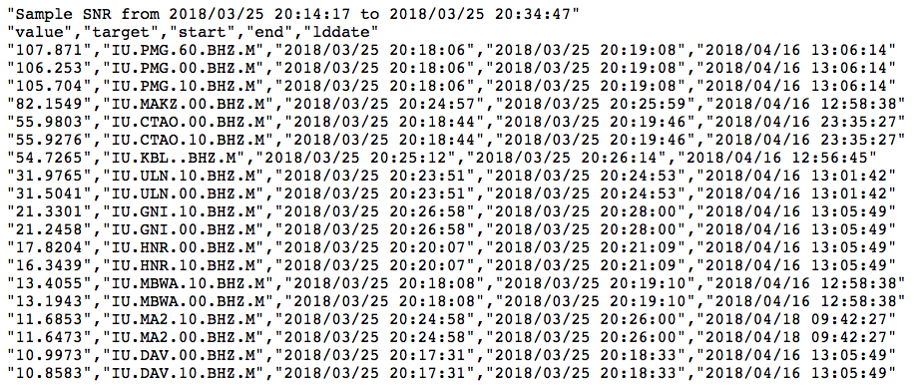
Measurement query example
All IU stations that have signal-to-noise-ratio > 10 for the 2018-03-25 20:14:47 Mw=6.4 Banda Sea event
http://service.iris.edu/mustang/measurements/1/query?metric=sample_snr
&net=IU&cha=BHZ&format=text&startafter=2018-03-25T20:14:17
&startbefore=2018-03-25T20:34:47&value_gt=10&orderby=value_desc
Notes:
Find max, min values using value_desc or value_asc
Sample_snr starts 30 seconds before the predicted P-arrival

Slide 59
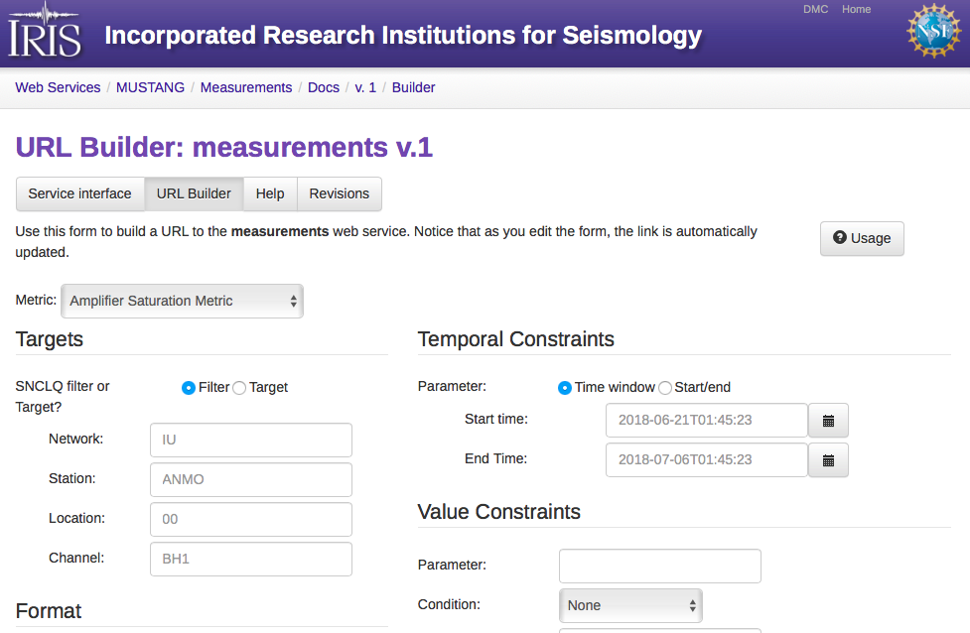
http://service.iris.edu/mustang/measurements/1/
Notes:
The URL builders do not have all options available, but are provided as a learning tool and for quick on—off queries.

Slide 60
Hands-on with the measurements URL Builder
How many stations in network II had at least one BH1, BH2, or BHZ channel that returned no data on July 4, 2018? (use percent_availability metric)
How many BHZ channels had 100% data return for 2018-to-date? (use ts_percent_availability_total metric)
What was the largest signal-to-noise ratio value for your network for the 07-06-2018 Kamchatka event, origin time 01:40:08 UTC? (use sample_snr metric)
http://service.iris.edu/mustang/measurements/1/

Slide 61
What if measurements are missing?
Does the metric run on this channel type? If in doubt, check the metric documentation
Did MUSTANG try to run the metric and record an error code?
http://service.iris.edu/mustang/metrics/docs/1/desc/metric_error/
Post a message to the IRIS Message Center
"MUSTANG QA" group
http://ds.iris.edu/message-center/topic/mustang-qa/
Email us directly: dmc_qa@iris.washington.edu

Slide 62
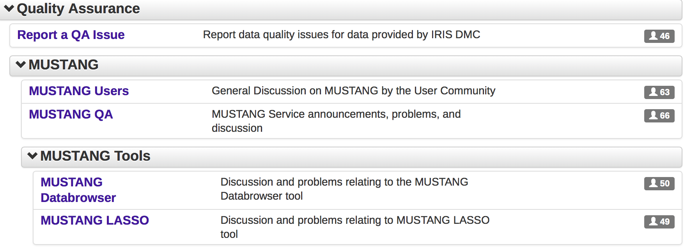
IRIS Message Center QA groups
http://ds.iris.edu/message-center

Slide 63
INTRODUCTION to:
PSDs and PDFs

Slide 64
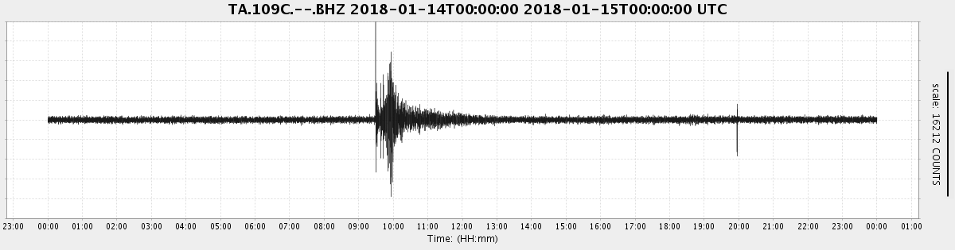
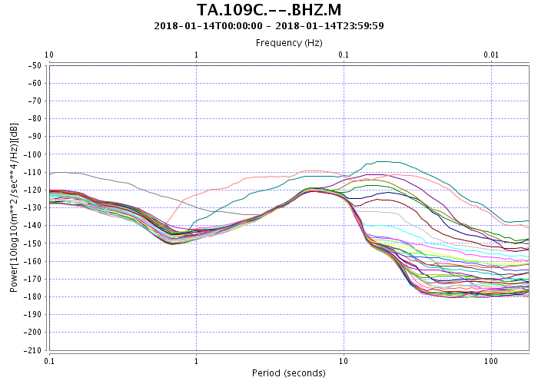
Power Spectral Densities (PSD)
Notes:
http://service.iris.edu/mustang/noise-psd/1/query?net=TA&sta=109C&loc=--&cha=BHZ&quality=M&starttime=2018-01-14&endtime=2018-01-15&correct=true&format=plot&plot.period.min=0.1&plot.period.max=180&plot.power.min=-210&plot.power.max=-50&plot.model=hide

Slide 65
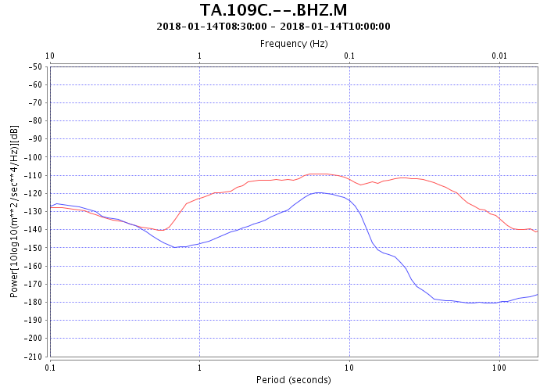
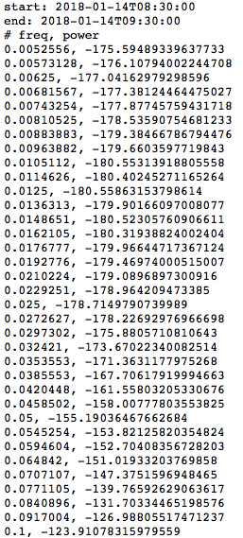
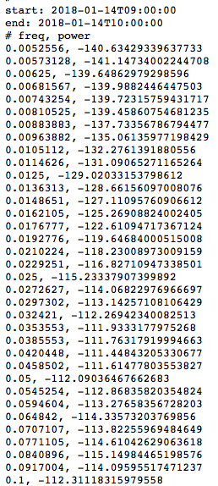
Power Spectral Densities (PSD)

Slide 66
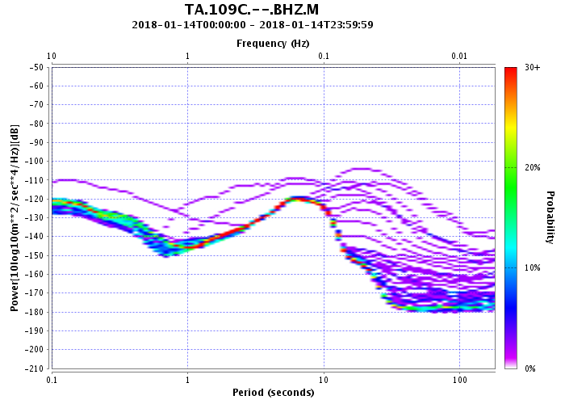
PSDs and PDFs
PSD
Probability Density Function (PDF)
Algorithm described in McNamara, D.E. and R.P. Buland, Ambient Noise Levels in the Continental United States, Bull. Seism. Soc. Am., 94, 4, 1517-1527, 2004.
Notes:
Frequency distribution
http://service.iris.edu/mustang/noise-psd/1/query?net=TA&sta=109C&loc=--&cha=BHZ&quality=M&starttime=2018-01-14&endtime=2018-01-15&correct=true&format=plot&plot.period.min=0.1&plot.period.max=180&plot.power.min=-210&plot.power.max=-50&plot.model=hide

Slide 67
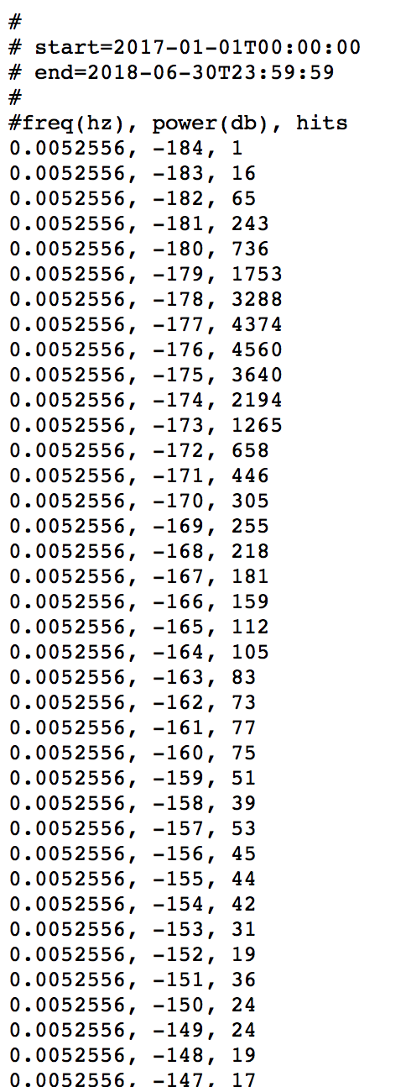
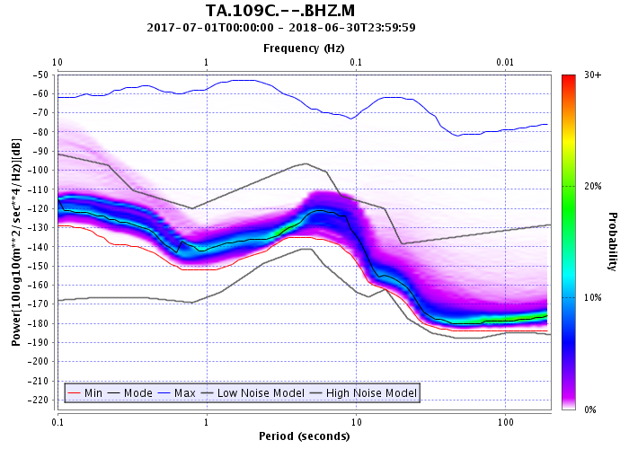
Probability Density Functions (PDF)
Notes:
47*365 days = 17155 PSDs as input into this PSD plot
http://service.iris.edu/mustang/noise-pdf/1/query?net=TA&sta=109C&loc=--&cha=BHZ&quality=M&starttime=2017-07-01&endtime=2018-07-01&format=plot&plot.interpolation=bicubic&plot.scale.display=show&plot.period.min=0.1&plot.period.max=200&plot.power.min=-225&plot.power.max=-50&nodata=404

Slide 68
Probability Density Functions (PDF)
New High Noise Model (NHNM)
New Low Noise Model (NLNM)
Noise Models from USGS Open File Report 93-322, 1993,
Observations and Modeling of Seismic Background Noise, Jon Peterson

Slide 69
Probability Density Functions (PDF)
Mode of PSDs
Maximum PSD
Minimum PSD
Noise Models from USGS Open File Report 93-322, 1993,
Observations and Modeling of Seismic Background Noise, Jon Peterson

Slide 70
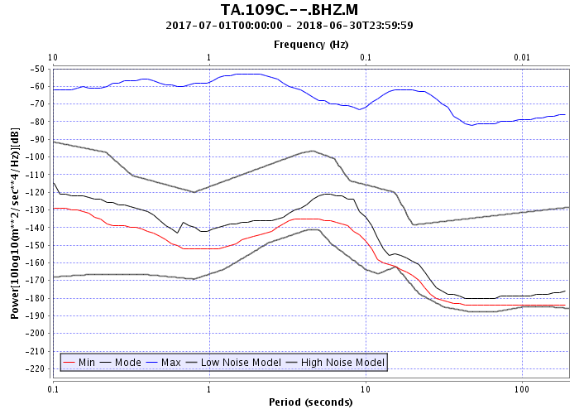
Probability Density Functions (PDF)
Mode of PSDs
Maximum PSD
Minimum PSD
Noise Models from USGS Open File Report 93-322, 1993,
Observations and Modeling of Seismic Background Noise, Jon Peterson

Slide 71
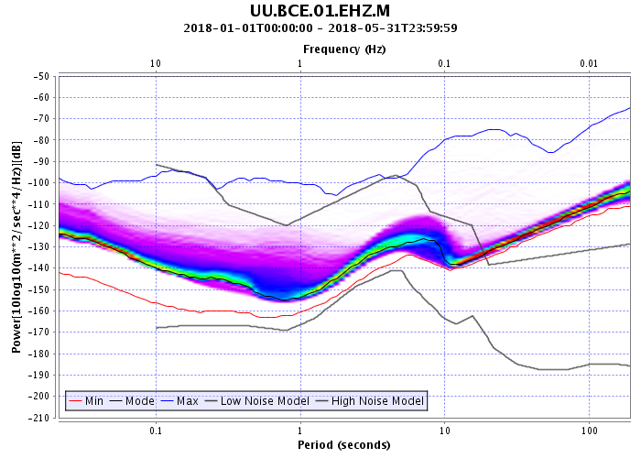
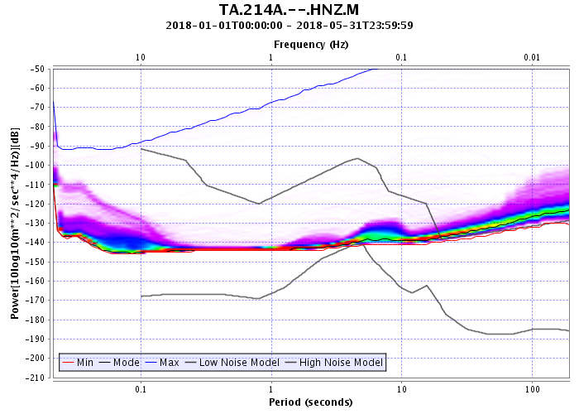
Probability Density Functions (PDF)
Example
Short period sensor
Example
Strong motion sensor
* noise models plotted are not applicable to instruments with these responses
Notes:
http://service.iris.edu/mustang/noise-pdf/1/query?net=UU&sta=BCE&loc=01&cha=EHZ&quality=M&starttime=2018-01-01&endtime=2018-06-01&format=plot&plot.interpolation=bicubic&plot.power.min=-210&plot.power.max=-50&nodata=404

Slide 72
Probability Density Functions (PDF)
What kinds of quality issues can be
observed in PDF plots?
Metadata problems
Sensor noise
Environmental noise
Digitizer noise or not recording signal
Gaps, calibrations, mass recenters

Slide 73
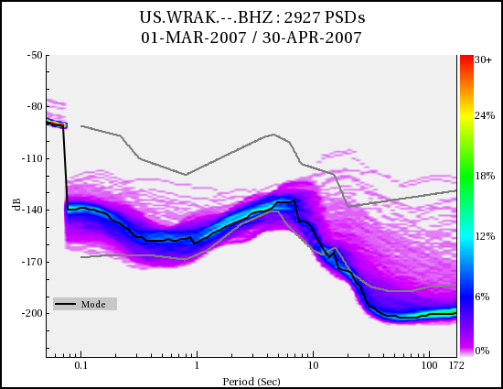
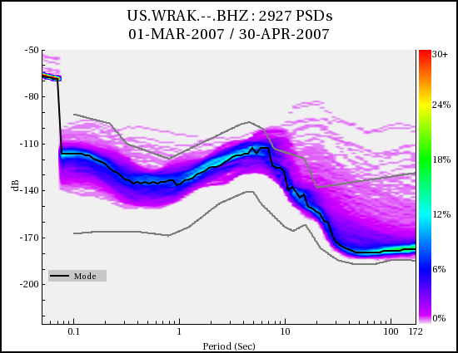
Metadata error example
Bad gain for STS-2
Used 20,000 counts/volt
instead of 1500 counts/volt
Results in low corrected amplitude
across spectrum
Corrected Response
*PDFs calculated with PQLX software
Notes:
PDF plots from PQLX, not MUSTANG
Slides modified from a presentation by Rick Benson

Slide 74
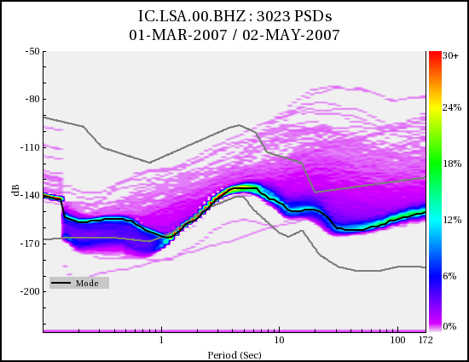
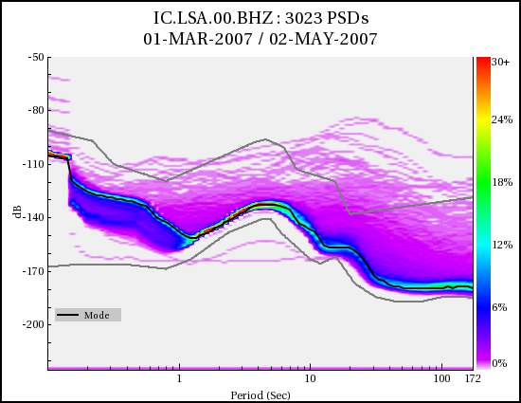
Metadata error example
Bad units for STS-1
Used acceleration input units (M/S**2)
But the poles and zeros in the response are appropriate for velocity
Results in tilted PSD:
Low power at low period
High power at high period
Corrected Response
*PDFs calculated with PQLX software

Slide 75
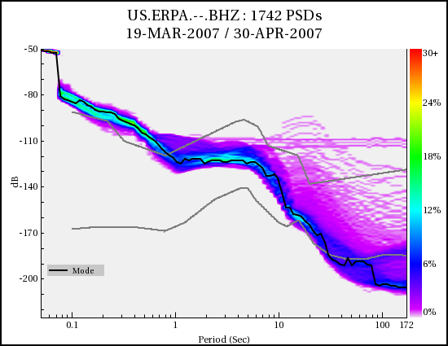
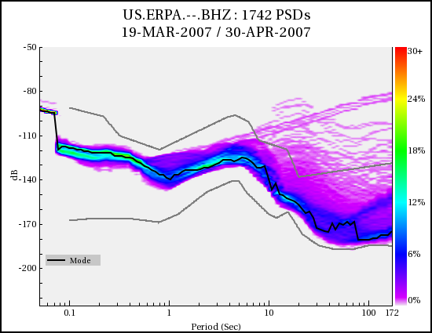
Metadata error example
Bad units for STS-2
Used displacement input units (M)
But the poles and zeros in the response are appropriate for velocity
Results in tilted PSD:
High power at low period
Low power at high period
Corrected Response
*PDFs calculated with PQLX software

Slide 76
What kinds of metrics are available?
MiniSEED Flag Counts
amplifier saturation
calibration signal
clock locked
digital filter charging
digitizer clipping
event begin/end
event in progress
glitches
missing padded data
spikes
suspect time tag
telemetry sync error
timing correction
Other
timing quality (blockette 1001)
metric error
Data Latency
real time data latency
real time feed latency
real time total latency
Data Availability
percent available
channel up time
maximum gap length
maximum overlap length
number of gaps
number of overlaps
Simple Data Statistics
maximum sample value
minimum sample value
median sample value
mean sample value
sample rms variance
unique sample count
Noise Analysis
Power Spectral Density (PSD)*
Probability Density Function (PDF)*
PSD/PDF statistics*
percent above high noise model
percent below low noise model
dead channel indicators
Signal Anomalies
cross talk
DC offset change
signal-to-noise ratio
maximum STA/LTA
number of spikes
pressure effects
Metadata Checks
orientation check
polarity check
transfer function
http://service.iris.edu/mustang/measurements/1/

Slide 77
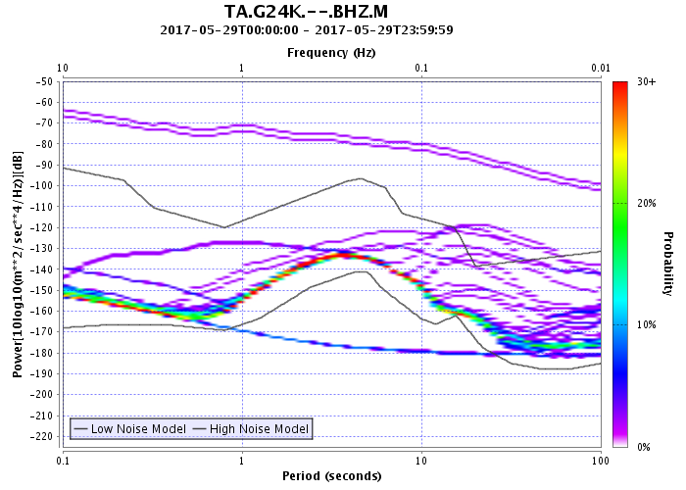
PDF-derived metrics
Percent above New High Noise Model
Percent below New Low Noise Model
Notes:
http://service.iris.edu/mustang/noise-pdf/1/query?net=TA&sta=G24K&loc=--&cha=BHZ&quality=M&starttime=2017-05-29&endtime=2017-05-30&format=plot&plot.minmodemax=hide&plot.interpolation=bicubic&plot.period.min=0.1&plot.period.max=100&plot.power.min=-225&plot.power.max=-50&plot.scale.display=show&nodata=404

Slide 78
PDF-derived metrics
pct_above_nhnm
Percentage of PDF matrix hits above the New High Noise Model
24-hour period 00:00:00 – 23:59:59.9999 UTC
pct_above_nhnm = 5.706
Notes:
http://service.iris.edu/mustang/noise-pdf/1/query?net=TA&sta=G24K&loc=--&cha=BHZ&quality=M&starttime=2017-05-29&endtime=2017-05-30&format=plot&plot.minmodemax=hide&plot.interpolation=bicubic&plot.period.min=0.1&plot.period.max=100&plot.power.min=-225&plot.power.max=-50&nodata=404

Slide 79
PDF-derived metrics
pct_below_nlnm
Percentage of PDF matrix hits below the New Low Noise Model
24-hour period 00:00:00 – 23:59:59.9999 UTC
pct_below_nlnm = 3.820
Notes:
http://service.iris.edu/mustang/noise-pdf/1/query?net=TA&sta=G24K&loc=--&cha=BHZ&quality=M&starttime=2017-05-29&endtime=2017-05-30&format=plot&plot.minmodemax=hide&plot.interpolation=bicubic&plot.period.min=0.1&plot.period.max=100&plot.power.min=-225&plot.power.max=-50&nodata=404

Slide 80
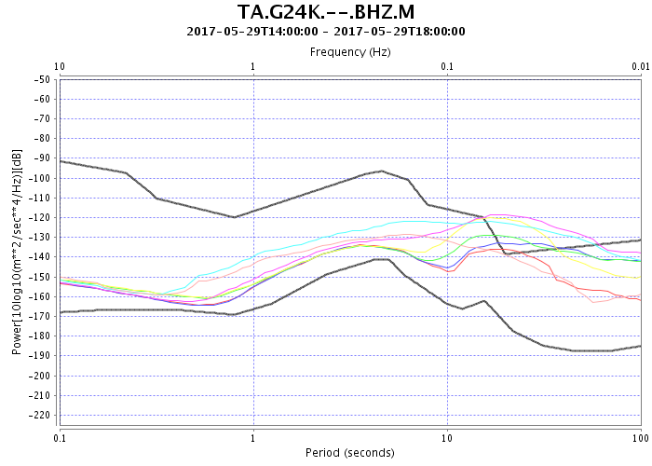
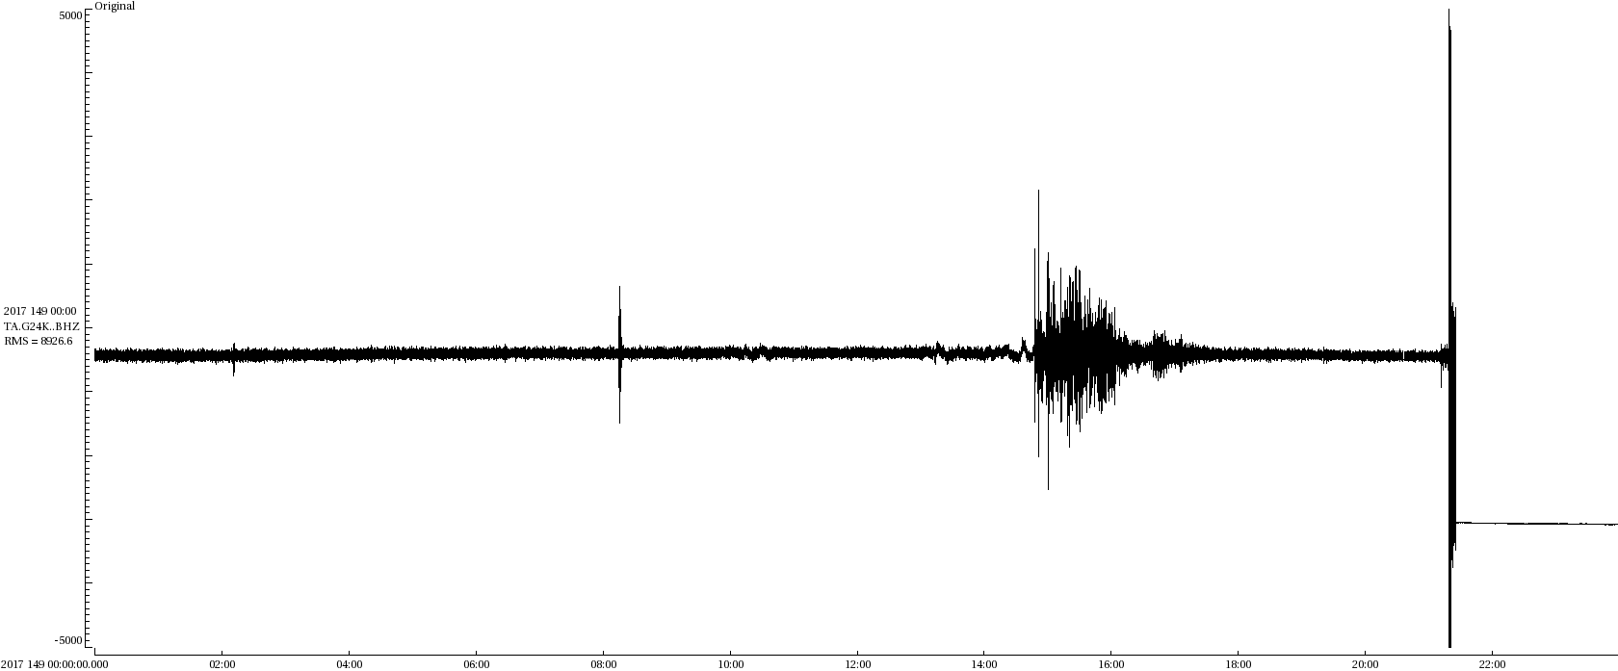
PDF-derived metrics
PDF
PSDs
Mw 6.6, Indonesia
TA.G24K..BHZ, 2017-05-29
scale +/- 5000 counts
TA.G24K..BHZ, 2017-05-29
+/- 5000 counts
Notes:
http://service.iris.edu/mustang/noise-pdf/1/query?net=TA&sta=G24K&loc=--&cha=BHZ&quality=M&starttime=2017-05-29&endtime=2017-05-30&format=plot&plot.minmodemax=hide&plot.interpolation=bicubic&plot.period.min=0.1&plot.period.max=100&plot.power.min=-225&plot.power.max=-50&nodata=404

Slide 81
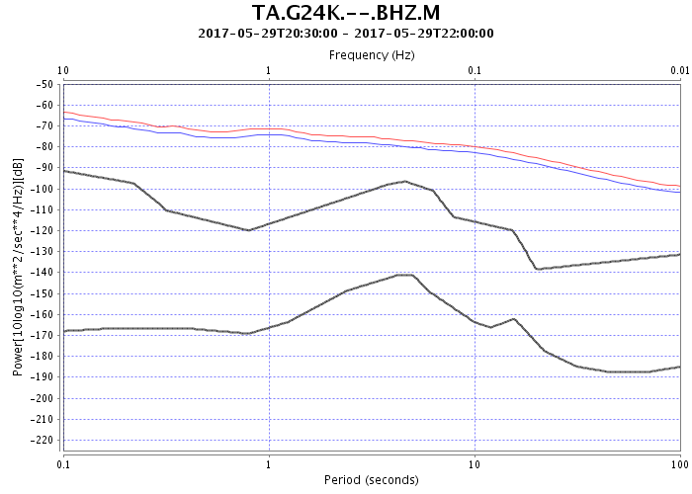
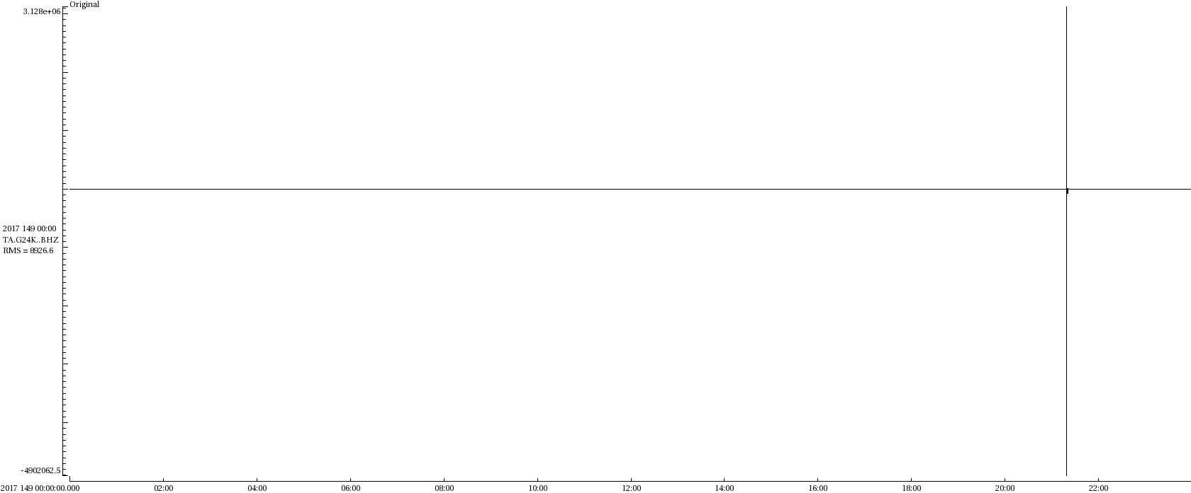
PDF-derived metrics
PDF
PSDs
bear (?) destroying cable
TA.G24K..BHZ, 2017-05-29
scale +3.1e+06/-4.9e+06 counts
Notes:
http://service.iris.edu/mustang/noise-pdf/1/query?net=TA&sta=G24K&loc=--&cha=BHZ&quality=M&starttime=2017-05-29&endtime=2017-05-30&format=plot&plot.minmodemax=hide&plot.interpolation=bicubic&plot.period.min=0.1&plot.period.max=100&plot.power.min=-225&plot.power.max=-50&nodata=404

Slide 82
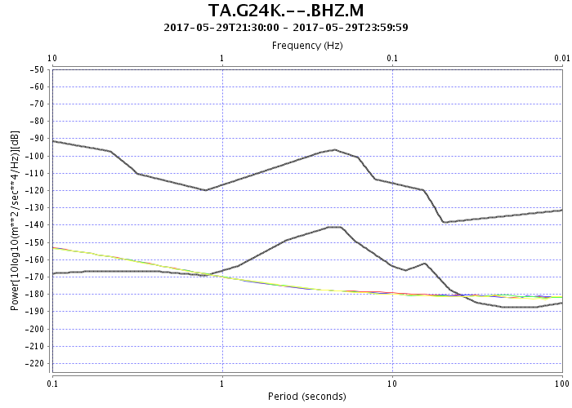
PDF-derived metrics
PDF
PSDs
TA.G24K..BHZ, 2017-05-29
scale +/- 5000 counts
digitizer noise
Notes:
http://service.iris.edu/mustang/noise-pdf/1/query?net=TA&sta=G24K&loc=--&cha=BHZ&quality=M&starttime=2017-05-29&endtime=2017-05-30&format=plot&plot.minmodemax=hide&plot.interpolation=bicubic&plot.period.min=0.1&plot.period.max=100&plot.power.min=-225&plot.power.max=-50&nodata=404
Nanometrics Trillium 120 Sec Response/Quanterra 330

Slide 83
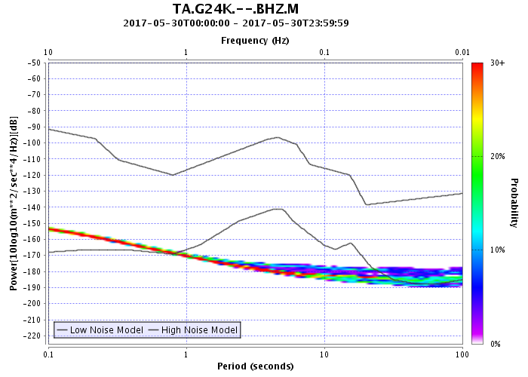
PDF-derived metrics
2017-05-30
pct_below_nlnm=52.926
pct_above_nhnm=0

Slide 84
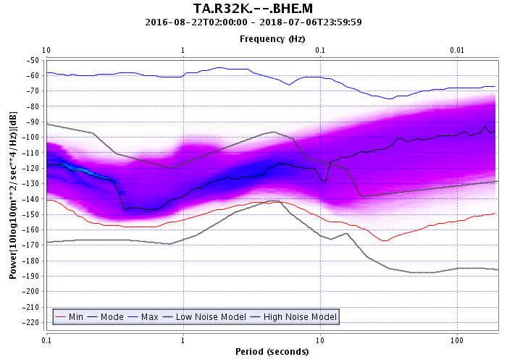
PDF-derived metrics
Environmental noise and pct_above_nhnm
Station sited at Douglas Island, Alaska, Eaglecrest Ski Area
average pct_above_nhnm = 37.45
Notes:
Island station in Alaska, likely subject ot high winds
Not typical of TA station noise levels

Slide 85
PDF-derived metrics
dead_channel_gsn
difference the median PSD from the NLNM for periods 4-8 seconds
average the values
dead_channel_gsn = 1 if result is more than 5 dB below the NLNM

Slide 86
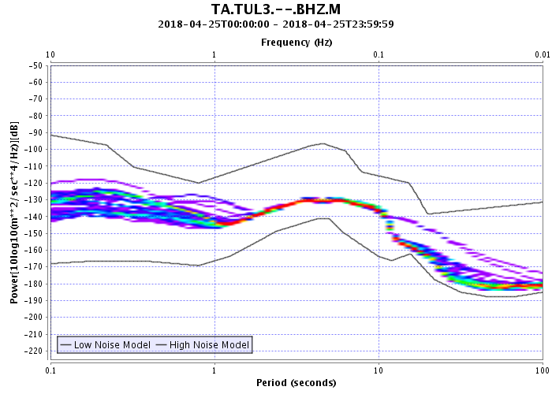





PDF-derived metrics
PDF
dead_channel_lin
Waveforms
Value=11.06
Normal Data
Value=0.91
Spikes
Notes:
Waveform plots are at different scales
empirical metric
There is also a dead_channel _exp metric that fits an exponential curve to the PDF, but that metric will likely be retired in the near future

Slide 87



PDF-derived metrics
PDF
dead_channel_lin
Waveforms
Value=11.06
Normal Data
Value=2.47
Digitizer Noise

Slide 88


Effect of gaps on PDF

Slide 89


PDF-derived metrics
Environmental noise and dead_channel_lin
US.LONY.00.BH1
PDF for 02-20-2016
dead_channel_lin=1.79
Notes:
Upper New York State

Slide 90

PDF-derived metrics
Environmental noise and dead_channel_lin
US.LONY.00.BH1
PDF for entire station history
Average dead_channel_lin=7.34

Slide 91



Flatlined channels have no PSDs
A flatlined channel records consistently one sample value
Metric sample_unique = 1 and sample_rms = 0
(if the condition lasts 00:00:00-24:00:00 UTC)
Cannot calculate FFT no PDF, no PDF-derived metrics for timespan
TA.K29M..BHE, 2017.018-2017.026
Digitizer problem, fixed by digitizer reboot

Slide 92
PDF BROWSER
MUSTANG WEB SERVICES
http://service.iris.edu/mustang/noise-pdf-browser/1/

Slide 93

http://service.iris.edu/mustang/noise-pdf-browser/1/

Slide 94

PDF Browser Breakout view
Explore the PDF history of a single station

Slide 95

PDF Browser Breakout queries
http://service.iris.edu/mustang/noise-pdf-browser/1/breakout?
target=IU.ADK.00.BHZ.M
entire station history
by years
Notes:
Can only specify one target
By years for all years the station channel was operating

Slide 96
PDF Browser Breakout queries
http://service.iris.edu/mustang/noise-pdf-browser/1/breakout?
net=IU&sta=ADK&loc=00&cha=BHZ&quality=M
entire station history
by years
Notes:
Can only specify one target
By years for all years the station channel was operating

Slide 97
PDF Browser Breakout queries
http://service.iris.edu/mustang/noise-pdf-browser/1/breakout?
target=IU.ADK.00.BHZ&interval=all
entire station history
by years
Notes:
Default view if you only specify station

Slide 98

PDF Browser Breakout queries
http://service.iris.edu/mustang/noise-pdf-browser/1/breakout?
target=IU.ADK.00.BHZ.M&interval=year&time=2015-06-01
by year
by month
Notes:
By month for all months in the year

Slide 99
PDF Browser Breakout queries
http://service.iris.edu/mustang/noise-pdf-browser/1/breakout?
target=IU.ADK.00.BHZ.M&interval=year&time=2015-06-01
navigation
arrows
Notes:
Go to link and demonstrate

Slide 100

PDF Browser Breakout queries
http://service.iris.edu/mustang/noise-pdf-browser/1/breakout?
target=IU.ADK.00.BHZ.M&interval=month&time=2015-06-01
Month
By Day
Notes:
By day for all days in the month

Slide 101

PDF Browser Breakout queries
http://service.iris.edu/mustang/noise-pdf-browser/1/breakout?
target=IU.ADK.00.BHZ.M&interval=week&time=2015-06-01
Week
By Day
Notes:
By day for all days in the week
Week starts on Sunday

Slide 102

PDF Browser Gallery view
Quickly review PDF plots for an entire network

Slide 103

PDF Browser Gallery queries
http://service.iris.edu/mustang/noise-pdf-browser/1/gallery?
net=IU

Slide 104
PDF Browser Gallery queries
http://service.iris.edu/mustang/noise-pdf-browser/1/gallery?
net=IU&interval=year&maxintervals=4
Notes:
Click on link, then change to &cha=BH?,HH?
You can also specify stations

Slide 105

PDF Browser Gallery queries
http://service.iris.edu/mustang/noise-pdf-browser/1/gallery?
net=IU&interval=month&maxintervals=3
Notes:
Click on link, change interval to week

Slide 106

PDF Browser Gallery queries
http://service.iris.edu/mustang/noise-pdf-browser/1/gallery?
net=IU&starttime=2017-01-01&endtime=2017-01-02
Notes:
Endtime behavior

Slide 107

PDF Browser Gallery queries
http://service.iris.edu/mustang/noise-pdf-browser/1/gallery?
net=IU&interval=all&starttime=2018-06-01&endtime=2018-07-10
One channel set
per line

Slide 108
PDF Browser Summary view
List of targets and date-ranges for
available PDF information
http://service.iris.edu/mustang/noise-pdf-browser/1/summary?
target=TA.*.*.BH?.M
http://service.iris.edu/mustang/noise-pdf-browser/1/summary?
net=TA&cha=BH?
http://service.iris.edu/mustang/noise-pdf-browser/1/summary?
network=TA&station=*&channel=BH?&location=*&quality=M

Slide 109
PDF Browser – script example
Create web link using php script to produce a PDF Browser gallery
for the TA network, BH and HH channels, most recent 1 month time period
<html>
<?php
date_default_timezone_set('UTC');
$start=urlencode(date('Y-m-d',time()-86400*30));
$link='http://service.iris.edu/mustang/noise-pdf-browser/1/gallery?' .
'network=TA&channel=BH?,HH?' .
'&starttime=' . $start . '&interval=all';
echo '<p><a href=$link>TA PDF Gallery Broadband </a> : ' .
'Past Month $start</br>';
?>
</html>
Notes:
Demonstrate at crunch USArray page

Slide 110
PDF Browser – script example
Create web link using php script to produce a PDF Browser gallery
for the TA network, BH and HH channels, most recent 1 month time period
<html>
<?php
date_default_timezone_set('UTC');
$start=urlencode(date('Y-m-d',time()-86400*30));
$link='http://service.iris.edu/mustang/noise-pdf-browser/1/gallery?' .
'network=TA&channel=BH?,HH?' .
'&starttime=' . $start . '&interval=all';
echo '<p><a href=$link>TA PDF Gallery Broadband </a> : ' .
'Past Month $start</br>';
?>
</html>
Notes:
Demonstrate at crunch USArray page

Slide 111
PDF Browser – script example
Create web link using php script to produce a PDF Browser gallery
for the TA network, BH and HH channels, most recent 1 month time period
<html>
<?php
date_default_timezone_set('UTC');
$start=urlencode(date('Y-m-d',time()-86400*30));
$link='http://service.iris.edu/mustang/noise-pdf-browser/1/gallery?' .
'network=TA&channel=BH?,HH?' .
'&starttime=' . $start . '&interval=all';
echo '<p><a href=$link>TA PDF Gallery Broadband </a> : ' .
'Past Month $start</br>';
?>
</html>
Notes:
Demonstrate at crunch USArray page

Slide 112
PDF Browser – script example
Create web link using php script to produce a PDF Browser gallery
for the TA network, BH and HH channels, most recent 1 month time period
<html>
<?php
date_default_timezone_set('UTC');
$start=urlencode(date('Y-m-d',time()-86400*30));
$link='http://service.iris.edu/mustang/noise-pdf-browser/1/gallery?' .
'network=TA&channel=BH?,HH?' .
'&starttime=' . $start . '&interval=all';
echo '<p><a href=$link>TA PDF Gallery Broadband </a> : ' .
'Past Month $start</br>';
?>
</html>
Notes:
Demonstrate at crunch USArray page

Slide 113
PDF Browser – script example
Create web link using php script to produce a PDF Browser gallery
for the TA network, BH and HH channels, most recent 1 month time period
<html>
<?php
date_default_timezone_set('UTC');
$start=urlencode(date('Y-m-d',time()-86400*30));
$link='http://service.iris.edu/mustang/noise-pdf-browser/1/gallery?' .
'network=TA&channel=BH?,HH?' .
'&starttime=' . $start . '&interval=all';
echo '<p><a href=$link>TA PDF Gallery Broadband </a> : ' .
'Past Month $start</br>';
?>
</html>
Notes:
Demonstrate at crunch USArray page

Slide 114
PDF Browser – script example
Create web link using php script to produce a PDF Browser gallery
for the TA network, BH and HH channels, most recent 1 month time period
<html>
<?php
date_default_timezone_set('UTC');
$start=urlencode(date('Y-m-d',time()-86400*30));
$link='http://service.iris.edu/mustang/noise-pdf-browser/1/gallery?' .
'network=TA&channel=BH?,HH?' .
'&starttime=' . $start . '&interval=all';
echo '<p><a href=$link>TA PDF Gallery Broadband </a> : ' .
'Past Month $start</br>';
?>
</html>
Notes:
Demonstrate at crunch USArray page

Slide 115

PDF Browser
The PDF Browser has fixed power limits of -225/-25 dB
If there are no PSDs available, then there is no plot displayed
If you see a blank plot, that means that all the PSDs fall outside these limits
metadata problem
Notes:
If there are no PSDs, then there is no plot displayed

Slide 116


PDF Browser
From PDF Browser
With expanded power limits

Slide 117
Hands-on with the PDF Browser
Create a PDF Gallery view of your network broadband channels for the past 2 months (use interval=all)
Are any stations currently returning digitizer noise? If so, when did they stop recording seismic energy?
Pick a station in your network. Have there been any time periods where you can observe changes to its characteristic noise levels? Use both the Gallery and Breakout views
http://service.iris.edu/mustang/noise-pdf-browser/1/

Slide 118
Noise-PDF
MUSTANG WEB SERVICES
http://service.iris.edu/mustang/noise-pdf/1/

Slide 119

http://service.iris.edu/mustang/noise-pdf/1/

Slide 120


http://service.iris.edu/mustang/noise-pdf/1/

Slide 121
MUSTANG noise-pdf queries
http://service.iris.edu/mustang/noise-pdf/1/query?
Like the other MUSTANG services, add station information:
target=TA.109C..BHZ.M
or
network=TA&station=109C&location=--&channel=BHZ
&quality=M
or
net=TA&sta=109C&loc=--&cha=BHZ&quality=M
all elements of network, station, location, and quality are required if target is not specified, but these can be wildcarded

Slide 122
MUSTANG noise-pdf queries
http://service.iris.edu/mustang/noise-pdf/1/query?
Add date and time information (optional):
target=TA.109C..BHZ.M&starttime=2017-07-01
&endtime=2017-08-01
Unlike the measurements service, you cannot shorten starttime to ‘start’ or
endtime to ‘end' and there are no other date options

Slide 123
MUSTANG noise-pdf queries
http://service.iris.edu/mustang/noise-psd/1/query?
Add format information for PDFs:
.../query?target=TA.109C..BHZ.M
&starttime=2018-07-01&endtime=2018-07-02
&format=plot
Format options are text, xml, plot

Slide 124

MUSTANG noise-pdf queries
http://service.iris.edu/mustang/noise-pdf/1/query?
target=TA.109C..BHZ.M&format=plot
Notes:
Entire station history

Slide 125

MUSTANG noise-pdf queries
http://service.iris.edu/mustang/noise-pdf/1/query?
target=TA.109C..BHZ.M&format=plot
&starttime=2017-07-15&endtime=2018-07-15

Slide 126
MUSTANG noise-pdf queries
With some plot options added:
http://service.iris.edu/mustang/noise-pdf/1/query?
target=TA.109C..BHZ.M&format=plot
&starttime=2017-07-15&endtime=2018-07-15
&plot.minmodemax=hide&plot.model=hide
&plot.title=TA+109C+--+BHZ++2017/07/15-2018/07/15
&plot.legend=hide&plot.scale.display=show
&plot.period.min=0.1&plot.period.max=200
&plot.power.min=-200&plot.power.max=-75
&plot.axisfont.size=14&plot.titlefont.size=24
&plot.labelfont.size=18&plot.frequency.label=hide
&plot.frequency.axis=hide&plot.subtitle=hide

Slide 127

MUSTANG noise-pdf queries
With some plot options added:
http://service.iris.edu/mustang/noise-pdf/1/query?
target=TA.109C..BHZ.M&format=plot
&starttime=2017-07-15&endtime=2018-07-15
&plot.minmodemax=hide&plot.model=hide
&plot.title=TA+109C+--+BHZ++2017/07/15-2018/07/15
&plot.legend=hide&plot.scale.display=show
&plot.period.min=0.1&plot.period.max=200
&plot.power.min=-200&plot.power.max=-75
&plot.axisfont.size=14&plot.titlefont.size=24
&plot.labelfont.size=18&plot.frequency.label=hide
&plot.frequency.axis=hide&plot.subtitle=hide

Slide 128

MUSTANG noise-pdf queries
http://service.iris.edu/mustang/noise-pdf/1/query?
target=TA.109C..BHZ.M&format=text
&starttime=2017-07-15&endtime=2018-07-15

Slide 129

MUSTANG noise-pdf queries
http://service.iris.edu/mustang/noise-pdf/1/query?
target=TA.109C..BHZ.M&format=xml
&starttime=2017-07-15&endtime=2018-07-15

Slide 130


Composite PDF plots
Combine PSDs from multiple stations into single PDF plot
http://service.iris.edu/mustang/noise-pdf/1/query?net=TA&sta=*&loc=*&cha=BHZ&quality=M
&starttime=2017-07-15&endtime=2018-07-15&format=plot&plot.period.min=0.1
&plot.period.max=200&plot.power.min=-225&plot.power.max=-50
Notes:
Wildcarded the station and location, it will use the PSDs from all the stations
This plot is for a year, July 2017- July 2018
View the most common noise levels across you network
Create noise models for station comparison

Slide 131


Composite PDF plots
Combine PSDs from multiple stations into single PDF plot
http://service.iris.edu/mustang/noise-pdf/1/query?net=TA&sta=*K,*L,*M,HARP,J29N,O30N
&loc=*&cha=BHZ&quality=M&plot.title=TA+Network+in+Alaska&... (truncated query)
Notes:
You can use lists of targets also.

Slide 132

PDF statistics numbers available
Minimum
Maximum
Mode
Mean
Median
Percentiles
Create noise models for station comparison
Use in other custom analyses
Notes:
This is a PDF plot, but with the histogram values hidden and just the min, mode, max curves displayed
These are numbers that can be output into text from the noise-pdf service
Not just min, mode, and max but also the mean, median, and arbitrary percentiles

Slide 133

PDF statistics numbers available
http://service.iris.edu/mustang/noise-pdf/1/query?target=TA.109C..BHZ.M
&starttime=2017-07-01&endtime=2018-07-01
&format=noiseprofile_text&noiseprofile.type=min,max,mode,median,5,95
Minimum
Maximum
Mode
Mean
Median
Percentiles

Slide 134
PDF statistics numbers available
http://service.iris.edu/mustang/noise-pdf/1/query?target=TA.109C..BHZ.M
&starttime=2017-07-01&endtime=2018-07-01
&format=noiseprofile_text&noiseprofile.type=min,max,mode,median,5,95
Minimum
Maximum
Mode
Mean
Median
Percentiles

Slide 135
PDF statistics numbers available
http://service.iris.edu/mustang/noise-pdf/1/query?target=TA.109C..BHZ.M
&starttime=2017-07-01&endtime=2018-07-01
&format=noiseprofile_text&noiseprofile.type=min,max,mode,median,5,95
Minimum
Maximum
Mode
Mean
Median
Percentiles

Slide 136

PDF statistics numbers available
http://service.iris.edu/mustang/noise-pdf/1/query?target=TA.*.*.BHZ.M
&format=noiseprofile_csvpipe&noiseprofile.type=mode
Single line, pipe-separated list of frequency, statistic pairs
Format used by the noise-mode-timeseries web service as model input

Slide 137

Noise-pdf URL builder

Slide 138
Hands-on with the noise-pdf service
Create a composite PDF plot for 2018 to-date using your network
  For horizontal channels (use list or wildcard)
  For vertical channels
Output the mode of these composite PDFs as text
http://service.iris.edu/mustang/noise-psd/

Slide 139
Noise-PSD
MUSTANG WEB SERVICES
http://service.iris.edu/mustang/noise-pdf/1/

Slide 140

http://service.iris.edu/mustang/noise-psd/1/

Slide 141
http://service.iris.edu/mustang/noise-psd/1/
Why use PSDs?
Create your own PDF using metadata not at IRIS
Explore noise features associated with time of day
  Cultural noise can have a strong difference between day and night
  Diurnal thermal-related noise
Create your own spectrogram plots

Slide 142
MUSTANG noise-psd queries
http://service.iris.edu/mustang/noise-psd/1/query?
The station information is the same as the noise-pdf service
target=TA.109C..BHZ.M

Slide 143
MUSTANG noise-psd queries
http://service.iris.edu/mustang/noise-psd/1/query?
The station information is the same as the noise-pdf service
target=TA.109C..BHZ.M
In addition to starttime and endtime options, you can specify
&time=2018-07-01T12:30:00
this will return PSDs that span the time
Unlike the noise-pdf service, both starttime and endtime must be specified if they are used

Slide 144
MUSTANG noise-psd queries
http://service.iris.edu/mustang/noise-psd/1/query?
The station information is the same as the noise-pdf service
target=TA.109C..BHZ.M
In addition to starttime and endtime options, you can specify
&time=2018-07-01T12:30:00
Format options are text, xml, and plot
&format=text

Slide 145
MUSTANG noise-psd queries
http://service.iris.edu/mustang/noise-psd/1/query?
The station information is the same as the noise-pdf service
target=TA.109C..BHZ.M
In addition to starttime and endtime options, you can specify
&time=2018-07-01T12:30:00
Format options are text, xml, and plot
&format=text
Return instrument-corrected or uncorrected PSDs
&correct=TRUE or &correct=FALSE

Slide 146

MUSTANG noise-psd queries
http://service.iris.edu/mustang/noise-psd/1/query?
target=TA.109C..BHZ.M
&starttime=2018-07-01
&endtime=2018-07-02
&correct=TRUE&format=text

Slide 147

Noise-psd URL builder

Slide 148
NOISE-MODE-TIMESERIES
MUSTANG WEB SERVICES
http://service.iris.edu/mustang/noise-mode-timeseries/1/

Slide 149

http://service.iris.edu/mustang/noise-mode-timeseries/1/

Slide 150


http://service.iris.edu/mustang/noise-mode-timeseries/1/

Slide 151

http://service.iris.edu/mustang/noise-mode-timeseries/1/
http://service.iris.edu/mustang/noise-mode-timeseries/1/query?
target=N4.S44A..BHZ.M&output=power&format=plot&periods=0.1,1,10,100
Notes:
Note that the plot chooses periods that are the closes match to what you asked for
Also added plot options to request for font size, y-axis limits, and linesize
http://service.iris.edu/mustang/noise-mode-timeseries/1/query?target=N4.S44A..BHZ.M&output=power&format=plot&periods=100&plot.timeaxisfont.size=18&plot.linewidth=1.5&plot.legendfont.size=18&plot.power.min=-200&plot.power.max=-100&plot.poweraxisfont.size=18&plot.subtitlefont.size=18&plot.titlefont.size=20&plot.powerlabelfont.size=18

Slide 152

http://service.iris.edu/mustang/noise-mode-timeseries/1/
Seasonal variation at 10 second period
http://service.iris.edu/mustang/noise-mode-timeseries/1/query?
target=N4.S44A..BHZ.M&output=power&format=plot&periods=10

Slide 153

http://service.iris.edu/mustang/noise-mode-timeseries/1/
Onset of sensor noise observed
at 103.75 second period
http://service.iris.edu/mustang/noise-mode-timeseries/1/query?
target=N4.S44A..BHZ.M&output=power&format=plot&periods=100
Notes:
Click on link, show with default formatting, then show with default periods

Slide 154

PDF Mode Difference from Model
daily PDF mode – New High Noise Model
daily PDF mode – New Low Noise Model
daily PDF mode – custom model
daily PDF mode compared to both a high and low model

Slide 155
PDF Mode Difference from Model
Specifying what kind of model to difference
&output=power actual values, no model
&output=powerdhnm high noise model
&output=powerdlnm low noise model
&output=powerdnm both high and low noise models

Slide 156
PDF Mode Difference from Model
Specifying a custom noise model
&noisemodel.byperiod=period1,power1|period2,power2| ...
&noisemodel.byperiod=period1,powerLow1,powerHigh1|
period2,powerLow2,powerHigh2| ...
&noisemodel.byfrequency=freq1,power1|freq2,power2| ...
&noisemodel.byfrequency=period1,freqLow1,freqHigh1|
period2,freqLow2,freqHigh2| ...
Notes:
This is the noiseprofile_csvpipe output format from the noise-pdf service

Slide 157

PDF Mode Difference from Custom Model
http://service.iris.edu/mustang/noise-mode-timeseries/1/query?
target=TA.G25K..BHZ.M&endtime=2017-07-01&format=plot&periods=0.1,1,10,100
&output=powerdhnm&noisemodel.byperiod=0.1,-129|1,-144|10,-137|102,-175
Notes:
Digitizer noise, high noise days are the result of many gaps in the data

Slide 158

PDF Mode Difference from Custom Model
http://service.iris.edu/mustang/noise-mode-timeseries/1/query?
target=TA.G25K..BHZ.M&endtime=2017-07-01&format=plot&periods=0.1,1,10,100
&output=powerdhnm&noisemodel.byperiod=0.1,-129|1,-144|10,-137|102,-175
&plot.title=Daily+PDF+Mode+Timeline+Differenced+From+TA+Network+Model
Notes:
Here is no place on the plot that specifies that this is differenced from a noise model, so it's helpful to add a custom title

Slide 159

PDF Mode Difference from NHNM&NLNM
http://service.iris.edu/mustang/noise-mode-timeseries/1/query?
target=TA.G25K..BHZ.M&endtime=2017-07-01&format=plot&periods=0.1,1,10,100
&output=powerdnm&plot.title=PDF+Mode+Differenced+From+NHNM+and+NLNM

Slide 160
Noise-mode-timeseries – script example
Batch download PDF mode timeline plots for entire network
#!/usr/bin/env python
import pandas, requests, shutil
net="TA"
start = "2016-01-01"
plot_options = "&plot.linewidth=1.5&plot.backgroundcolor=white"
url_station = ("https://service.iris.edu/fdsnws/station/1/query?net="+net+
"&cha=BH?&starttime="+start+"&level=channel&format=text")
df = pandas.read_csv(url_station,sep='|',na_filter=False)
targets = df[['#Network ',' Station ',' Location ',' Channel ']].apply(lambda x: '.'.join(x), axis=1)
for target in targets:
url_plot = ("https://service.iris.edu/mustang/noise-mode-timeseries/1/query?target="+
target+".M&starttime="+start+"&output=power&format=plot"+plot_options)
response = requests.get(url_plot, stream=True)
file_name = "timeline."+target+"."+start+".png"
with open(file_name, 'wb') as file_out:
shutil.copyfileobj(response.raw, file_out)

Slide 161
Noise-mode-timeseries – script example
Batch download PDF mode timeline plots for entire network
#!/usr/bin/env python
import pandas, requests, shutil
net="TA"
start = "2016-01-01"
plot_options = "&plot.linewidth=1.5&plot.backgroundcolor=white"
url_station = ("https://service.iris.edu/fdsnws/station/1/query?net="+net+
"&cha=BH?&starttime="+start+"&level=channel&format=text")
df = pandas.read_csv(url_station,sep='|',na_filter=False)
targets = df[['#Network ',' Station ',' Location ',' Channel ']].apply(lambda x: '.'.join(x), axis=1)
for target in targets:
url_plot = ("https://service.iris.edu/mustang/noise-mode-timeseries/1/query?target="+
target+".M&starttime="+start+"&output=power&format=plot"+plot_options)
response = requests.get(url_plot, stream=True)
file_name = "timeline."+target+"."+start+".png"
with open(file_name, 'wb') as file_out:
shutil.copyfileobj(response.raw, file_out)

Slide 162
Noise-mode-timeseries – script example
Batch download PDF mode timeline plots for entire network
#!/usr/bin/env python
import pandas, requests, shutil
net="TA"
start = "2016-01-01"
plot_options = "&plot.linewidth=1.5&plot.backgroundcolor=white"
url_station = ("https://service.iris.edu/fdsnws/station/1/query?net="+net+
"&cha=BH?&starttime="+start+"&level=channel&format=text")
df = pandas.read_csv(url_station,sep='|',na_filter=False)
targets = df[['#Network ',' Station ',' Location ',' Channel ']].apply(lambda x: '.'.join(x), axis=1)
for target in targets:
url_plot = ("https://service.iris.edu/mustang/noise-mode-timeseries/1/query?target="+
target+".M&starttime="+start+"&output=power&format=plot"+plot_options)
response = requests.get(url_plot, stream=True)
file_name = "timeline."+target+"."+start+".png"
with open(file_name, 'wb') as file_out:
shutil.copyfileobj(response.raw, file_out)

Slide 163
Noise-mode-timeseries – script example
Batch download PDF mode timeline plots for entire network
#!/usr/bin/env python
import pandas, requests, shutil
net="TA"
start = "2016-01-01"
plot_options = "&plot.linewidth=1.5&plot.backgroundcolor=white"
url_station = ("https://service.iris.edu/fdsnws/station/1/query?net="+net+
"&cha=BH?&starttime="+start+"&level=channel&format=text")
df = pandas.read_csv(url_station,sep='|',na_filter=False)
targets = df[['#Network ',' Station ',' Location ',' Channel ']].apply(lambda x: '.'.join(x), axis=1)
for target in targets:
url_plot = ("https://service.iris.edu/mustang/noise-mode-timeseries/1/query?target="+
target+".M&starttime="+start+"&output=power&format=plot"+plot_options)
response = requests.get(url_plot, stream=True)
file_name = "timeline."+target+"."+start+".png"
with open(file_name, 'wb') as file_out:
shutil.copyfileobj(response.raw, file_out)
Notes:
Get a list of stations in the TA network using the FDSNWS station web service
Read into a dataframe using pandas read.csv
Create a list of SNCL targets from the dataframe columns

Slide 164
Noise-mode-timeseries – script example
Batch download PDF mode timeline plots for entire network
#!/usr/bin/env python
import pandas, requests, shutil
net="TA"
start = "2016-01-01"
plot_options = "&plot.linewidth=1.5&plot.backgroundcolor=white"
url_station = ("https://service.iris.edu/fdsnws/station/1/query?net="+net+
"&cha=BH?&starttime="+start+"&level=channel&format=text")
df = pandas.read_csv(url_station,sep='|',na_filter=False)
targets = df[['#Network ',' Station ',' Location ',' Channel ']].apply(lambda x: '.'.join(x), axis=1)
for target in targets:
url_plot = ("https://service.iris.edu/mustang/noise-mode-timeseries/1/query?target="+
target+".M&starttime="+start+"&output=power&format=plot"+plot_options)
response = requests.get(url_plot, stream=True)
file_name = "timeline."+target+"."+start+".png"
with open(file_name, 'wb') as file_out:
shutil.copyfileobj(response.raw, file_out)

Slide 165
Noise-mode-timeseries – script example
Batch download PDF mode timeline plots for entire network
#!/usr/bin/env python
import pandas, requests, shutil
net="TA"
start = "2016-01-01"
plot_options = "&plot.linewidth=1.5&plot.backgroundcolor=white"
url_station = ("https://service.iris.edu/fdsnws/station/1/query?net="+net+
"&cha=BH?&starttime="+start+"&level=channel&format=text")
df = pandas.read_csv(url_station,sep='|',na_filter=False)
targets = df[['#Network ',' Station ',' Location ',' Channel ']].apply(lambda x: '.'.join(x), axis=1)
for target in targets:
url_plot = ("https://service.iris.edu/mustang/noise-mode-timeseries/1/query?target="+
target+".M&starttime="+start+"&output=power&format=plot"+plot_options)
response = requests.get(url_plot, stream=True)
file_name = "timeline."+target+"."+start+".png"
with open(file_name, 'wb') as file_out:
shutil.copyfileobj(response.raw, file_out)

Slide 166
Noise-mode-timeseries – script example
Batch download PDF mode timeline plots for entire network
#!/usr/bin/env python
import pandas, requests, shutil
net="TA"
start = "2016-01-01"
plot_options = "&plot.linewidth=1.5&plot.backgroundcolor=white"
url_station = ("https://service.iris.edu/fdsnws/station/1/query?net="+net+
"&cha=BH?&starttime="+start+"&level=channel&format=text")
df = pandas.read_csv(url_station,sep='|',na_filter=False)
targets = df[['#Network ',' Station ',' Location ',' Channel ']].apply(lambda x: '.'.join(x), axis=1)
for target in targets:
url_plot = ("https://service.iris.edu/mustang/noise-mode-timeseries/1/query?target="+
target+".M&starttime="+start+"&output=power&format=plot"+plot_options)
response = requests.get(url_plot, stream=True)
file_name = "timeline."+target+"."+start+".png"
with open(file_name, 'wb') as file_out:
shutil.copyfileobj(response.raw, file_out)
Notes:
Can set this up as a cron job

Slide 167
COLOR GRID PLOTS
UPCOMING IN THE FUTURE

Slide 168

Notes:
SNOFLU

Slide 169


Notes:
SNOFLU
http://service.iris.edu/mustang/noise-mode-timeseries/1/query?target=N4.N47A..BHE.M&plot.titlefont.size=18&plot.subtitlefont.size=18&plot.powerlabelfont.size=18&plot.poweraxisfont.size=18&plot.timeaxisfont.size=18&plot.legendfont.size=16&starttime=2018-05-01&output=power&format=plot&plot.power.min=-200&plot.power.max=-50&periods=0.1,1,6.5,10,30,100&plot.linewidth=2&nodata=404

Slide 170



Notes:
Relative to a TA network model for horizontal channels, not the NLNM
http://service.iris.edu/mustang/noise-mode-timeseries/1/query?target=N4.N47A..BHE.M&plot.titlefont.size=18&plot.subtitlefont.size=18&plot.powerlabelfont.size=18&plot.poweraxisfont.size=18&plot.timeaxisfont.size=18&plot.legendfont.size=16&starttime=2018-05-01&output=power&format=plot&plot.power.min=-200&plot.power.max=-50&periods=0.1,1,6.5,10,30,100&plot.linewidth=2&nodata=404

